Slide 1
Storm tops – color versus greyscale enhancement
Martin Setvák
Satellite Department, CHMI
martin.setvak@chmi.cz
Convection Working Group (CWG) 2024 workshop, Praha, Czech Republic
version: 2024-04-06

Slide 2
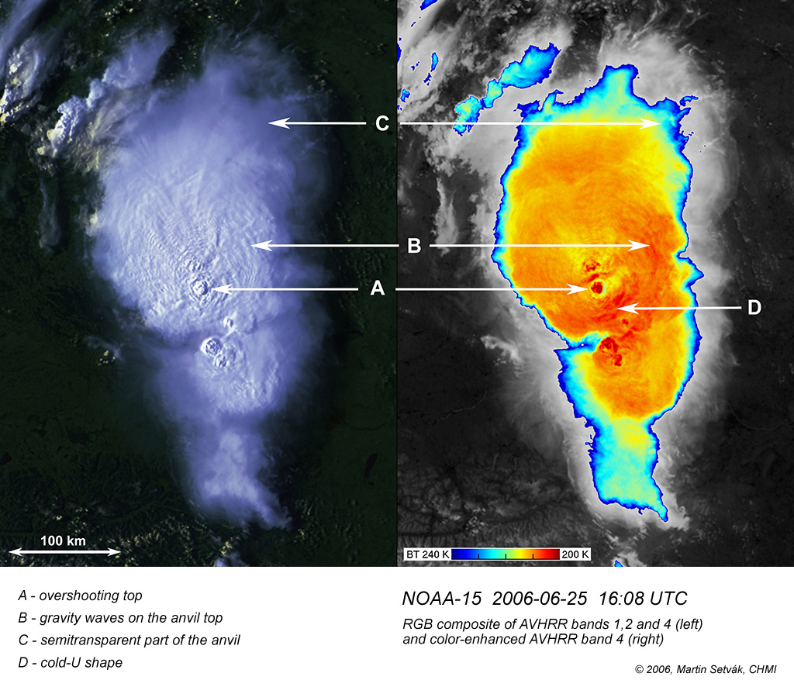
Color enhancement of IR-window imagery
In CHMI’s satellite department, first experiments with AVHRR IR data greyscale enhancement date back to early 1980’s, on MDA HRPT system (black and white prints)
First CHMI tests with color enhancing AVHRR imagery since late 1980’s, on image processing system Pericolor 2000 of ÚTIA ČSAV, Praha (with output on 24x36 mm color slides)
The presently used blue-red color scheme started to be used in CHMI for research purposes since 1996, on SGI Indigo-2 UNIX workstation and IDL/ENVI image processing software
Broader operational use of blue-red enhancement since 2004 – 2005, with purchase of CHMI’s VCS MSG/SEVIRI 2met! system
In 2006, cold-ring (“doughnut-shaped”) type of storms first described, using this color enhancement
In 2007, at first CWG workshop in Krakow, first suggestions to agree on this blue-red color palette as a “standard” one within CWG and EUMETSAT (described at CWG website e.g. here)
Since 2009 – 2010 used in VIS & IR-window sandwich products
Finally, broader global use of this enhancement scheme (or similar) with launch of Himawari-8 (2014) and GOES-R (2016) satellites
Martin Setvák, ČHMÚ

Slide 3
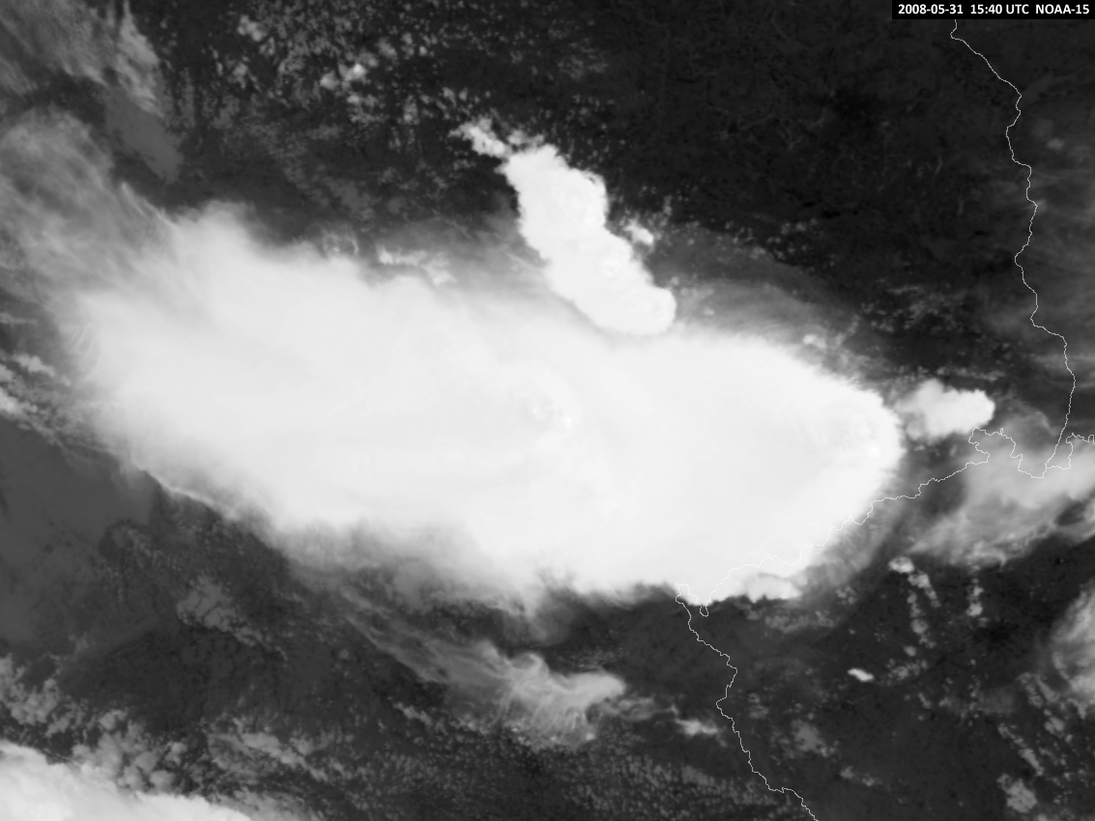
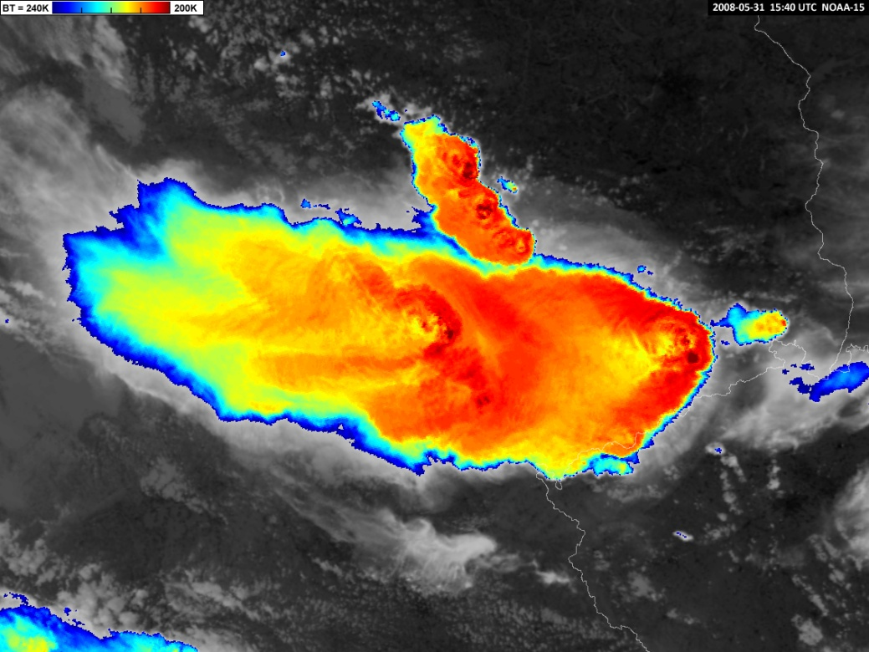
Color enhancement of IR-window imagery
2008-05-31 15:40 UTC NOAA-15, Germany
Color enhancement of the IR brightness temperature (BT) imagery – replacement of a part of the grey scale, representing certain brightness temperature range, by dedicated colors. This specific brightness temperature range (BT 240K-200K) of color enhancement is suitable for typical (central) European storms; however in some cases or for other geographic regions it may need some adjustment (shift and/or stretch of the brightness temperature range represented in colors), mainly depending on the tropopause temperature and height.
Martin Setvák, ČHMÚ

Slide 4
Color enhancement of IR-window imagery
Main reason for color enhancement – to reveal cloud-top structure details of storms, which would otherwise remain hidden in almost uniform brightest shades of grey scale
Essential for fast assessment of potential storm severity in operational meteorology, in nowcasting
Useful also for research purposes ...
Martin Setvák, ČHMÚ

Slide 5
Color enhancement of IR-window imagery
Main reason for color enhancement – to reveal cloud-top structure details of storms, which would otherwise remain hidden in almost uniform brightest shades of grey scale
Essential for fast assessment of potential storm severity in operational meteorology, in nowcasting
Useful also for research purposes ...
However, does it indeed reveal all the information about storm top structure, about its fine details?
In daytime, visible and near infrared bands, RGBs and sandwich products provide sufficient amount of information on details of storm top morphology and microphysics, but we lack these in the night. Can stronger black and white enhancement replace some of these throughout the night, can it provide any meaningful additional information?
Martin Setvák, ČHMÚ

Slide 6
6 September 2016, 02:57 UTC
Storm cloud-top and airglow-levels gravity waves, Mauretania and Senegal
Suomi-NPP
Martin Setvák, ČHMÚ

Slide 7
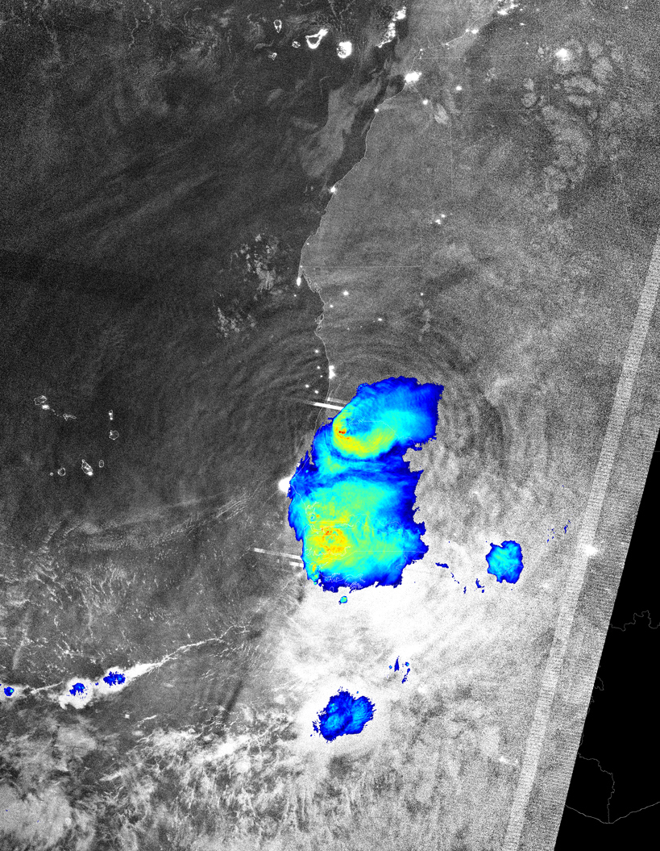
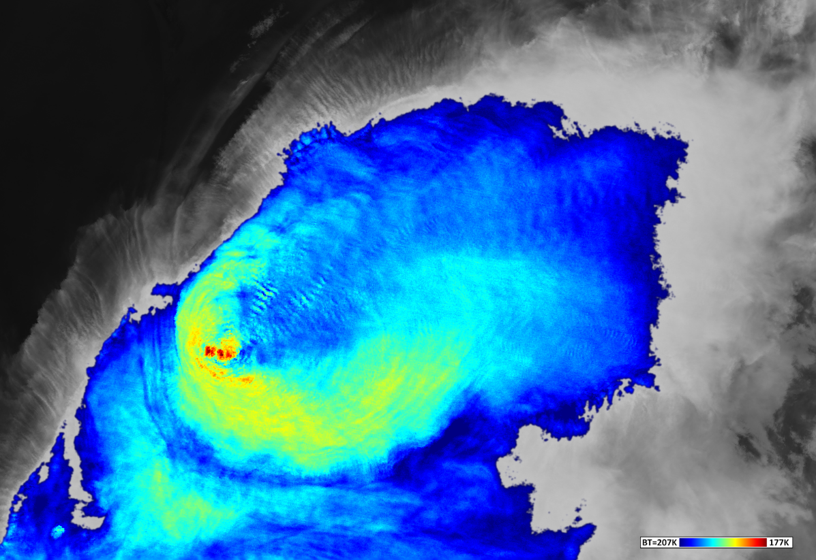
06 September 2016 02:57 UTC, Suomi-NPP
Cloud-top GW, VIIRS band I5 BT 177-207K (375m)
VIIRS DNB & band I5 (BT 177-207K)
Martin Setvák, ČHMÚ

Slide 8
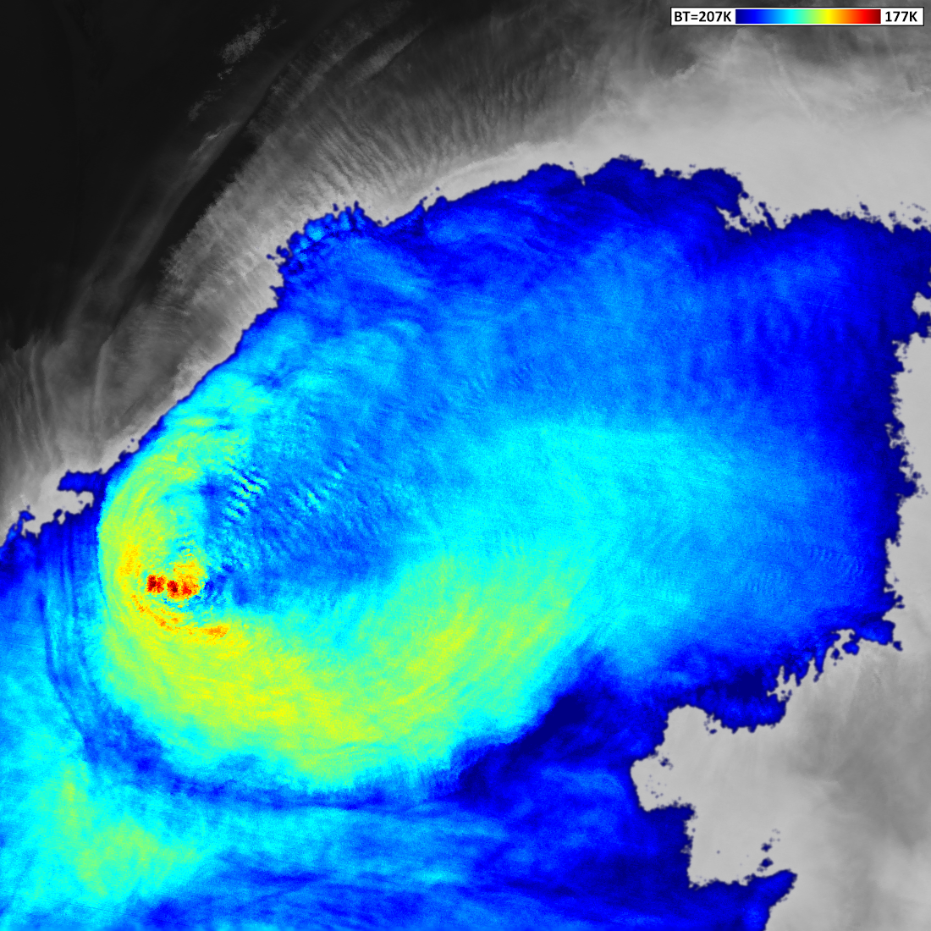
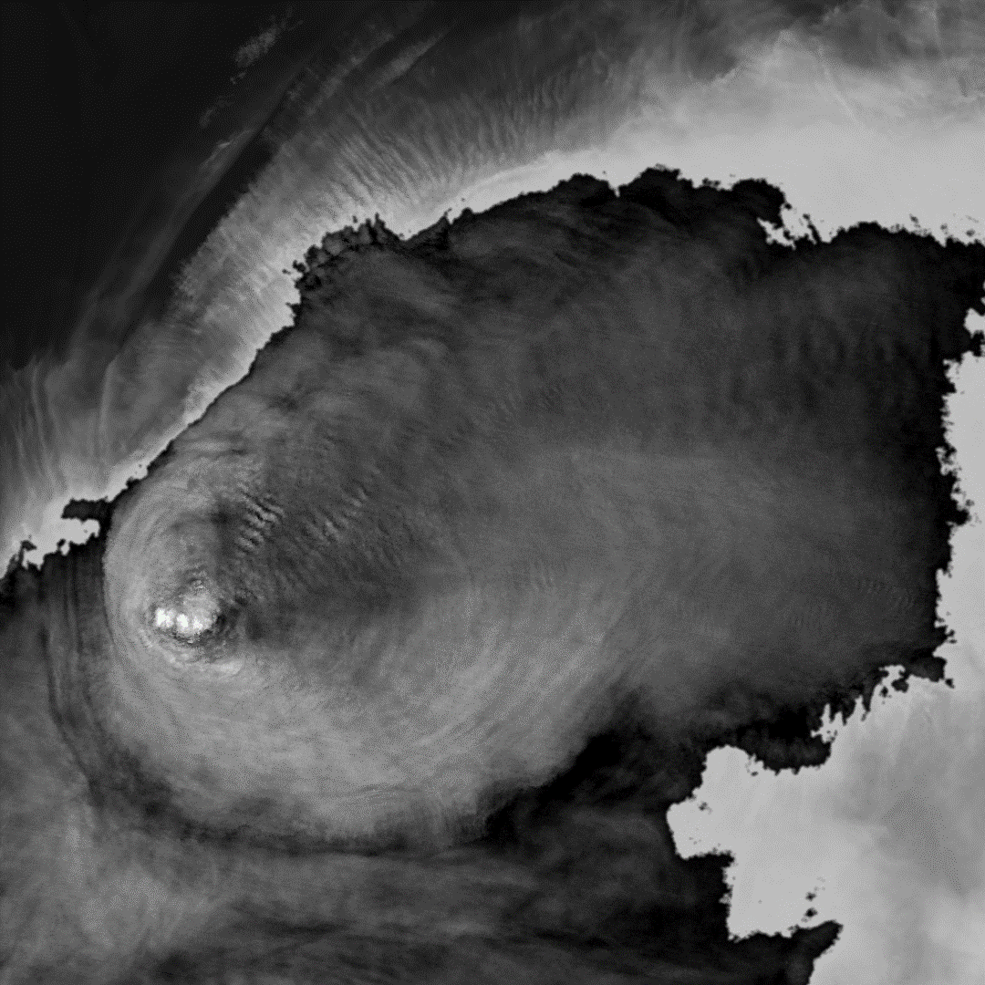
06 September 2016 02:57 UTC, Suomi-NPP
BT 177 K (white) – 207 K (black)
Martin Setvák, ČHMÚ

Slide 9
06 September 2016 02:57 UTC, Suomi-NPP
BT 177 K (white) – 207 K (black)
In this case, much better visibility of storm cloud top gravity waves in the black and white version of enhancement (same BT range as in the blue-red version).
Martin Setvák, ČHMÚ

Slide 10
09 July 2021, 01:26 UTC
Nocturnal storms with a sharp discontinuity of cloud-top brightness temperature
north Poland
NOAA-20 (JPSS-1)
Martin Setvák, ČHMÚ

Slide 11
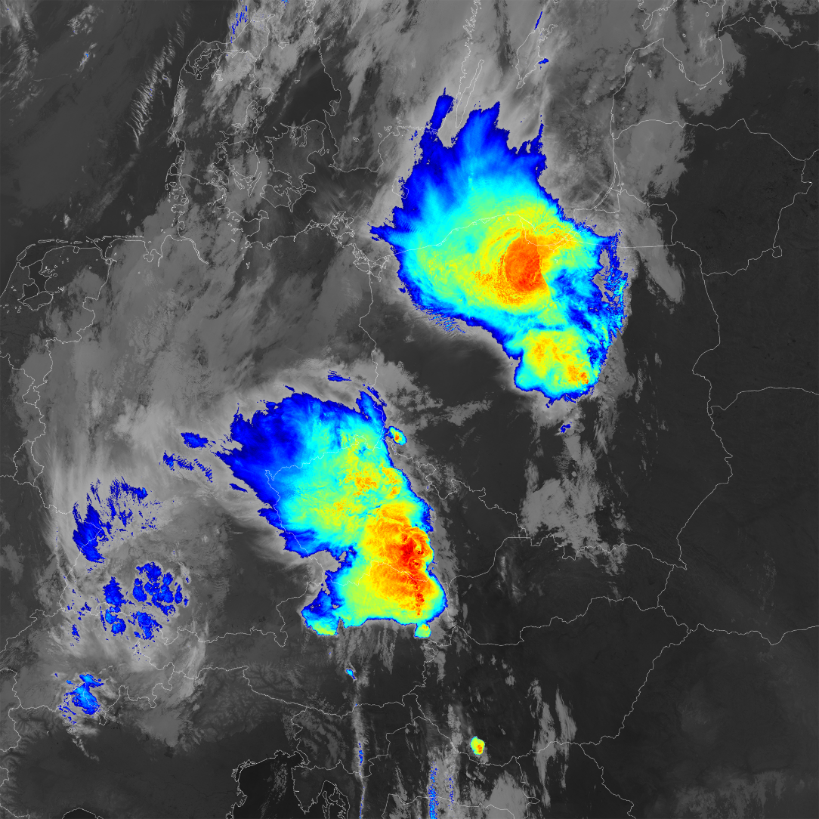
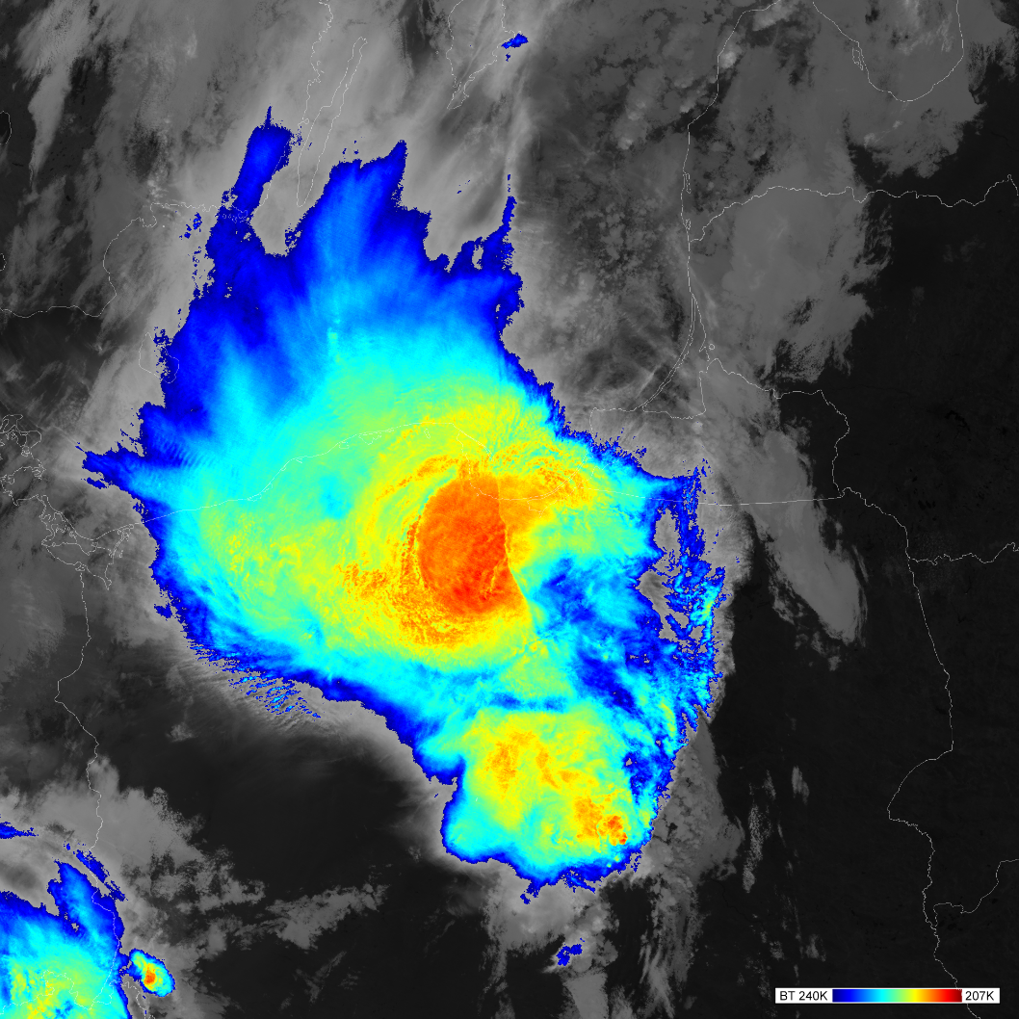
09 July 2021, 01:26 UTC, NOAA-20 (JPSS-1), VIIRS I5 BT 207-240K
Martin Setvák, ČHMÚ

Slide 12
09 July 2021, 01:26 UTC, NOAA-20 (JPSS-1), VIIRS I5 BT 207-240K
08/09 July 2021, 21:00 – 03:00 UTC, MSG IR10.8 204-244K
Martin Setvák, ČHMÚ

Slide 13
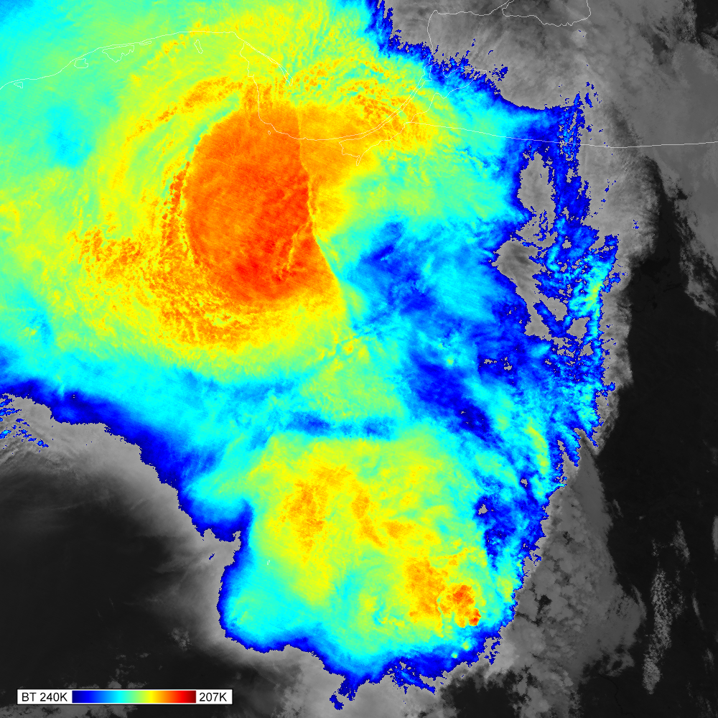
09 July 2021, 01:26 UTC, NOAA-20 (JPSS-1)
VIIRS I5 BT 207-240K 375 m
214
217
225
215
Martin Setvák, ČHMÚ

Slide 14
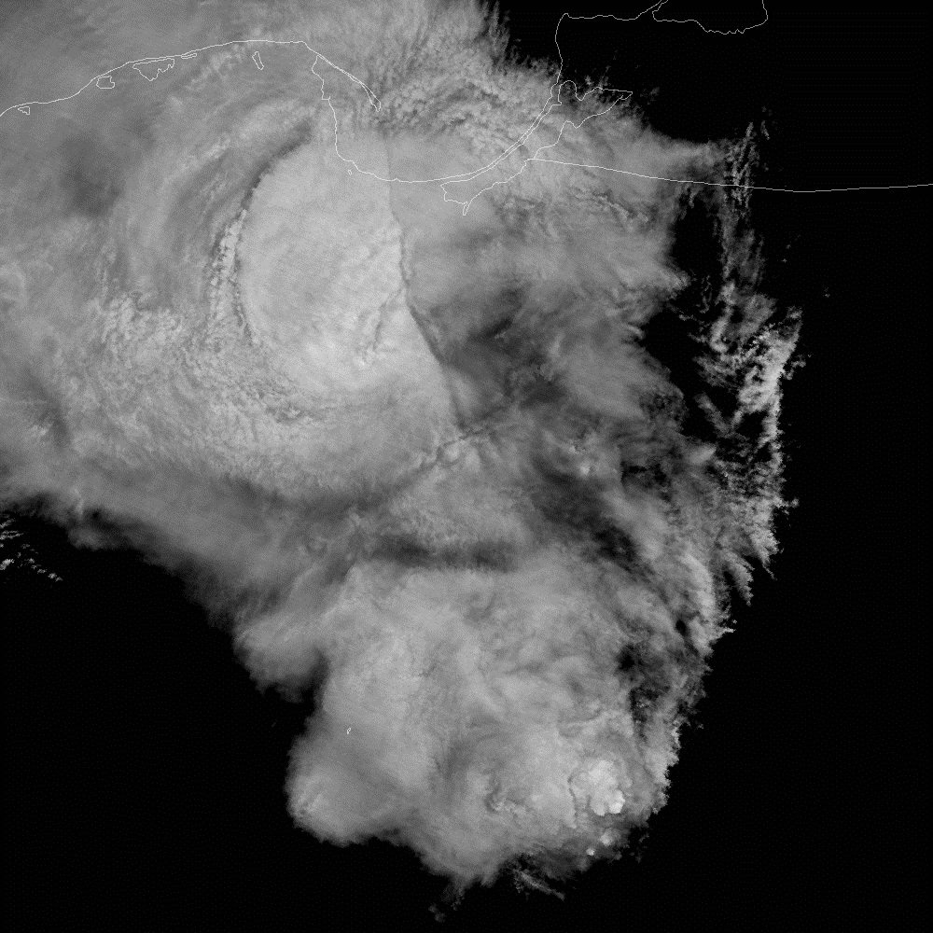
09 July 2021, 01:26 UTC, NOAA-20 (JPSS-1)
VIIRS I5 BT 207-240K 375 m
VIIRS I5 BT 207-240K 375 m
Martin Setvák, ČHMÚ

Slide 15
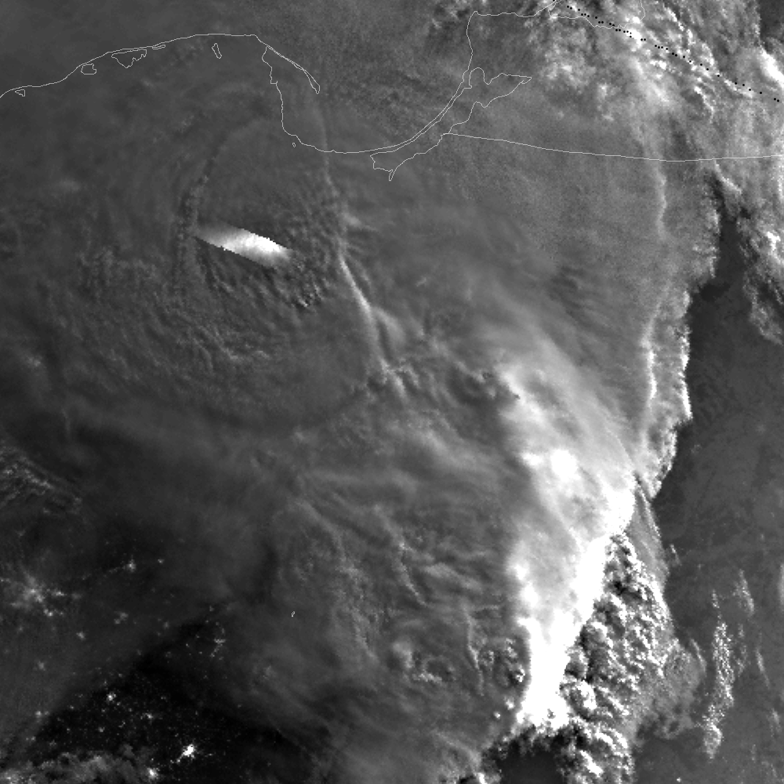
09 July 2021, 01:26 UTC, NOAA-20 (JPSS-1)
VIIRS I5 BT 207-240K 375 m
VIIRS DNB NCC
750 m
Martin Setvák, ČHMÚ

Slide 16
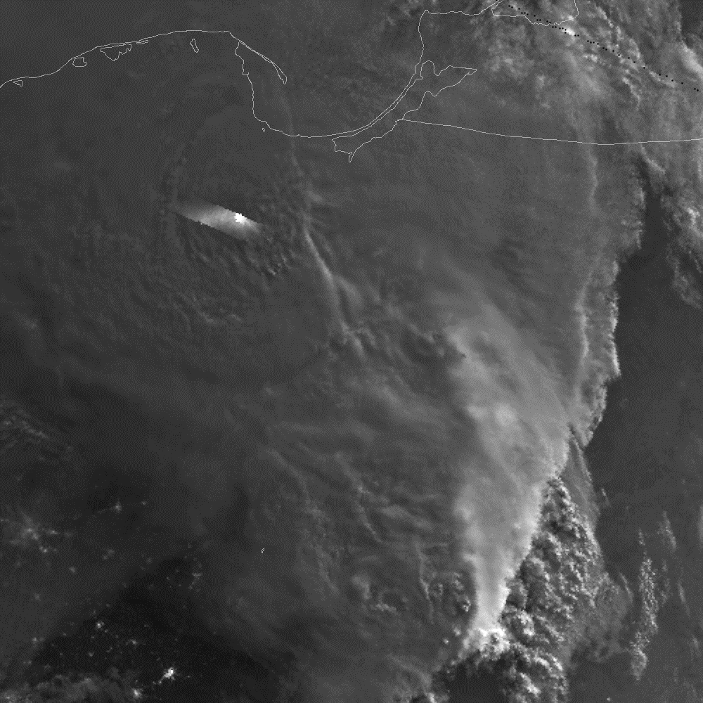
09 July 2021, 01:26 UTC, NOAA-20 (JPSS-1)
VIIRS I5 BT 207-240K 375 m
VIIRS DNB NCC
750 m
Martin Setvák, ČHMÚ

Slide 17
09 July 2021, 01:26 UTC, NOAA-20 (JPSS-1)
08/09 July 2021, 21:00 – 03:00 UTC, MSG IR10.8 205-240K
VIIRS I5 BT 207-240K 375 m
Martin Setvák, ČHMÚ

Slide 18
09 July 2021, 01:26 UTC, NOAA-20 (JPSS-1)
VIIRS I5 BT 207-240K 375 m
Possible explanations:
sharp discontinuity of cloud top height (CTH) – but why?
– subsidence and dissipation of the anvil itself,
– subsidence of dryer warmer LS air from above,
– gravity wave(s),
– or ?????
warm semitransparent layer higher above the warmer part of the storm (not consistent with illumination conditions in DNB)
Due to illumination of the discontinuity line in DNB, first explanation (CTH) seems to be more likely.
Can it be somehow linked to the plume visible in DNB?
Martin Setvák, ČHMÚ

Slide 19
25 July 2023, 00:23 UTC
Nocturnal severe storms (hail-producing supercells) with a distinct plume, modified by gravity waves and “ship waves”, generated by overshooting tops
Slovenia and Croatia
NOAA-21 (JPSS-2)
Martin Setvák, ČHMÚ

Slide 20
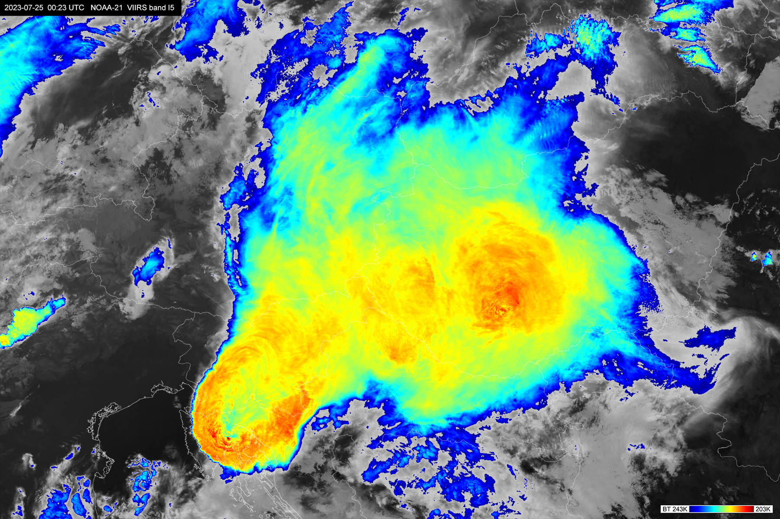
2023-07-25 00:23 UTC NOAA-21 VIIRS band I5 BT 203 – 243 K
Martin Setvák, ČHMÚ

Slide 21
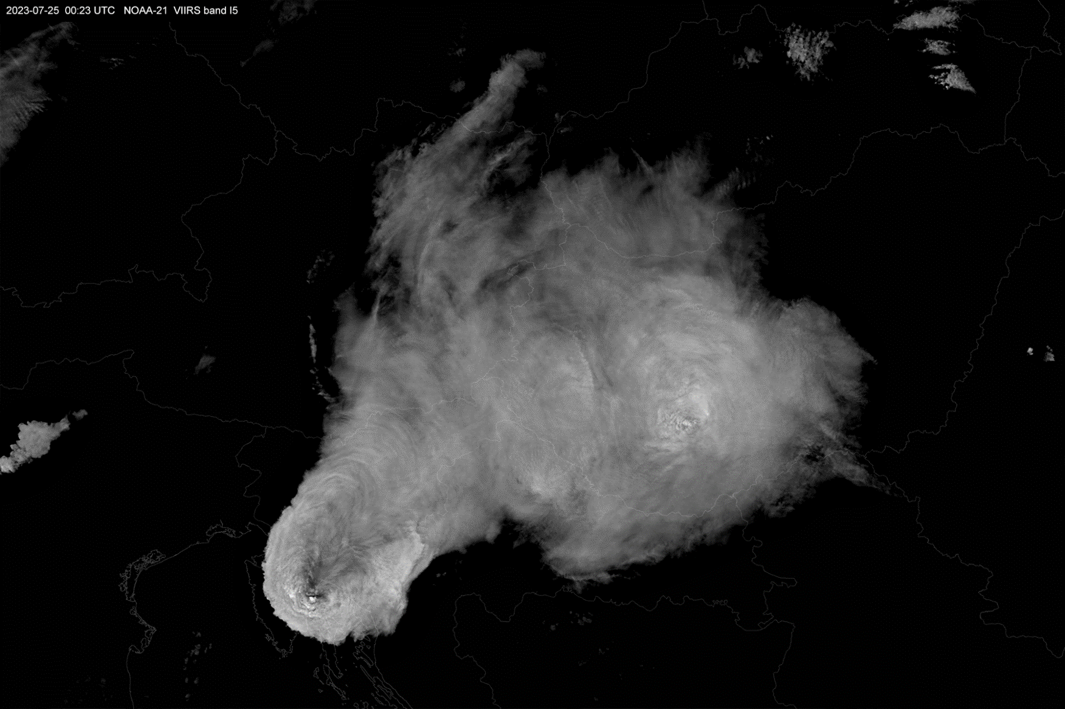
2023-07-25 00:23 UTC NOAA-21 VIIRS band I5 BT 203 – 233 K
Martin Setvák, ČHMÚ

Slide 22
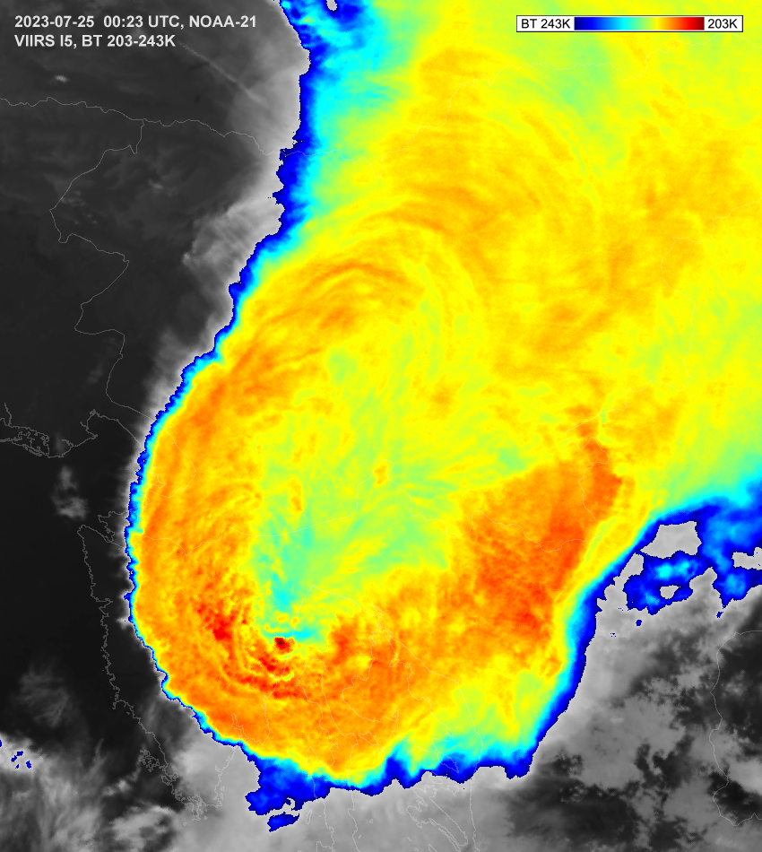
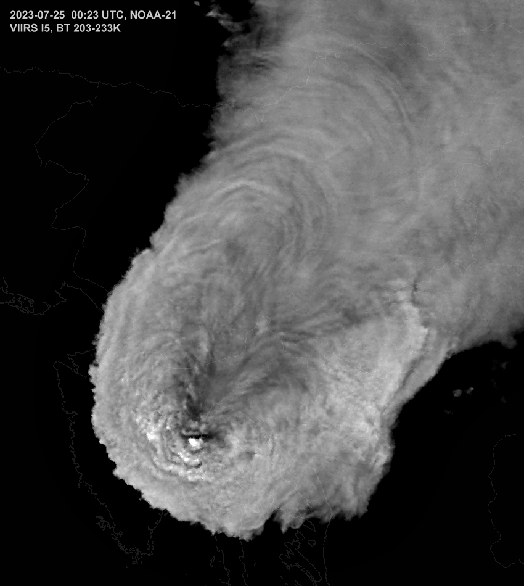
Martin Setvák, ČHMÚ

Slide 23
Final comments
In most cases, strong greyscale enhancement can show more details of storm cloud top (morphology, features) than the color enhancement.
Can be useful for case studies, not for daily operational use.
Potential use in AI-based plume detection in nocturnal imagery/data (similar details, morphology as in daytime imagery).
Martin Setvák, ČHMÚ

