Slide 1

CONVECTIVE STORMS FROM SATELLITES (1)
Martin Setvák
martin.setvak@chmi.cz
Czech Hydrometeorological Institute, Satellite department
version: 2025-04-27

Slide 2
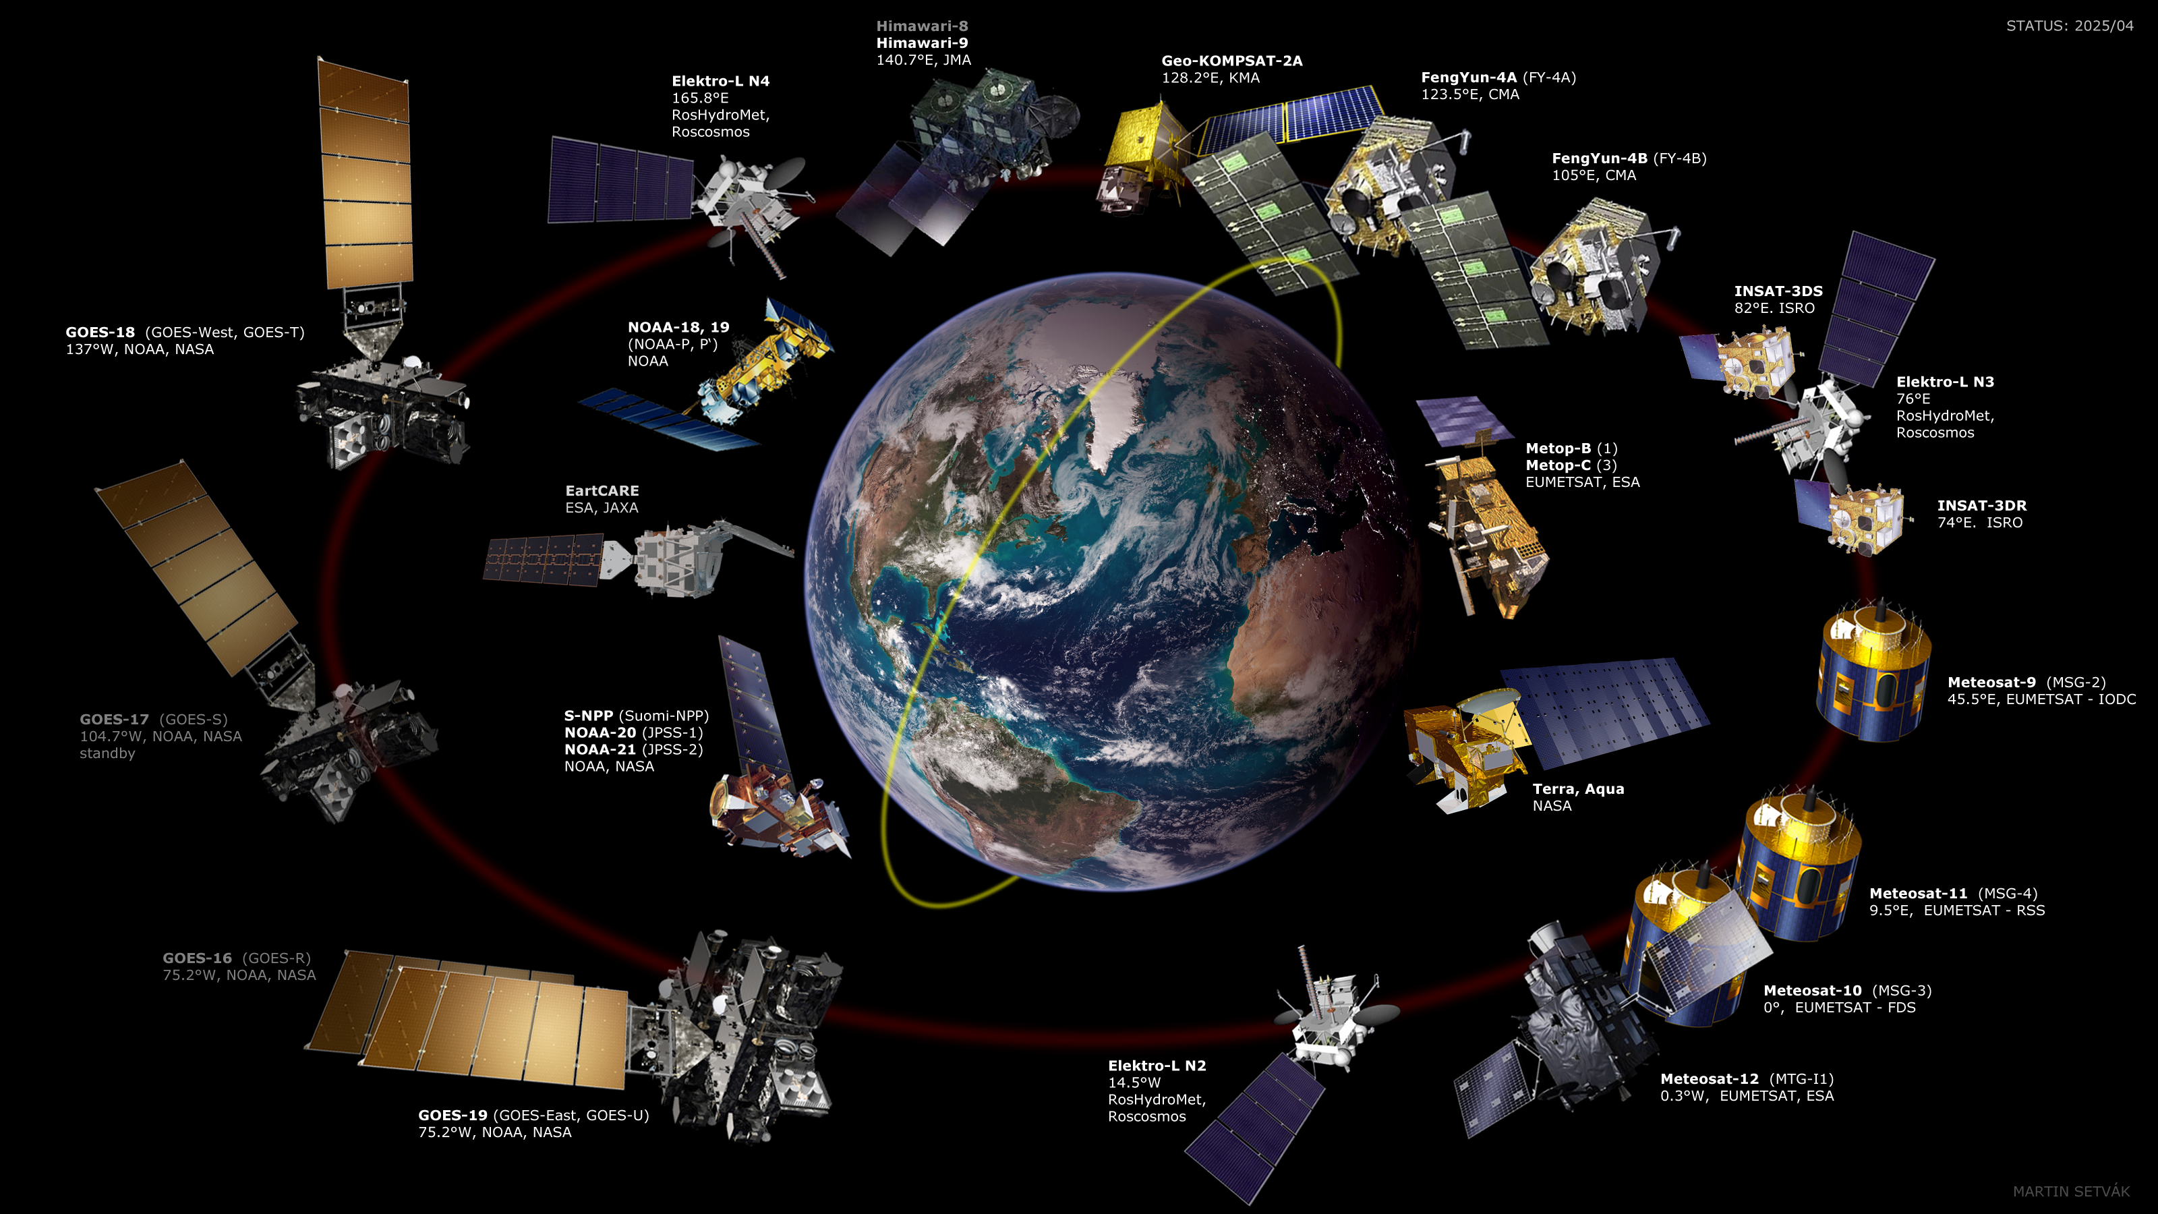

Slide 3
PART 1
INTRODUCTION: GENERAL APPEARENCE OF STORMS

Slide 4
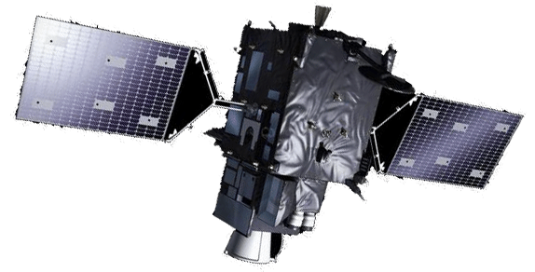
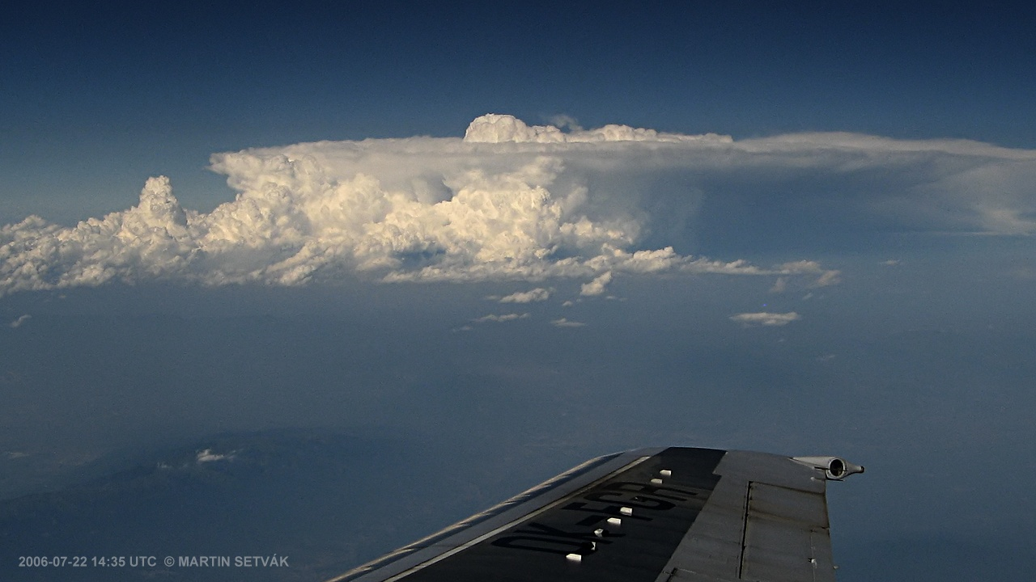
Convective storms from above …
? ? ?

Slide 5
Convective storms from above …
Satellites with passive radiometers can monitor the cloud tops only, they do not see inside the storms, or even under them! Thus, these satellites can’t provide us with a direct information about the weather conditions under the storms, such information has to be inferred (derived) from the satellite data indirectly, utilizing conceptual models of convective storms.

Slide 6
PART 1
INTRODUCTION: GENERAL APPEARENCE OF STORMS
Impact of the wind shear on appearance
of convective storms (SHAPE OF STORM ANVILS)
distortion of the storm anvil is directly proportional to the difference between propagation speed of the storm core and winds at the storm-top levels
no-shear or weak-shear environment >>> almost circular shape of the storm anvil
the stronger the wind shear (or stronger storm-top relative winds), the more elongated anvils

Slide 7
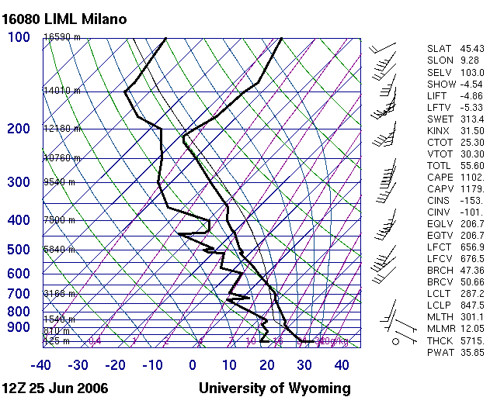
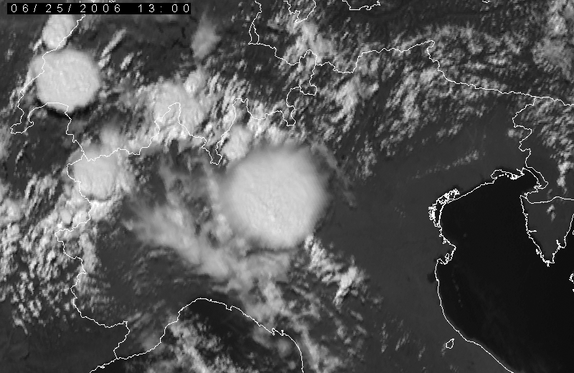
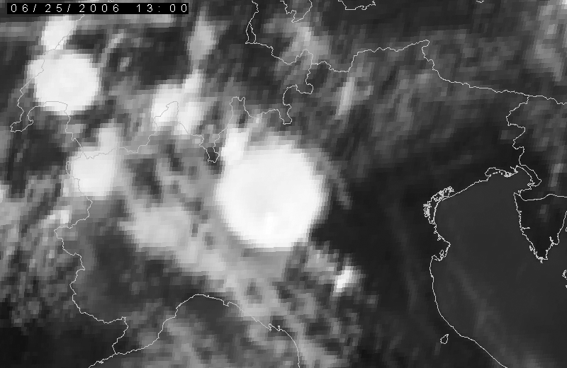
Impact of the wind shear – low shear
HRV
2006-06-25 13:00, Meteosat-8, north Italy
IR10.8

Slide 8
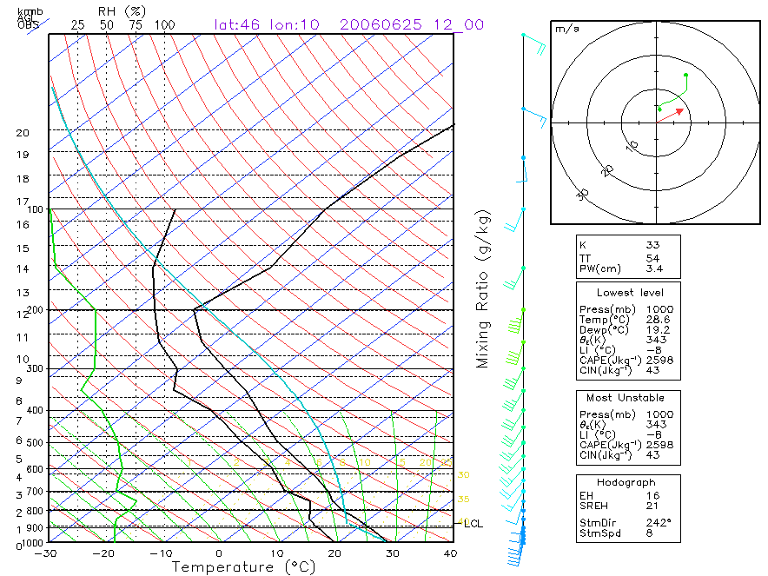
Impact of the wind shear – low shear
Artificial sounding, based on GFS model (image provided by Alois Sokol)

Slide 9
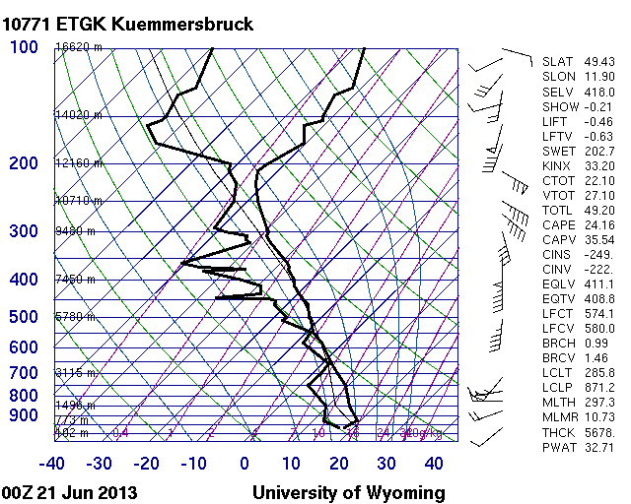
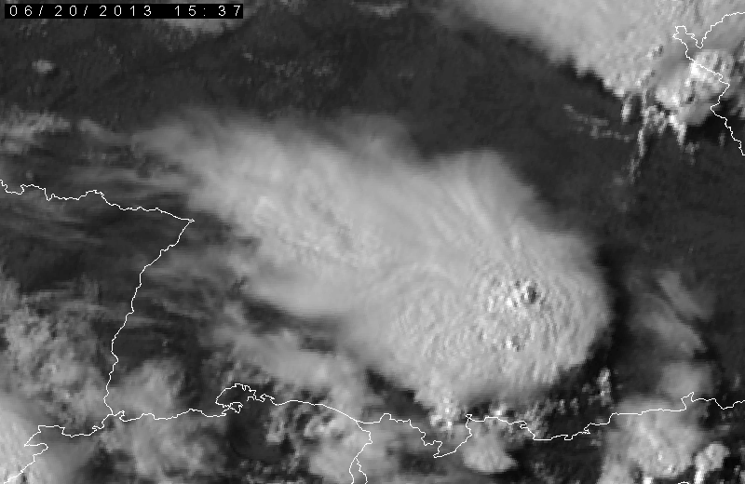
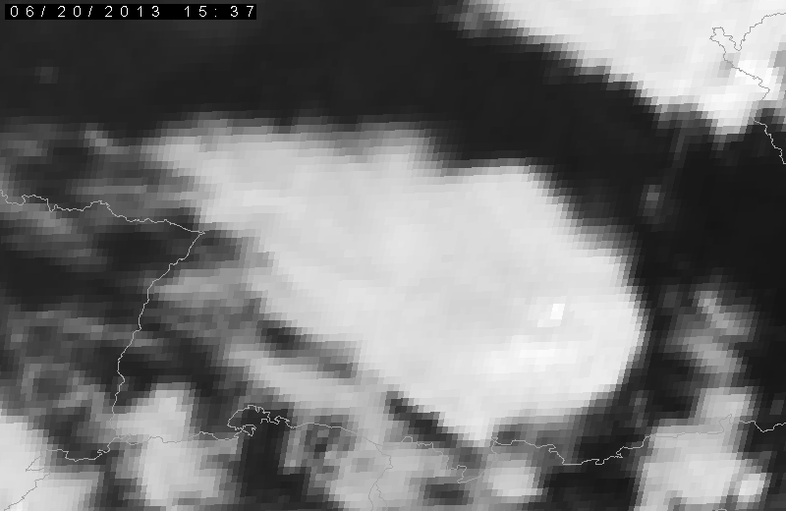
Impact of the wind shear – strong shear
HRV
2013-06-20 15:37, Meteosat-8, south Germany
IR10.8

Slide 10
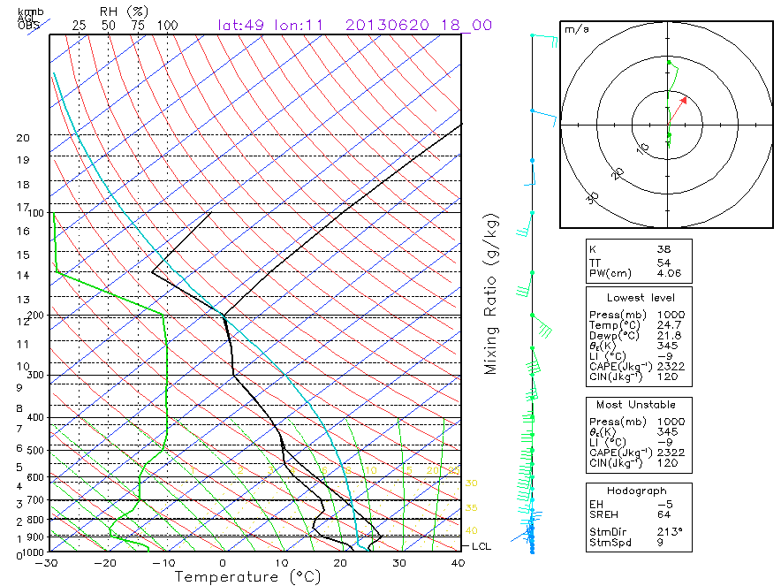
Impact of the wind shear – strong shear
Artificial sounding, based on GFS model (image provided by Alois Sokol)

Slide 11
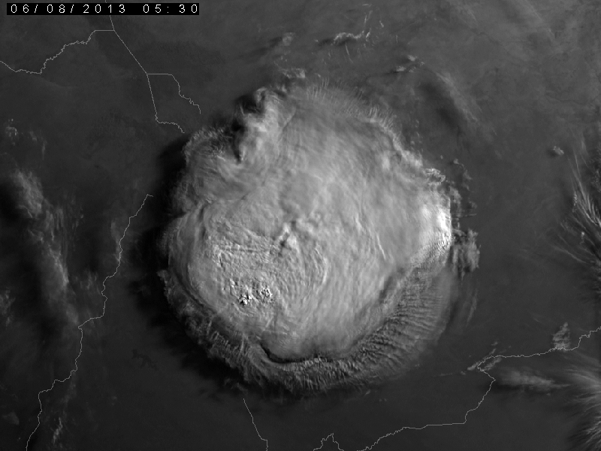
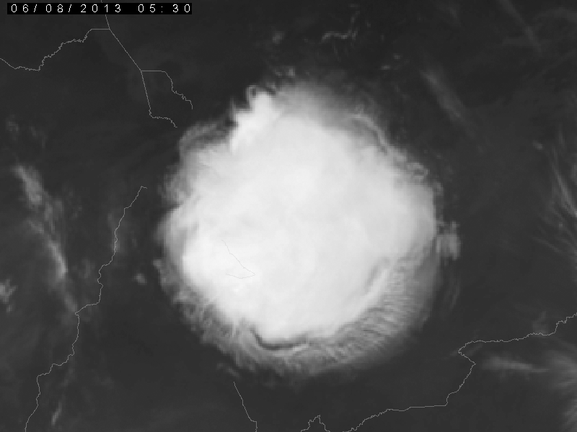
Impact of the wind shear – low shear
no real sounding available
HRV
2013-06-08 05:30, Meteosat-10, south-west Chad
IR10.8

Slide 12
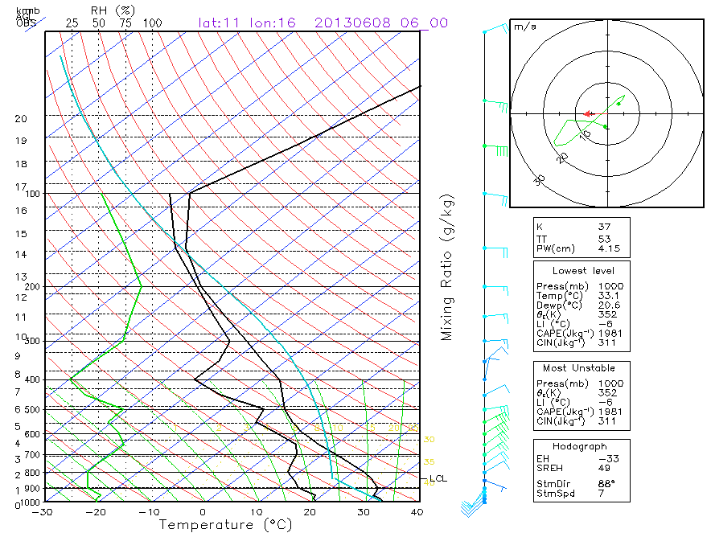
Impact of the wind shear – low shear
Artificial sounding, based on GFS model (image provided by Alois Sokol)

Slide 13
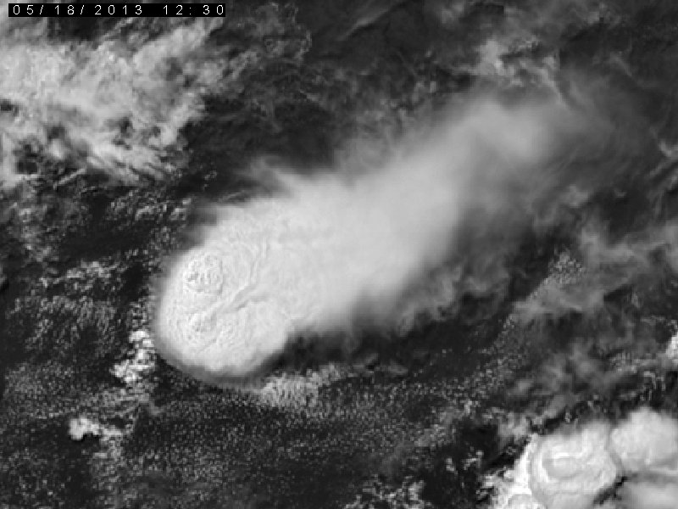
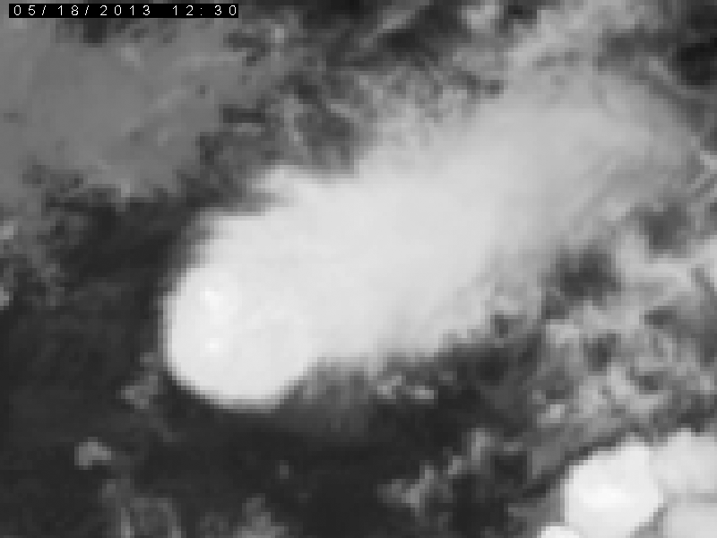
Impact of the wind shear – strong shear
no real sounding available
HRV
2013-05-18 12:30, Meteosat-10, south-east Nigeria
IR10.8

Slide 14
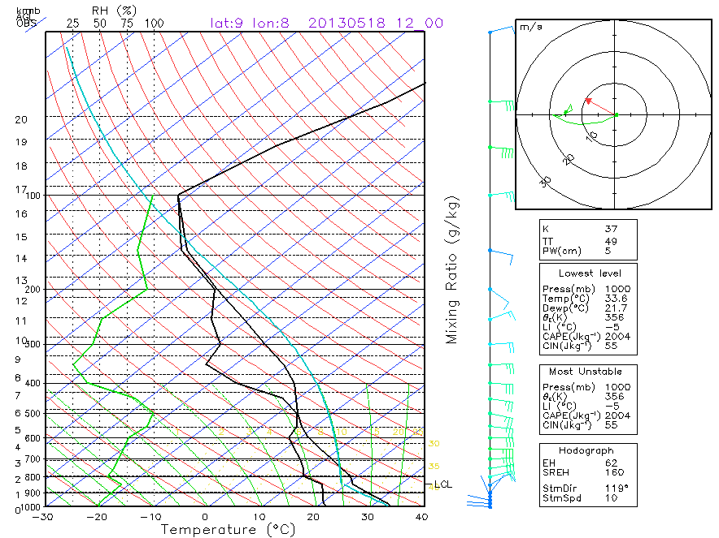
Impact of the wind shear – strong shear
Artificial sounding, based on GFS model (image provided by Alois Sokol)

Slide 15
PART 1
INTRODUCTION: GENERAL APPEARENCE OF STORMS
CLOUD TOP IR BRIGHTNESS TEMPERATURE (BT)

Slide 16
Cloud top IR brightness temperature (BT)
Emissivity - deviation of a real body (land or sea surface, opaque cloud) radiative properties from those of idealized black body, emitting at λ according to the Planck function B_{λ}(T), expressed either in the range of 0 - 1, or in % (0 - 100%)
ε_{λ} = real emission (λ) / B_{λ}(T)
Brightness temperature - fictitious temperature (based on radiance detected by a satellite) assigned to the given surface assuming that it emits like a black body (i.e. with emissivity equal to 1) => also sometimes called black body temperature.
Brightness temperature always lower than the real temperature !!!
(for opaque clouds)

Slide 17
Cloud top IR brightness temperature (BT)
Brightness temperature (IR-window bands) applications:
Cloud top brightness temperature (BT), its gradients and minima;
detection and characteristics of the overshooting tops;
detection and tracking of storm cores and storm “cells”;
anvil growth;
special “severity-related” cloud top features:
- MCC (Mesoscale Convective Complex, Maddox, 1980’s),
- cold-U/V (enhanced-V) and cold-ring features;
BT differences (BTD) between various IR-window bands => storm top microphysics, low-level tropospheric moisture boundaries;
BT differences between IR-window and absorption bands (WV, CO2, O3) => cloud top height, wind vectors, lower-stratospheric moisture detection, ...
etc., ...

Slide 18
Cloud top IR brightness temperature (BT)
Brightness temperature (IR-window bands) interpretation:
Classic interpretation: cloud top brightness temperature (BT) directly related to the cloud top level environment temperature – valid only for opaque clouds and state of thermal equilibrium between the cloud top and its environment => cloud top height (CTH) products.
However, rapidly ascending cloud tops (namely overshooting tops) are not in thermal equilibrium with their environment => these keep cooling down with their ascent, well below the temperature of the tropopause, can be cooler by about 20 – 30 K as compared to the tropopause temperature => standard CTH products can’t be applied to these!
At the downwind side of the overshooting tops formation of warm spots (areas), resulting from a complex of processes occurring here (lee effects, gravity wave breaking, jumping cirrus, plumes, ...).
Activity/severity-related cloud-top features found in the enhanced IR-BT imagery: overshooting tops, cold-U/V (enhanced-V) & cold-ring shapes.

Slide 19
PART 1
INTRODUCTION: GENERAL APPEARENCE OF STORMS
COLOR ENHANCEMENT OF THE IR WINDOW
BRIGHTNESS TEMPERATURE IMAGERY

Slide 20
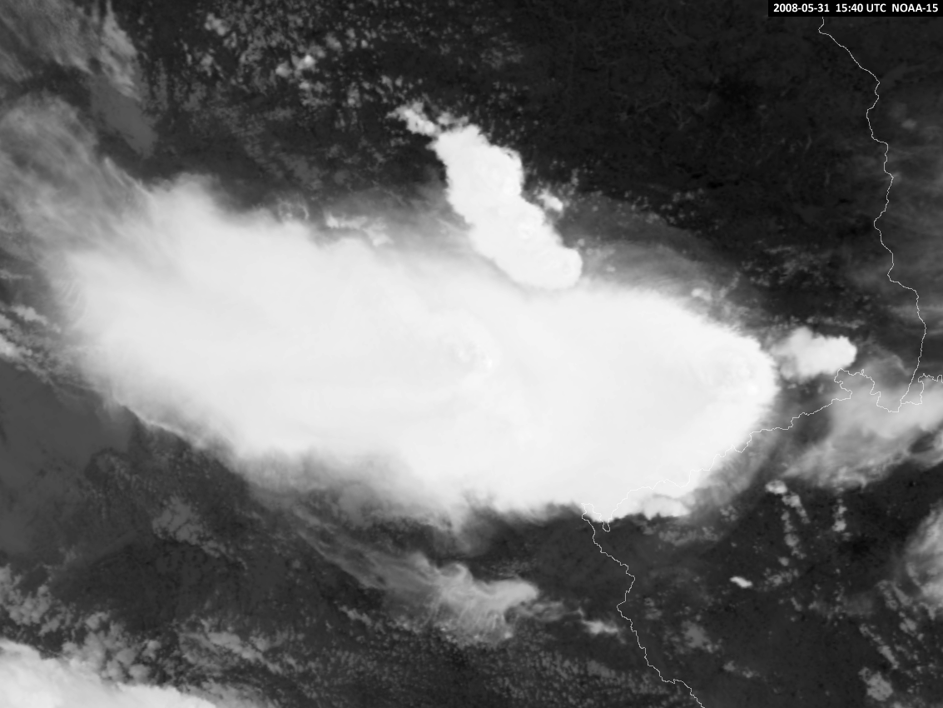
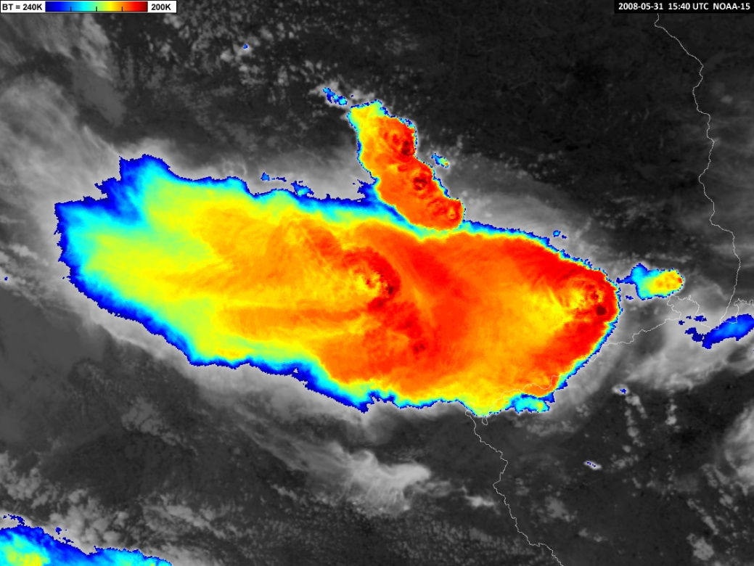


Color enhancement of the IR brightness temperature (BT) imagery
2008-05-31 15:40 UTC NOAA-15, Germany
Color enhancement of the IR brightness temperature (BT) imagery – replacement of a part of the grey scale, representing
a certain temperature range, by dedicated colors. The color scale can either be continuous - using a maximum of available colors, or a step-scale, using only a limited number of colors (each color representing a smaller BT interval).

Slide 21
Color enhancement of the IR brightness temperature (BT) imagery
2008-05-31 15:40 UTC NOAA-15, Germany
This specific brightness temperature range (BT 240K-200K) of the color enhancement is suitable for typical (central) European storms; however in some cases or for other geographic regions it may need some adjustment (shift and/or stretch of the brightness temperature range represented in colors), mainly depending on the tropopause temperature and height.

Slide 22
Color enhancement of the IR brightness temperature (BT) imagery
Why the color enhancement? What is it good for?
To enable or to ease detection of various cloud-top features related to storm dynamics, structure and possible storm severity – such as overshooting tops, cold-U/V (enhanced-V) or cold-ring features, embedded warm spots/areas, ...
Direct support to monitoring and nowcasting of convective storms, operationally used by many weather services. In areas with no or poor weather radar coverage, an alternative (substitute) to the radar observations.
Also, the color-enhanced IR brightness temperature (BT) images are used as one of the possible input components for the “sandwich” products, as documented in the next part of the presentation.

Slide 23
Color enhancement of the IR brightness temperature (BT) imagery
Various color schemes used for the IR-BT enhancement ...
Possible problems with assignment of colors (color “schemes”) used for the purposes of the color enhancement, different color palettes used by various users – uneasy interpretation, necessity to “get used” to the color schemes used by the others …
The blue-red color enhancement shown within this presentation is based on the standard IDL/ENVI (https://www.l3harrisgeospatial.com/Software-Technology/ENVI) blue-red color table, used also in other remote-sensing software packages or systems.

Slide 24
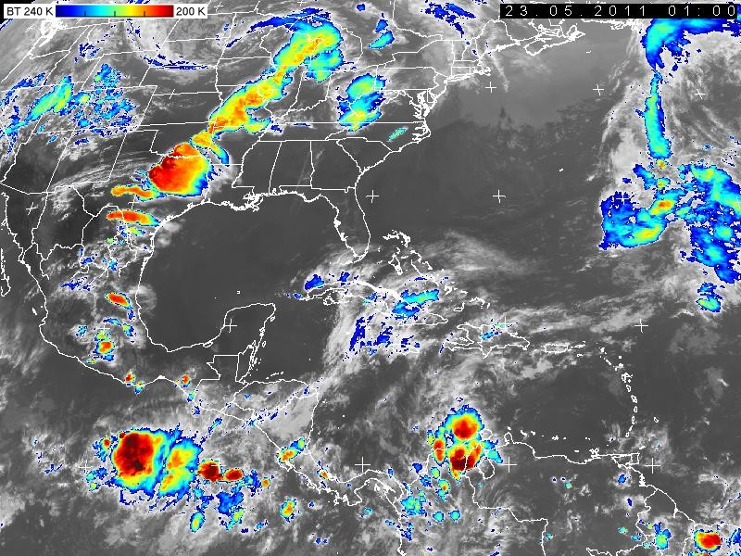
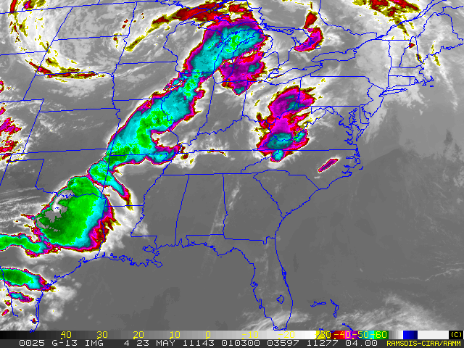
Color enhancement of the IR brightness temperature (BT) imagery
Older U.S. color scheme broadly used before launch of the GOES-R series
EUMETSAT’s CWG blue-red color scheme applied to the same image

Slide 25
Color enhancement of the IR brightness temperature (BT) imagery
Why red for the coldest temperatures?
For a human, red is typically associated with some form of danger or importance;
in satellite IR imagery, the highest “overshooting” or “penetrating” tops of convective storms are typically represented by the coldest pixels in the image, and at the same time these represent the core of the storm, thus the most active, dangerous and important part of it.
Also: by Wien’s displacement law, red stands for cold, blue for hot (similar as with the colors of stars – red giants being the cold ones, blue stars the hot ones)
This particular color scheme (enhancement) is since 2007 recommended by CWG of EUMETSAT as a standard one. Users should tune the range of the BT for their geographic region.
More information, color tables (palettes) for various satellite user stations or software packages, and examples at the CWG (Convection Working Group) website
https://cwg.eumetsat.int/color-enhancements/

Slide 26
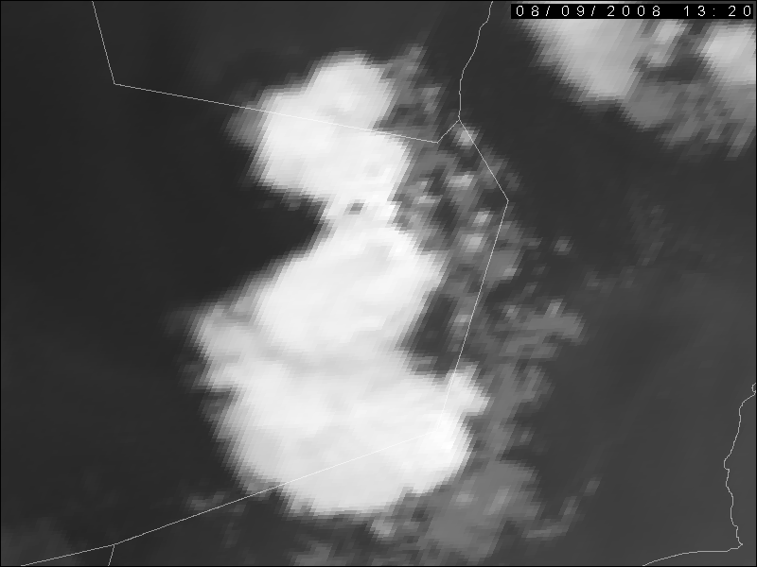
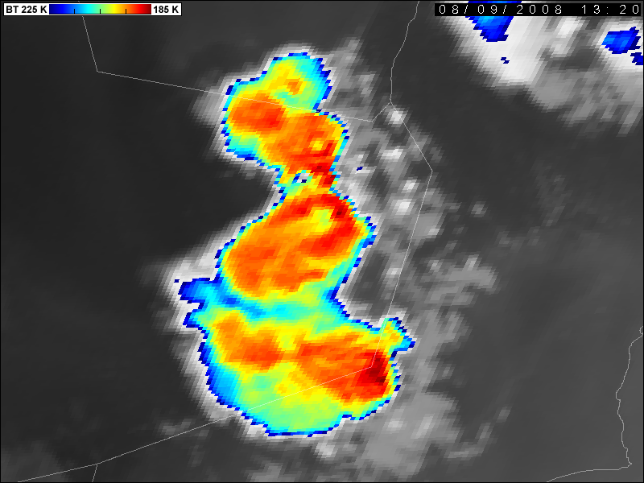
Color enhancement of the IR brightness temperature (BT) imagery
2008-08-09 13:20 UTC Meteosat-8, IR10.8 BT
Arab Peninsula, eastern parts of Rub al Khali
For lower latitudes (tropics, sub-tropics and lowest mid-latitudes) this BT scale needs to be shifted to about 230K-190K or even 220K-180K, depending on the tropopause temperature/height (next slides). Example of the blue-red color enhancement BT scale, shifted to 225K-185K for lower, sub-tropical latitudes.

Slide 27
Color enhancement of the IR brightness temperature (BT) imagery
The next two series of slides document how the storm-top appearance changes with a simple shift of the used color-scale range ...
… For operational use and case studies a necessity to find the most suitable, optimal enhancement for the given geographical region and state of the atmosphere.

Slide 28
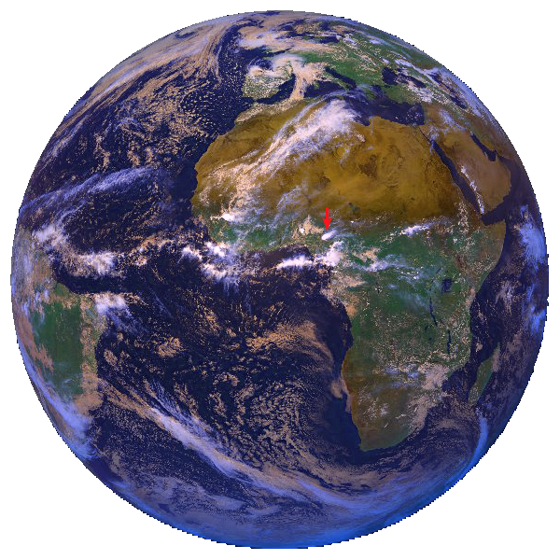
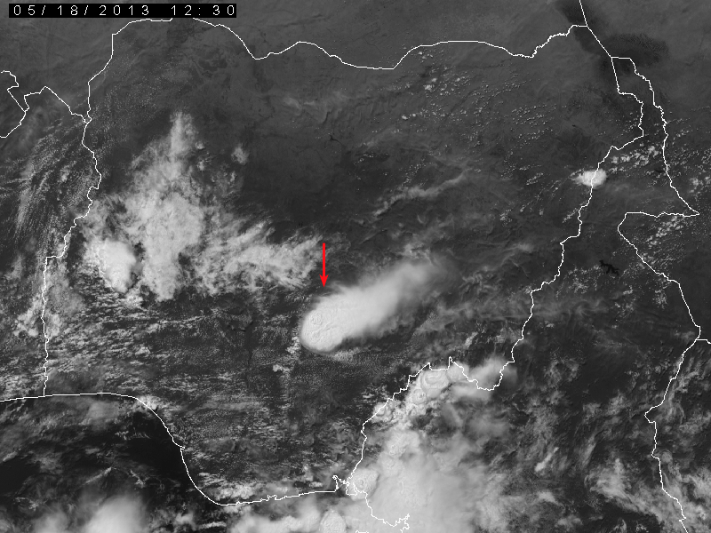
Color enhancement of the IR brightness temperature (BT) imagery
Example #1: storms above Nigeria (overshooting tops), 2013-05-18 12:30 UTC, Meteosat-10

Slide 29
Color enhancement of the IR brightness temperature (BT) imagery
Example #1: storms above Nigeria (overshooting tops), 2013-05-18 12:30 UTC, Meteosat-10
IR10.8 black and white image

Slide 30
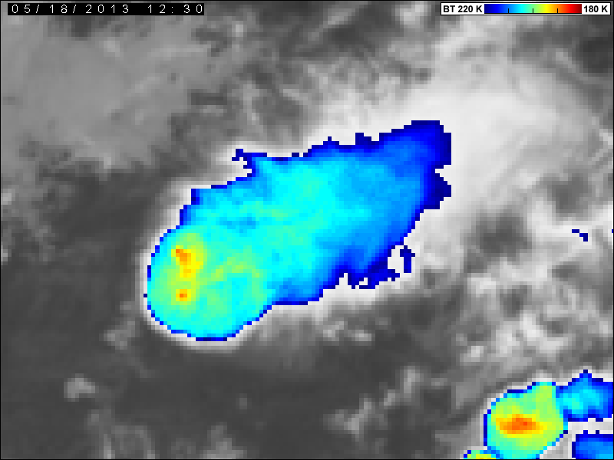
Color enhancement of the IR brightness temperature (BT) imagery
Example #1: storms above Nigeria (overshooting tops), 2013-05-18 12:30 UTC, Meteosat-10
IR10.8 color-enhanced BT image, 180 – 220 K

Slide 31
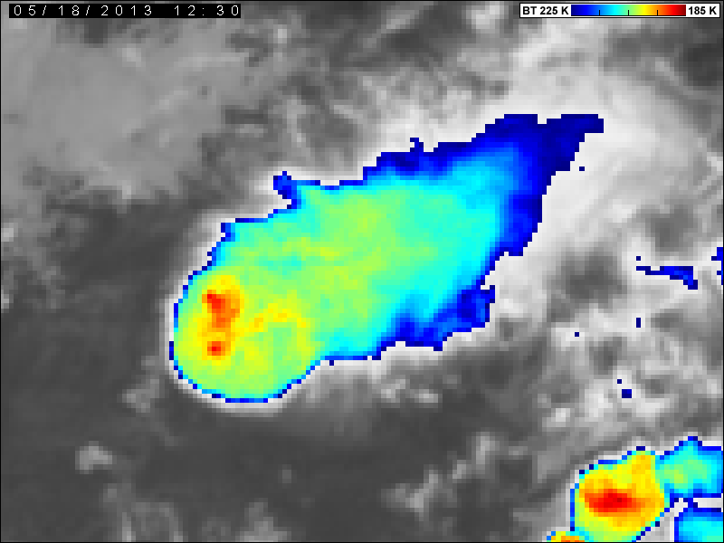
Color enhancement of the IR brightness temperature (BT) imagery
Example #1: storms above Nigeria (overshooting tops), 2013-05-18 12:30 UTC, Meteosat-10
IR10.8 color-enhanced BT image, 185 – 225 K

Slide 32
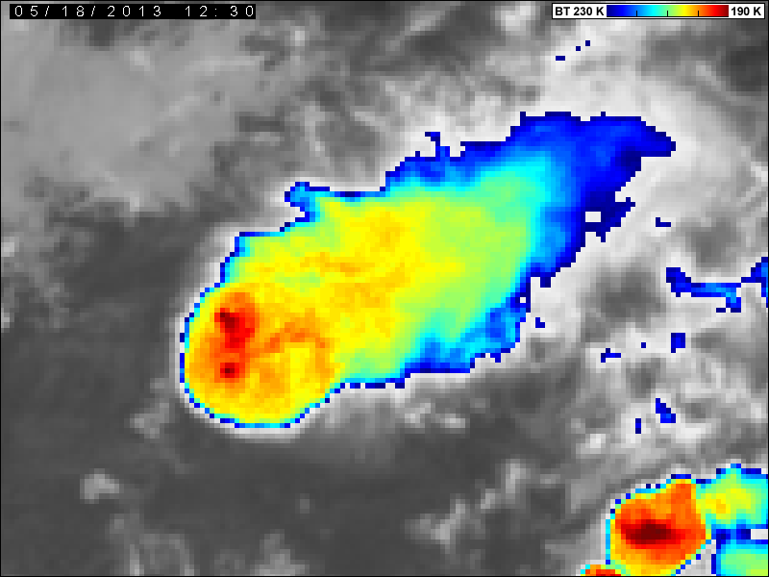
Color enhancement of the IR brightness temperature (BT) imagery
Example #1: storms above Nigeria (overshooting tops), 2013-05-18 12:30 UTC, Meteosat-10
IR10.8 color-enhanced BT image, 190 – 230 K

Slide 33
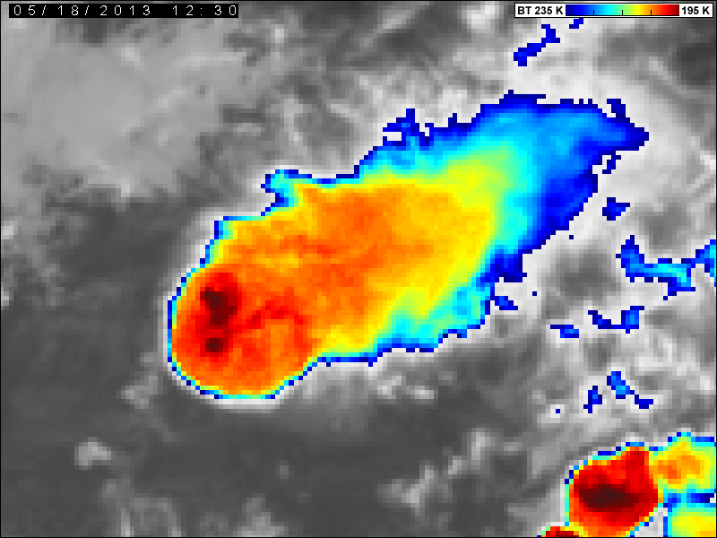
Color enhancement of the IR brightness temperature (BT) imagery
Example #1: storms above Nigeria (overshooting tops), 2013-05-18 12:30 UTC, Meteosat-10
IR10.8 color-enhanced BT image, 195 – 235 K

Slide 34
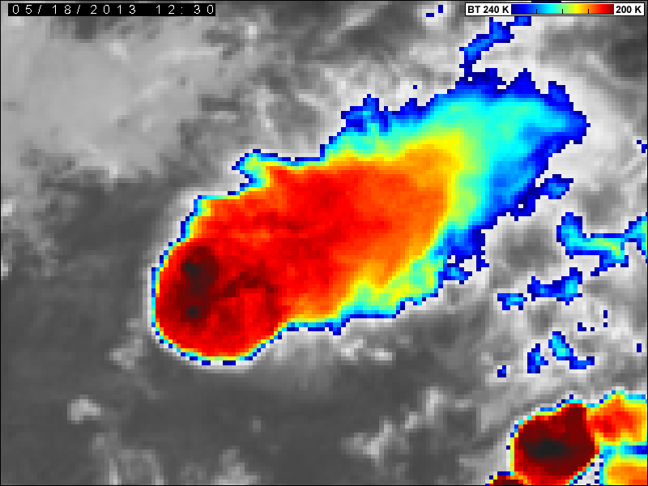
Color enhancement of the IR brightness temperature (BT) imagery
Example #1: storms above Nigeria (overshooting tops), 2013-05-18 12:30 UTC, Meteosat-10
IR10.8 color-enhanced BT image, 200 – 240 K

Slide 35
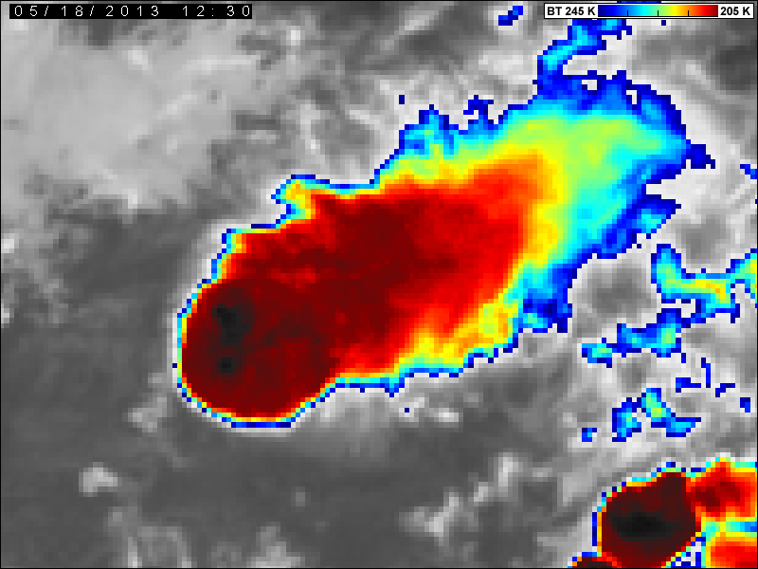
Color enhancement of the IR brightness temperature (BT) imagery
Example #1: storms above Nigeria (overshooting tops), 2013-05-18 12:30 UTC, Meteosat-10
LOOP
IR10.8 color-enhanced BT image, 205 – 245 K

Slide 36
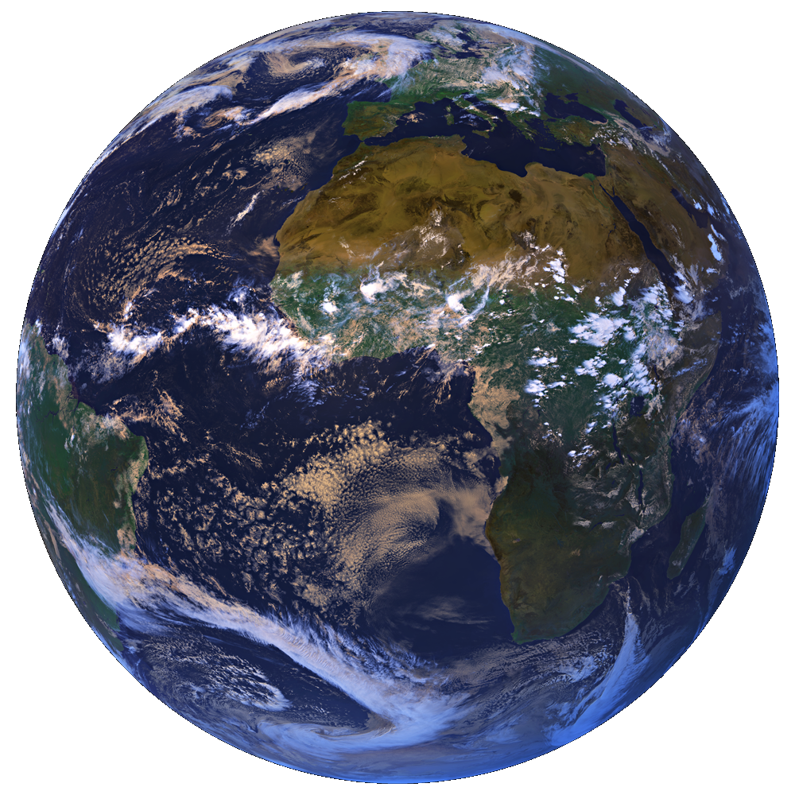
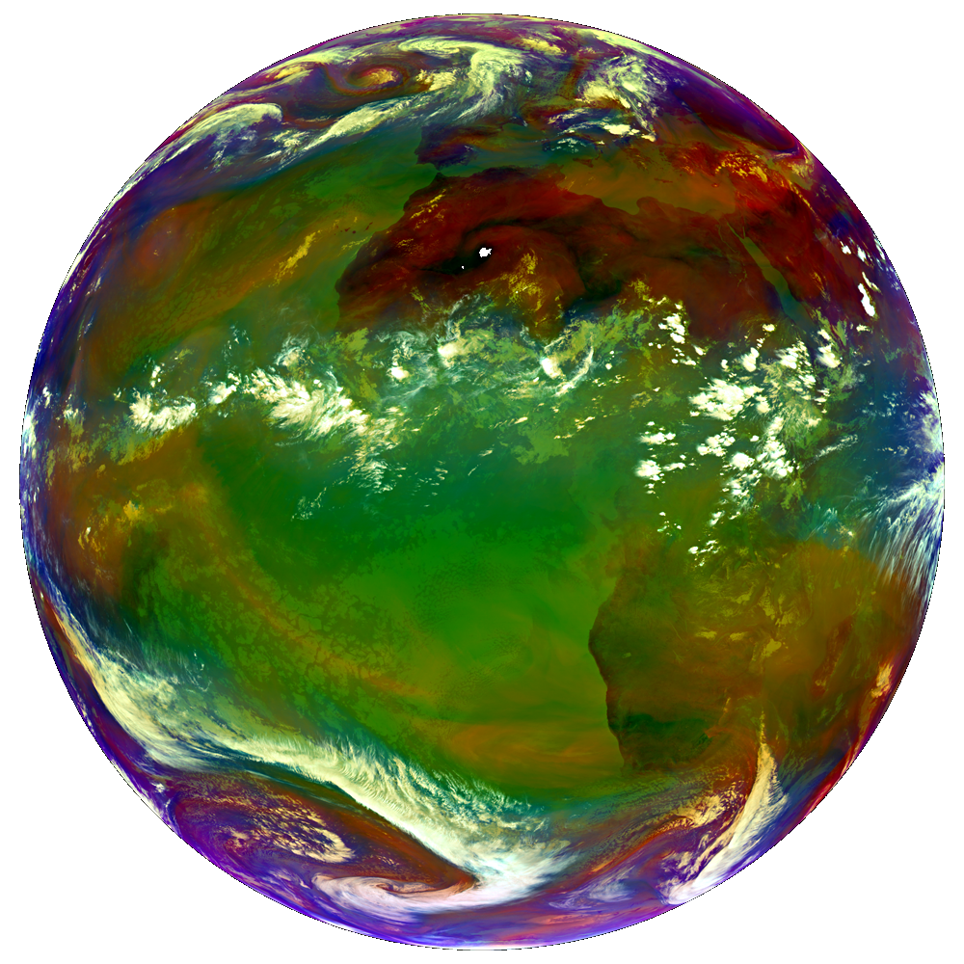
Color enhancement of the IR brightness temperature (BT) imagery
Example #2 storms above Arab Peninsula, Rub-al-Khali (cold-U, plume), 2008-08-09 13:20 UTC Meteosat-8

Slide 37
Color enhancement of the IR brightness temperature (BT) imagery
Example #2 storms above Arab Peninsula, Rub-al-Khali (cold-U, plume), 2008-08-09 13:20 UTC Meteosat-8
IR10.8 black and white image

Slide 38
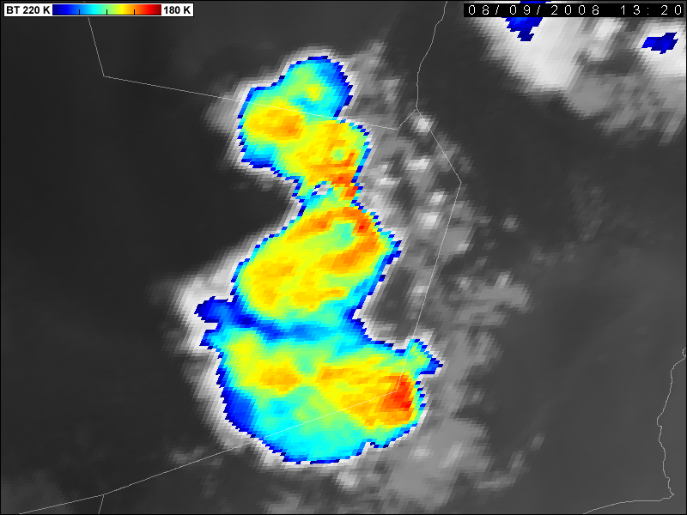
Color enhancement of the IR brightness temperature (BT) imagery
Example #2 storms above Arab Peninsula, Rub-al-Khali (cold-U, plume), 2008-08-09 13:20 UTC Meteosat-8
IR10.8 color-enhanced BT image, 180 – 220 K

Slide 39
Color enhancement of the IR brightness temperature (BT) imagery
Example #2 storms above Arab Peninsula, Rub-al-Khali (cold-U, plume), 2008-08-09 13:20 UTC Meteosat-8
IR10.8 color-enhanced BT image, 185 – 225 K

Slide 40
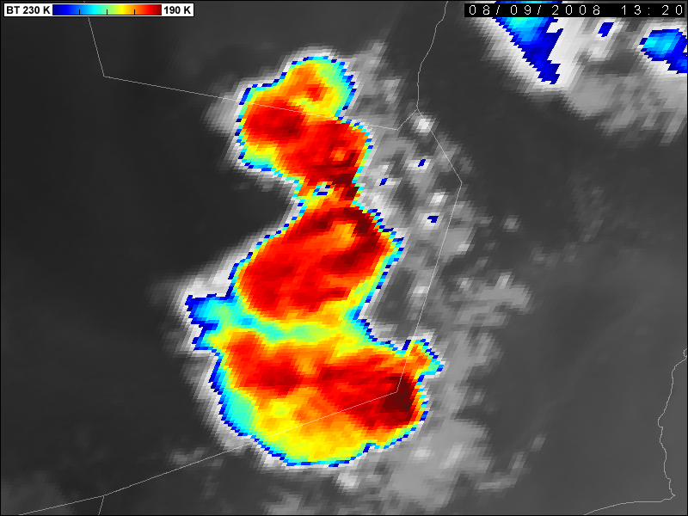
Color enhancement of the IR brightness temperature (BT) imagery
Example #2 storms above Arab Peninsula, Rub-al-Khali (cold-U, plume), 2008-08-09 13:20 UTC Meteosat-8
IR10.8 color-enhanced BT image, 190 – 230 K

Slide 41
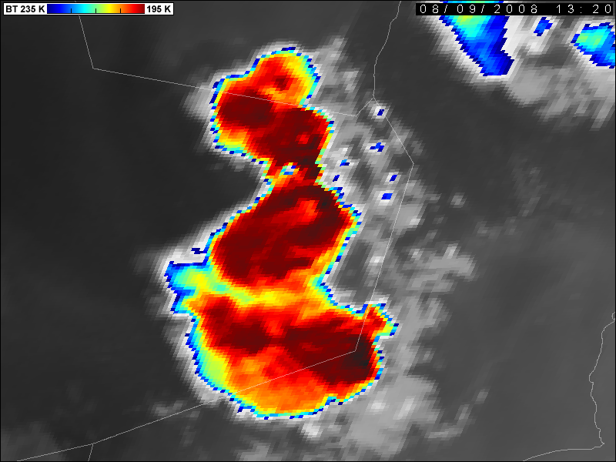
Color enhancement of the IR brightness temperature (BT) imagery
Example #2 storms above Arab Peninsula, Rub-al-Khali (cold-U, plume), 2008-08-09 13:20 UTC Meteosat-8
IR10.8 color-enhanced BT image, 195 – 235 K

Slide 42
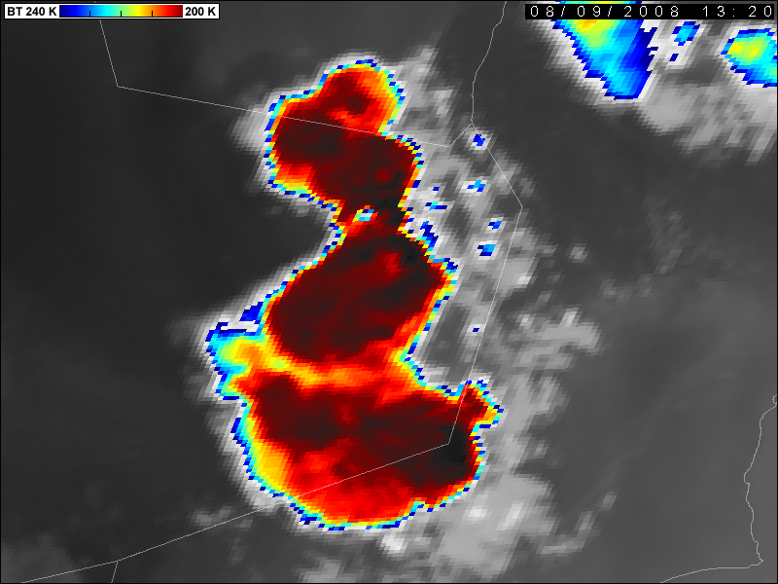
Color enhancement of the IR brightness temperature (BT) imagery
Example #2 storms above Arab Peninsula, Rub-al-Khali (cold-U, plume), 2008-08-09 13:20 UTC Meteosat-8
LOOP
IR10.8 color-enhanced BT image, 200 – 240 K

Slide 43
PART 1
INTRODUCTION: GENERAL APPEARENCE OF STORMS
RGB IMAGE PRODUCTS

Slide 44
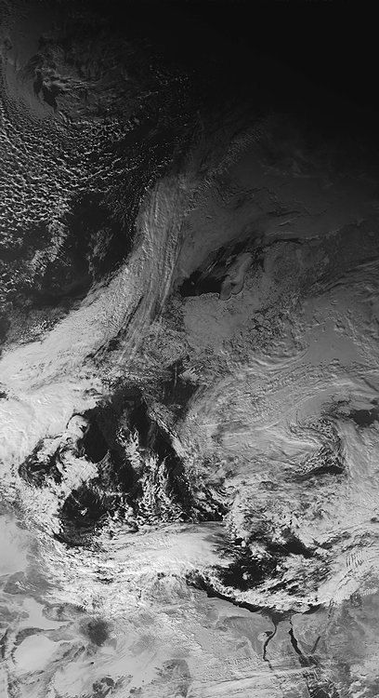
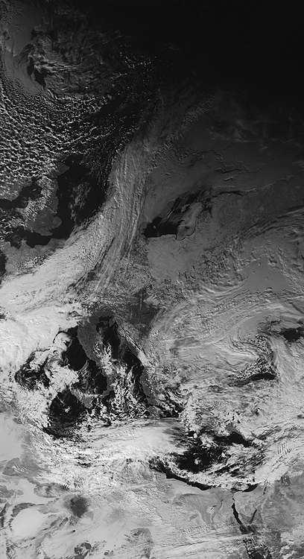
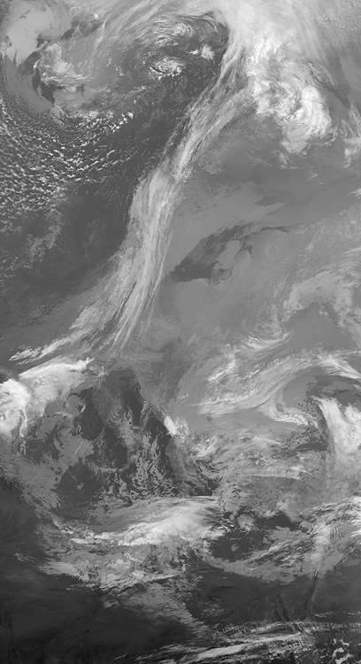
RGB composite image products – principle of the method
A method, which merges three or more different spectral bands (or their mathematical combinations) into one single color image product, using these as red, green and blue input components of the new RGB color image. Broadly used in satellite meteorology namely with onset of the MSG satellites (since 2002). Also used before, e.g. for visualizations of the AVHRR and MODIS data.
AVHRR band 1
AVHRR band 2
AVHRR band 4

Slide 45
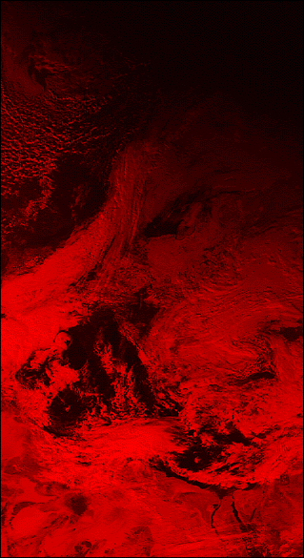
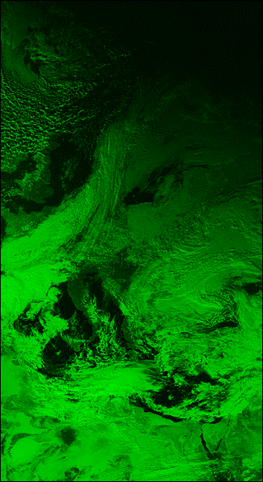
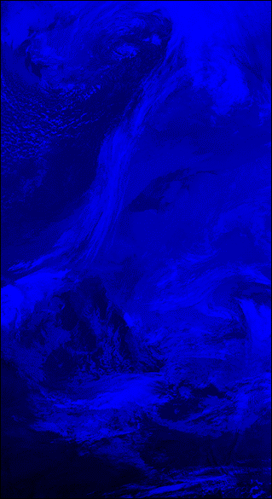
RGB composite image products – principle of the method
A method, which merges three or more different spectral bands (or their mathematical combinations) into one single color image product, using these as red, green and blue input components of the new RGB color image. Broadly used in satellite meteorology namely with onset of the MSG satellites (since 2002). Also used before, e.g. for visualizations of the AVHRR and MODIS data.
AVHRR band 1
AVHRR band 2
AVHRR band 4

Slide 46
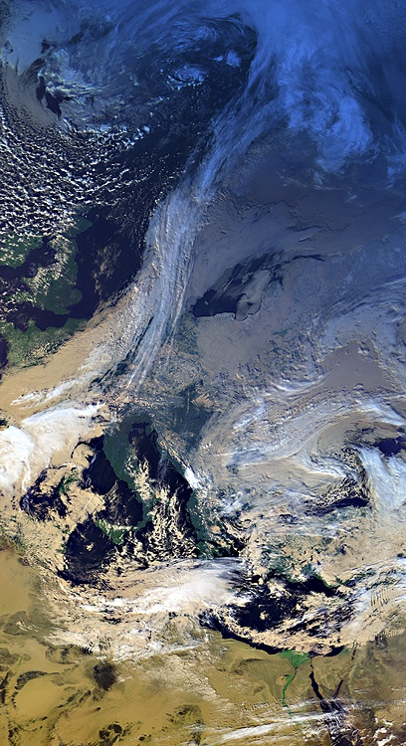
RGB composite image products – principle of the method
AVHRR band 1
AVHRR band 2
AVHRR band 4
RGB composite image of the AVHRR bands 1, 2 and 4

Slide 47
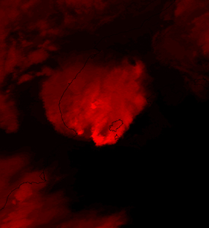
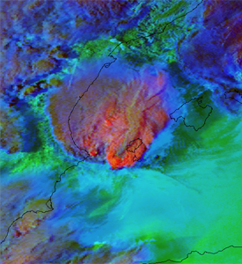
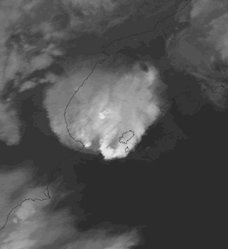
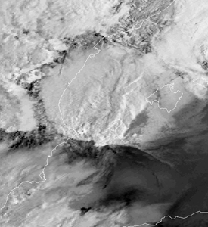
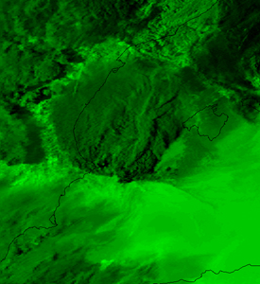
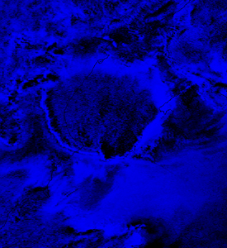

RGB composite image products – principle of the method
11 September 1996 1724 UTC NOAA 12
AVHRR ch4 ENH
AVHRR ch3
AVHRR DIF ch (5-4)
Experimentally used in CHMI since late 1980’s

Slide 48
PART 1
INTRODUCTION: GENERAL APPEARENCE OF STORMS
BLENDED „SANDWICH“ IMAGE PRODUCTS

Slide 49

Blended (sandwich) image products
2023-07-19 12:27 UTC S-NPP VIIRS, sandwich of bands I2 and I5 (BT 195-260K), 375m

Slide 50

Blended (sandwich) image products – principle of the method
2009-07-09 11:35 UTC NOAA-15 AVHRR (South Dakota, Minnesota, Nebraska, Iowa, U.S.A.)

Slide 51


Blended (sandwich) image products – principle of the method
Upper layer: IR-window BT color-enhanced image
Bottom layer (background image): visible or near-IR high-resolution image, typically single-band black-and-white image, alternatively true-color image (or any other similar RGB).

Slide 52
Blended (sandwich) image products – principle of the method
Upper layer: IR-window BT color-enhanced image
Bottom layer (background image): VIS image
Multi-layer image (in this case 2 layers) … e.g. PSD format (Photoshop)

Slide 53

Blended (sandwich) image products – principle of the method
Upper layer: IR-window BT color-enhanced image
Bottom layer (background image): VIS image
Multi-layer image (in this case 2 layers) … e.g. PSD format (Photoshop)
Blending options – applied to the upper layer !!!

Slide 54

Blended (sandwich) image products – principle of the method
In the Adobe Photoshop: Layers >>> Blending Options >>> General Blending >>> Multiply or Linear Burn, Opacity 80 – 100%

Slide 55
Blended (sandwich) image products
The primary advantage of sandwich products is that they merge the features of the two input images into one single image, thus enabling one to observe the characteristics of both images simultaneously in one single product. In the case of the visible – IR-window sandwich combination (VIS/IR-BT), the visible band brings to the final image the cloud-top “morphology” (shadows and textures), while the color-enhanced IR-window band adds the BT information.
Also, it is much easier to follow the evolution of convective storms (or any other weather phenomenon) in one single sandwich product, rather than in two windows, showing the two input bands separately. This makes the sandwich products very attractive for operational applications.
Efficient namely for observations of storm-top (cloud-top) details, not as much on larger scales!
More on sandwich products e.g. here:
https://cwg.eumetsat.int/sandwich-product-blending-the-hrv-and-ir10-8-bt-imagery/

Slide 56


Blended (sandwich) image products – examples
12 July 2011 17:40 UTC Meteosat-8 (MSG-1) SEVIRI, Germany
HRV
IR10.8-BT

Slide 57

Blended (sandwich) image products – examples
12 July 2011 17:40 UTC Meteosat-8 (MSG-1) SEVIRI, Germany
HRV
Sandwich HRV & IR10.8-BT

Slide 58

Blended (sandwich) image products – examples
12 July 2011 17:40 UTC Meteosat-8 (MSG-1) SEVIRI, Germany
HRV
Storm RGB

Slide 59

Blended (sandwich) image products – examples
12 July 2011 17:40 UTC Meteosat-8 (MSG-1) SEVIRI, Germany
HRV
Sandwich HRV & Storm RGB

Slide 60
Blended (sandwich) image products – examples
12 July 2011 17:40 UTC Meteosat-8 (MSG-1) SEVIRI, Germany
Sandwich HRV & IR10.8-BT
Sandwich HRV & Storm RGB

Slide 61
PART 1
INTRODUCTION: GENERAL APPEARENCE OF STORMS
General appearance – size and shape of convective storms (thunderstorms, storm cells, cumulonimbus clouds) – affected namely by:
viewing geometry (scan conditions, angle of view), parallax shift effect, data re-mapping
internal storm dynamics – strength and duration of the storm's updrafts (driven
by storm's environment)
interaction with other storm cells in the area (e.g. merging of individual storm anvils), or storm splitting (supercells)
interaction with environment of the storm (storm-relative winds), impact of the wind shear

Slide 62




Impact of viewing (scanning) geometry – Low Earth Orbit (LEO) versus Geostationary Orbit (GEO)
NADIR VIEW FROM
LOW POLAR ORBIT
METEOSAT IMAGE REMAPPED
TO MERCATOR PROJECTION
SLANTED, LOW-ANGLE VIEW FROM GEOSTATIONARY ORBIT, ORIGINAL SATELLITE PROJECTION
LIMB OF THE EARTH
NOAA-15 and Meteosat-8, 04 August 2010, Russia (pyro-Cb)

Slide 63

Impact of viewing (scanning) geometry – geostationary orbit
Distortion of the image is directly proportional to the distance of the observed area from sub-satellite point (nadir, nominal position of the satellite).
For Meteosat satellites, providing full disc 15 minute imagery, the nominal position is at 0 degrees longitude, above the Equator (shown by the + ).
Besides the image distortion, this distance also impacts the image resolution (pixel size), and the parallax shift effect.
2010-08-04 13:00 UTC, Meteosat-9 (RGB bands 1,2,9)

Slide 64
Impact of viewing (scanning) geometry – geostationary orbit
The red line (circle) in this image indicates geographic regions with the same amount of the image distortion, pixel size, and parallax shift effect.
As can be seen from this image, similar conditions as in most parts of Europe can be found at central-east Brazil, Madagascar, eastern Somalia, and the Arab Peninsula.
The closer to the sub-satellite point, the better is the image quality (lesser distortion, higher image resolution, and smaller the parallax shift).
2010-08-04 13:00 UTC, Meteosat-9 (RGB bands 1,2,9)

Slide 65

Parallax shift effect in satellite imagery
Projection of various cloud-top features to surface (georeferencing, navigation, re-mapping) strongly depends on their actual height above the ground level and on the scanning geometry.

Slide 66

Parallax shift effect in satellite imagery
The parallax-shift effect applies not only to the geostationary satellites and their instruments, but also to the polar-orbiting ones (e.g. MetOp and NOAA POES AVHRR, Aqua & Terra MODIS, Suomi NPP and JPSS VIIRS, etc.).

Slide 67
Parallax shift effect in satellite imagery
different appearance and location of the same cloud when observed from two different satellites (locations)
problems with accurate geo-referencing of higher clouds and some of the derived products
The more tilted view and higher the cloud, the larger is the amount of the parallax shift !!!!!
Geostationary satellites – the parallax effect increases with the radial distance from the center of the globe as viewed by the satellite (from the sub-satellite point).
Polar-orbiting satellites – the parallax effect increases with the distance from the center line of the image swath (representing the ground track of the satellite).

Slide 68
Parallax shift effect in satellite imagery
The parallax shift correction is important namely in these cases:
combination of simultaneous satellite and radar data,
comparison of satellite data from two different satellites,
comparison of satellite data with ground observations,
satellite-based rainfall estimates (namely in hydrology),
storm tracking applications (in nowcasting),
etc.
All of this applies namely to the highest clouds, specifically to tops of convective storms (namely location of overshooting tops).

Slide 69

Parallax shift effect in satellite imagery – comparison with radar data
15 August 2010 18:38 UTC, Czech Republic
Radar reflectivity image (Z-Max)
Core of the storm (radar reflectivity core)

Slide 70

Parallax shift effect in satellite imagery – comparison with radar data
15 August 2010 18:38 UTC, Czech Republic
Meteosat-8 (MSG-1) IR10.8 BT image
Original satellite position after remapping.
Overshooting tops area in MSG image
Core of the storm in radar data
Strong disagreement (shift) of the storm core from the radar data and the overshooting tops area in MSG IR10.8 image.

Slide 71

Parallax shift effect in satellite imagery – comparison with radar data
15 August 2010 18:38 UTC, Czech Republic
Meteosat-8 (MSG-1) IR10.8 BT image
Original satellite position after remapping,
only the temperatures below 250K shown.
Overshooting tops area in MSG image
Core of the storm in radar data

Slide 72

Parallax shift effect in satellite imagery – comparison with radar data
15 August 2010 18:38 UTC, Czech Republic
Meteosat-8 (MSG-1) IR10.8 BT image
Position after the parallax correction for
height of the clouds at 11 km, shift 2 km
west and 18 km south.
Core of the storm in radar data
Excellent agreement of the storm core as detected in the radar data and the overshooting tops area in MSG IR10.8 image (flip to the next slide, and then back again).

Slide 73
Parallax shift effect in satellite imagery – comparison with radar data
15 August 2010 18:38 UTC, Czech Republic
Radar reflectivity image (Z-Max)
Core of the storm in radar data

Slide 74
PART 1
INTRODUCTION: GENERAL APPEARENCE OF STORMS
SPATIAL RESOLUTION (PIXEL SIZE)

Slide 75


Comparison of MODIS (250m and 1 km) and MSG SEVIRI (1km and 3 km)
MODIS band 1
250 m
SEVIRI HRV
1 km
MODIS Aqua, 16 September 2016 12:22 UTC
Meteosat-9, 16 September 2016 12:20 UTC

Slide 76


Comparison of MODIS (250m and 1 km) and MSG SEVIRI (1km and 3 km)
MODIS band 31
1 km
SEVIRI IR10.8
3 km
MODIS Aqua, 16 September 2016 12:22 UTC
Meteosat-9, 16 September 2016 12:20 UTC

Slide 77


Comparison of MODIS (250m and 1 km) and MSG SEVIRI (1km and 3 km)
MODIS sandwich
band 1 & band 31
250m & 1 km
SEVIRI sandwich
HRV & IR10.8
1 km & 3 km
MODIS Aqua, 16 September 2016 12:22 UTC
Meteosat-9, 16 September 2016 12:20 UTC

Slide 78



Detection of brightness temperature (BT) minima (coldest spots of storm tops) versus pixel size
MODIS band 31
pixel size 1 km
Simulated pixel
size: 2 km
Simulated pixel
size: 3 km

Slide 79

Detection of BT minima (coldest spots of storm tops) versus pixel size – impact of averaging of the coldest tops (pixels) with their warmer surroundings
MODIS band 31
pixel size 1 km
Here shown for 1 km => 3 km

Slide 80
Detection of BT minima (coldest spots of storm tops) versus pixel size – impact of averaging of the coldest tops (pixels) with their warmer surroundings
Biggest impact of averaging (due to lower resolution or pixel aggregation) on small-scale coldest tops (isolated pixels)
moderate effect on larger-scale cold tops (groups of several cold pixels)
no effect on large, homogeneous cold areas (such as uniform cirrus layers)

Slide 81
PART 1
INTRODUCTION: GENERAL APPEARENCE OF STORMS
TEMPORAL RESOLUTION (SCAN FREQUENCY)

Slide 82

Satellite scan frequency and timelapse photography – the role of scanning / shooting interval
2015-08-09 15:23-17:37 UTC
Ricoh GX100, IR72 filter, interval 10 seconds
From: http://www.setvak.cz/timelapse
TIMELAPSE INTERVAL: 15 min 5 min 2.5 min 1 min 10 sec
MSG HRV scan interval: 15 min 5 min
For more simulations of the impacts of spatial and temporal resolution go here:
http://www.setvak.cz/timelapse/2015.html#20150809

Slide 83

Satellite scan frequency – impact of the scanning interval
2013-06-20
MSG sandwich product: 2.5 min 5 min 15 min 30 min 60 min 180 min

Slide 84




















Satellite scan frequency – impact of the scanning interval – 2.5 min, 5 min, 10 min and 15 min
14:27.5
14:40.0
14:52.5
15:05.0
14:30.0
14:42.5
14:55.0
15:07.5
14:32.5
14:45.0
14:57.5
15:10.0
14:35.0
14:47.5
15:00.0
15:12.5
14:37.5
14:50.0
15:02.5
15:15.0
Meteosat-8, 20 June 2013 14:27 - 15:15 UTC, experimental 2.5 minute rapid scan, sandwich of HRV and IR10.8 bands

Slide 85
Satellite scan frequency – impact of the scanning interval – 2.5 minutes
14:27.5
14:40.0
Coldest tops here
14:52.5
15:05.0
14:30.0
14:42.5
14:55.0
15:07.5
14:32.5
14:45.0
14:57.5
15:10.0
14:35.0
14:47.5
15:00.0
15:12.5
14:37.5
Coldest tops here
14:50.0
15:02.5
15:15.0
Meteosat-8, 20 June 2013 14:27 - 15:15 UTC, experimental 2.5 minute rapid scan, sandwich of HRV and IR10.8 bands

Slide 86



Satellite scan frequency – impact of the scanning interval – 5 minutes
14:27.5
14:40.0
14:52.5
15:05.0
14:30.0
14:42.5
14:55.0
15:07.5
14:32.5
14:45.0
14:57.5
15:10.0
14:35.0
14:47.5
15:00.0
15:12.5
14:37.5
14:50.0
15:02.5
15:15.0
Meteosat-8, 20 June 2013 14:27 - 15:15 UTC, experimental 2.5 minute rapid scan, sandwich of HRV and IR10.8 bands

Slide 87
Satellite scan frequency – impact of the scanning interval – 10 minutes
14:27.5
14:40.0
14:52.5
15:05.0
14:30.0
14:42.5
14:55.0
15:07.5
14:32.5
14:45.0
14:57.5
15:10.0
14:35.0
14:47.5
15:00.0
15:12.5
14:37.5
14:50.0
15:02.5
15:15.0
Meteosat-8, 20 June 2013 14:27 - 15:15 UTC, experimental 2.5 minute rapid scan, sandwich of HRV and IR10.8 bands

Slide 88
Satellite scan frequency – impact of the scanning interval – 15 minutes
14:27.5
14:40.0
14:52.5
15:05.0
14:30.0
14:42.5
14:55.0
15:07.5
14:32.5
14:45.0
14:57.5
15:10.0
14:35.0
14:47.5
15:00.0
15:12.5
14:37.5
14:50.0
15:02.5
15:15.0
Meteosat-8, 20 June 2013 14:27 - 15:15 UTC, experimental 2.5 minute rapid scan, sandwich of HRV and IR10.8 bands

Slide 89




Satellite scan frequency – important namely for detection of short-lived overshooting tops of storms
Meteosat-8, 20 June 2013 18:17 UTC
sandwich HRV & IR10.8-BT HRV IR10.8-BT (200-240K) BTD (WV6.2-IR10.8)
Textbook appearance of the overshooting top – well defined bubble-like shape and casted shadow in HRV, distinct isolated local IR-BT minimum (much colder than its surrounding anvil top); however not associated with any local BTD (WV6.2-IR10.8) maximum.
Next slides document the rapid evolution of the overshooting top in 2.5 minute super-rapid scan performed experimentally with Meteosat-8 (MSG-1) satellite on 20 June 2013.

Slide 90




Satellite scan frequency – important namely for detection of short-lived overshooting tops of storms
Meteosat-8, 20 June 2013 18:12.5 UTC

Slide 91




Satellite scan frequency – important namely for detection of short-lived overshooting tops of storms
Meteosat-8, 20 June 2013 18:15 UTC

Slide 92




Satellite scan frequency – important namely for detection of short-lived overshooting tops of storms
Meteosat-8, 20 June 2013 18:17.5 UTC

Slide 93




Satellite scan frequency – important namely for detection of short-lived overshooting tops of storms
Meteosat-8, 20 June 2013 18:20 UTC

Slide 94




Satellite scan frequency – important namely for detection of short-lived overshooting tops of storms
Meteosat-8, 20 June 2013 18:22.5 UTC

Slide 95




Satellite scan frequency – important namely for detection of short-lived overshooting tops of storms
Meteosat-8, 20 June 2013 18:00 UTC
sandwich HRV & IR10.8-BT HRV IR10.8-BT (200-240K) BTD (WV6.2-IR10.8)
Textbook appearance of the overshooting top – distinct in HRV, with long casted shadow, very strong local IR-BT minimum (much colder than its surrounding anvil cloud top); weak local BTD (WV6.2-IR10.8) maximum shifted downwind of the OT.
Next slides document the rapid evolution of the overshooting top in 2.5 minute super-rapid scan performed experimentally with Meteosat-8 (MSG-1) satellite on 20 June 2013.

Slide 96




Satellite scan frequency – important namely for detection of short-lived overshooting tops of storms
Meteosat-8, 20 June 2013 17:55 UTC

Slide 97




Satellite scan frequency – important namely for detection of short-lived overshooting tops of storms
Meteosat-8, 20 June 2013 17:57.5 UTC

Slide 98




Satellite scan frequency – important namely for detection of short-lived overshooting tops of storms
Meteosat-8, 20 June 2013 18:00 UTC

Slide 99




Satellite scan frequency – important namely for detection of short-lived overshooting tops of storms
Meteosat-8, 20 June 2013 17:02.5 UTC

Slide 100




Satellite scan frequency – important namely for detection of short-lived overshooting tops of storms
Meteosat-8, 20 June 2013 18:05 UTC

Slide 101
PART 1
INTRODUCTION: GENERAL APPEARENCE OF STORMS
COLOR ENHANCED SATELLITE IR BT IMAGERY
VERSUS RADAR REFLECTIVITY DATA

Slide 102
Storm cells in satellite versus radar data ...
Radar-based storm cell: defined by a certain radar reflectivity threshold (dBz)
Satellite-based storm cell: defined by a certain cloud-top BT threshold (K)
Typically, it is not possible to distinguish the individual storm cells (radar cells) in satellite imagery, as they are usually all hidden under a common “umbrella” – the storm anvil. What appears in satellite imagery as a single, large storm cell, may actually be a cluster or organized system of smaller-scale convective storm cells (radar cells).
Based on satellite imagery only, it is very difficult to decide about the type or internal structure of a storm. The same applies to the storm intensity (severity) and maturity – the satellite sees only the result of previous storm activity, which has formed the storm anvil, not the actual internal state of the storm. The only exception are the overshooting tops, manifesting momentary state of the storm updraft (at it’s upper part!).

Slide 103



Storm cells in satellite versus radar data ...
2008-05-31 14:30 UTC
Germany - Czech republic
MSG-1 (Meteosat 8) sandwich product
Radar Brdy (CZRAD), Z_{max}

Slide 104


Storm cells in satellite versus radar data ...
2006-06-22 01:10 UTC, Czech Republic
MSG-1 (Meteosat 8) IR10.8 BT
Radar (CZRAD) Z_{max}

Slide 105
THE END OF PART 1

Slide 108
BLACK

