Slide 1

Sun glint from the Industrial Palace in Prague, observed in MTG FCI and MSG SEVIRI data
Martin Setvák (with support from Ondřej Nedělčev, Pavel Hampl and Jindřich Šťástka)
Satellite Department of CHMI
E-mail: martin.setvak@chmi.cz, setvak@gmail.com
Personal web site: www.setvak.cz
version: 2026-03-27

Slide 2
MTG FCI and MSG SEVIRI observations
Martin Setvák, CHMI

Slide 3
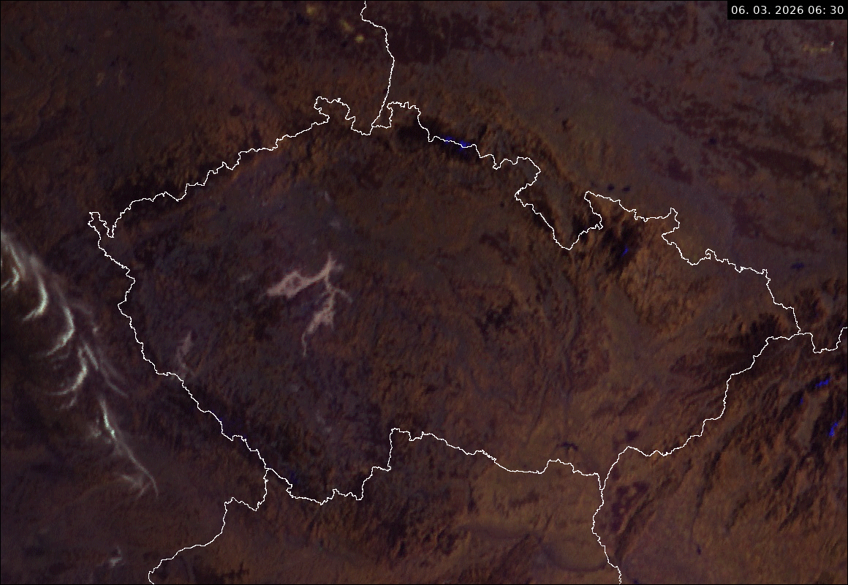
The Sun glint was first observed in Meteosat-12 (MTG-I1) Cloud Phase RGB (version CHMI), composed of FCI NIR1.6, NIR2.2 and VIS0.6 bands, at 07:10 UTC
present in one single image only, not before or after it,
best seen in near infrared bands or RGBs containing one or more of these,
in FCI imagery observed at the same time on three consecutive days - March 5, 6 and 7, 2026 (limited by clear weather above the region),
later found in FCI images for the same three days in 2025, with the same weather limit (cloudy before and after these dates).
FOLLOW
THIS
AREA
ANIM GIF
Martin Setvák, CHMI

Slide 4
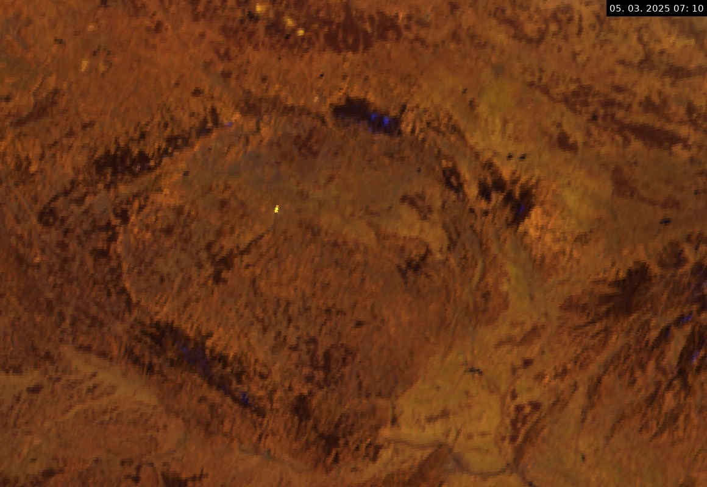
FCI Cloud Phase RGB
05 March 2025 07:10 UTC
Martin Setvák, CHMI

Slide 5
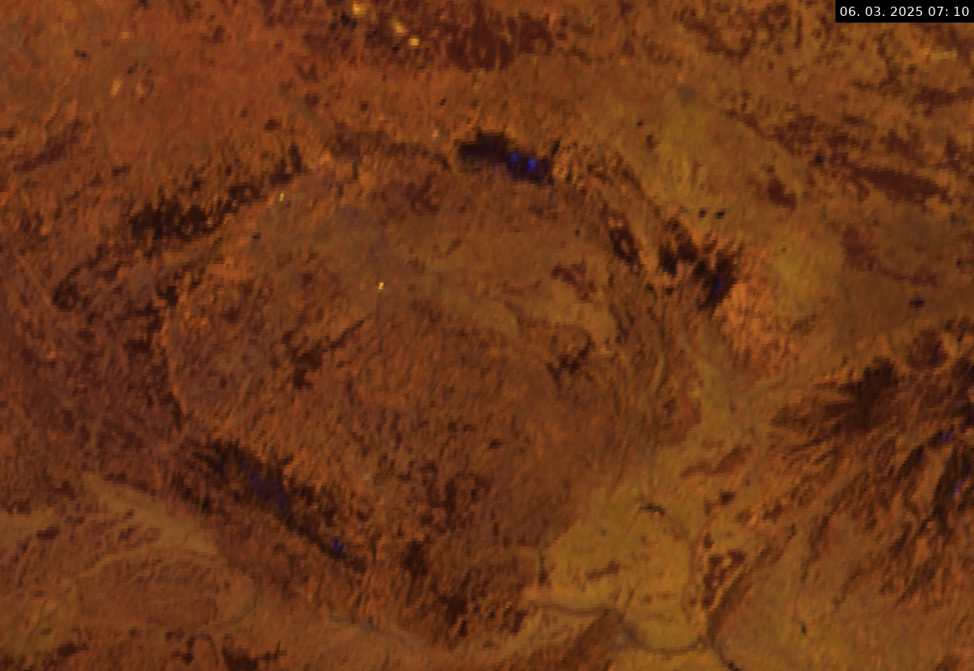
FCI Cloud Phase RGB
06 March 2025 07:10 UTC
Martin Setvák, CHMI

Slide 6
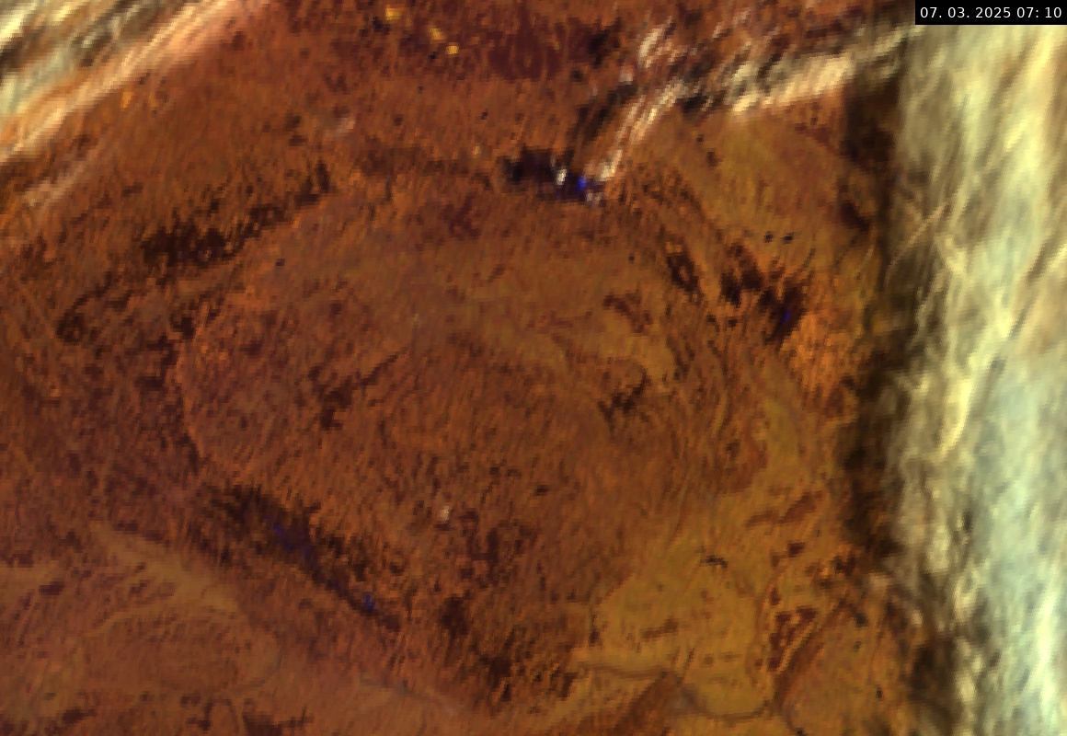
FCI Cloud Phase RGB
07 March 2025 07:10 UTC
Martin Setvák, CHMI

Slide 7
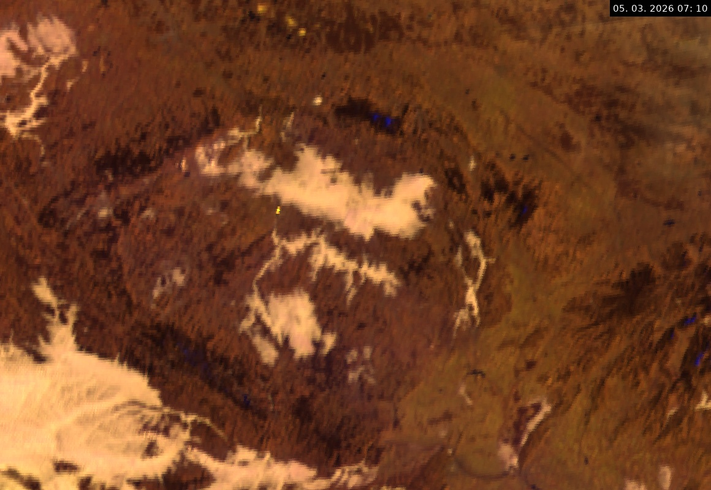
FCI Cloud Phase RGB
05 March 2026 07:10 UTC
Martin Setvák, CHMI

Slide 8
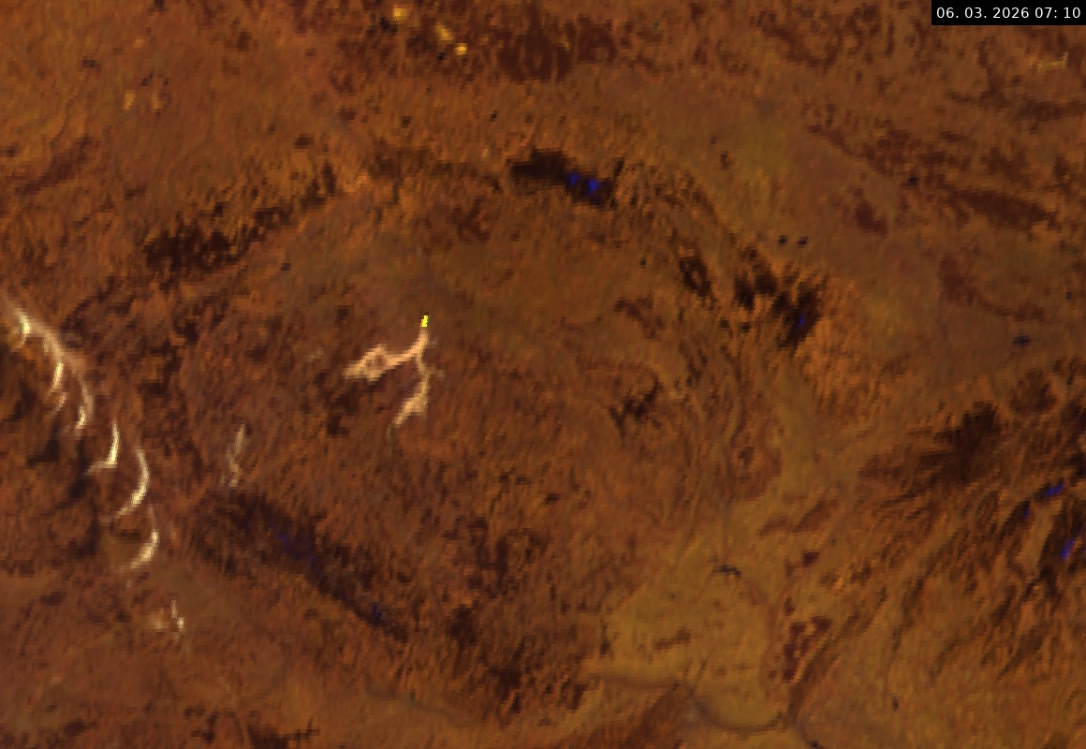
FCI Cloud Phase RGB
06 March 2026 07:10 UTC
Martin Setvák, CHMI

Slide 9
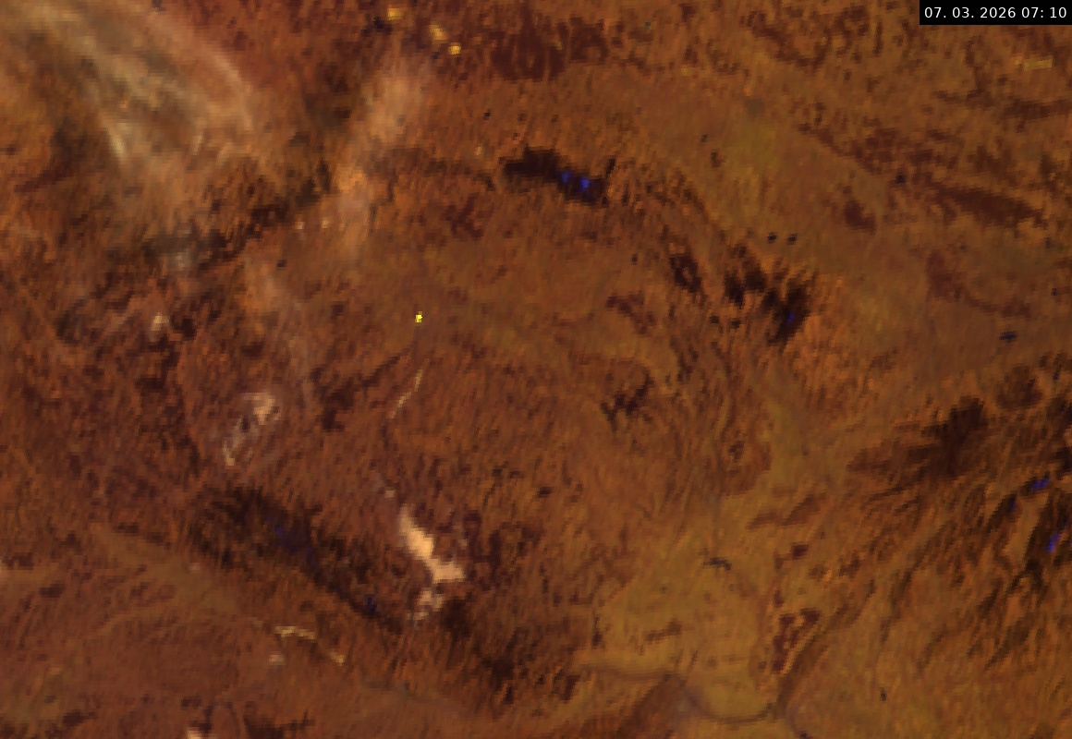
FCI Cloud Phase RGB
07 March 2026 07:10 UTC
Martin Setvák, CHMI

Slide 10
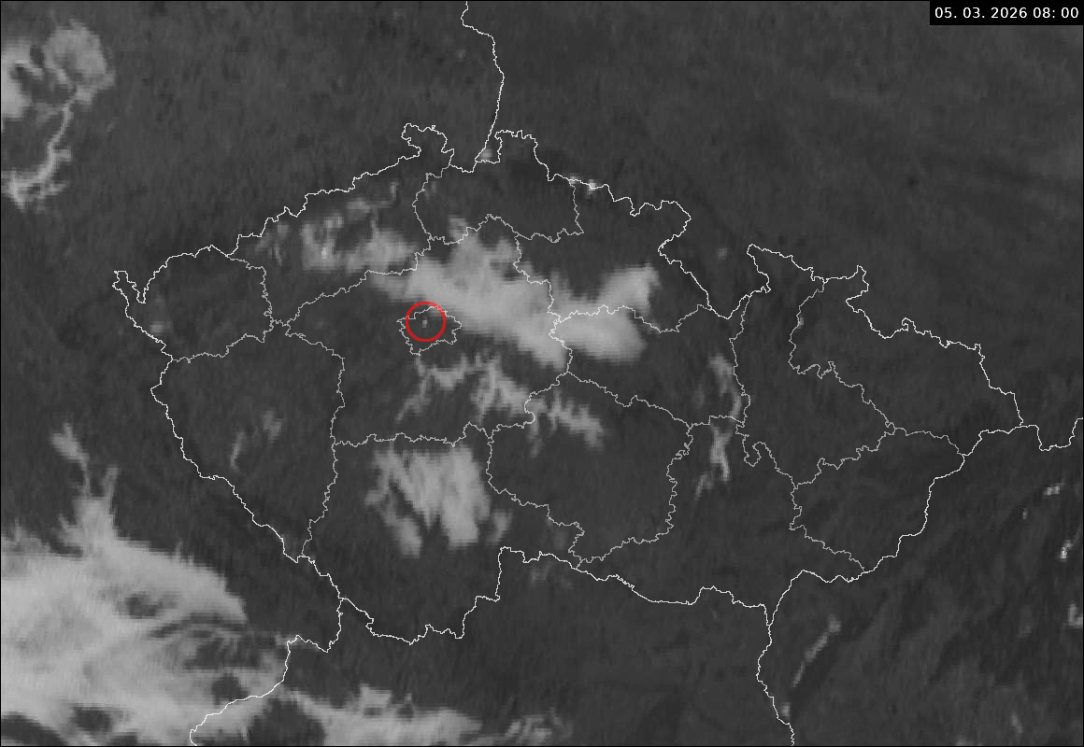
The Sun glint was also recorded in Meteosat-11 (MSG-4) SEVIRI HRV band (0.6 - 0.9 µm) in 5 minute RSS data. Time of the glint differs from that of Meteosat-12 (MTG-I1), which results from different nominal positions of these two satellite (0.3°W for Met-12 vs. 9.3°E for Met-11).
The glint in 2026 occurred on the same days as for Meteosat-12, but in 2025 it occurred on 2 March only, with no glints between 5 – 7 March. This most likely results from slightly different positions of Meteosat-11 in 2025 and 2026, and thus different viewing geometry.
In two cases (6 and 7 March 2026), the glint was observed in two consecutive scans (07:55 and 08:00 UTC), never in three. This indicates that visibility of the glint lasts for about 7 – 8 minutes.
The glint was also visible in SEVIRI RGBs containing the NIR 1.6 band.
No glint was found in MSG RSS data from previous years (March 01 – 10 and October 01 – 10, 2016 – 2024).
And no glint was observed in any of the 15 minute MSG FES (Full Earth Scan) data (2017-2026, same range of days).
Martin Setvák, CHMI

Slide 11
Searching for the reflecting surface
Martin Setvák, CHMI

Slide 12
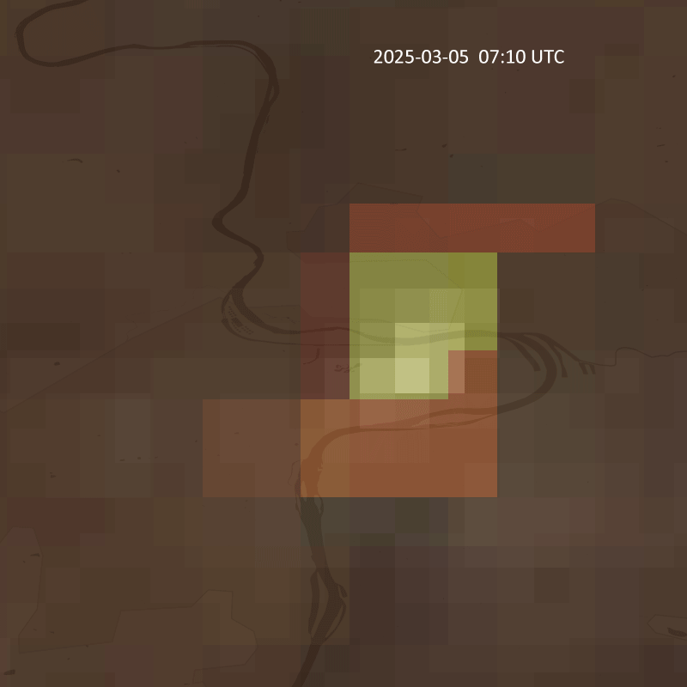
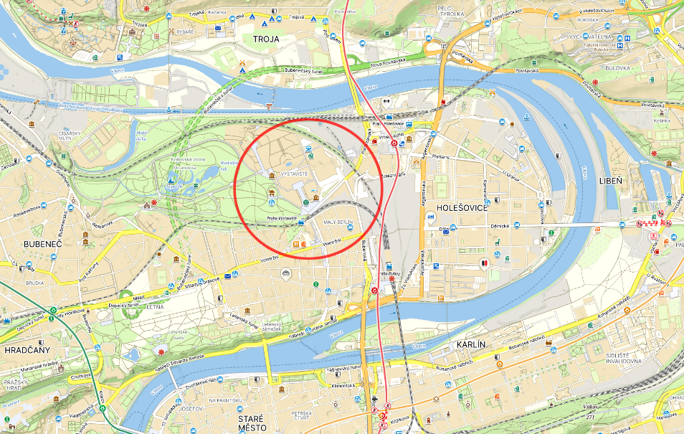
EUMETView: strongly zoomed MTG-I1 FCI Cloud Phase RGB (at 1km) and VIS 0.6 band (at 0.5 km), partially transparent, overlayed above map (dark line – Vltava River). This indicates that the source of the Sun reflection might be somewhere at Výstaviště (Prague Exhibition Grounds) in Holešovice – Bubeneč area.
„Diffusion” of the glint into surrounding pixels is partially (among other) due to re-mapping interpolation in this view.
ANIM GIF
Map source: Mapy.com
Martin Setvák, CHMI

Slide 13
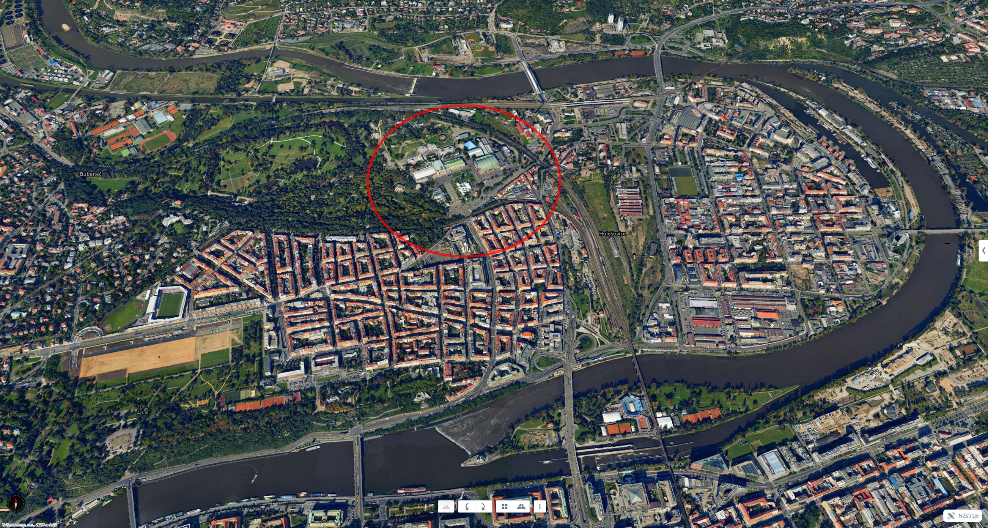
Map source: Mapy.com

Slide 14
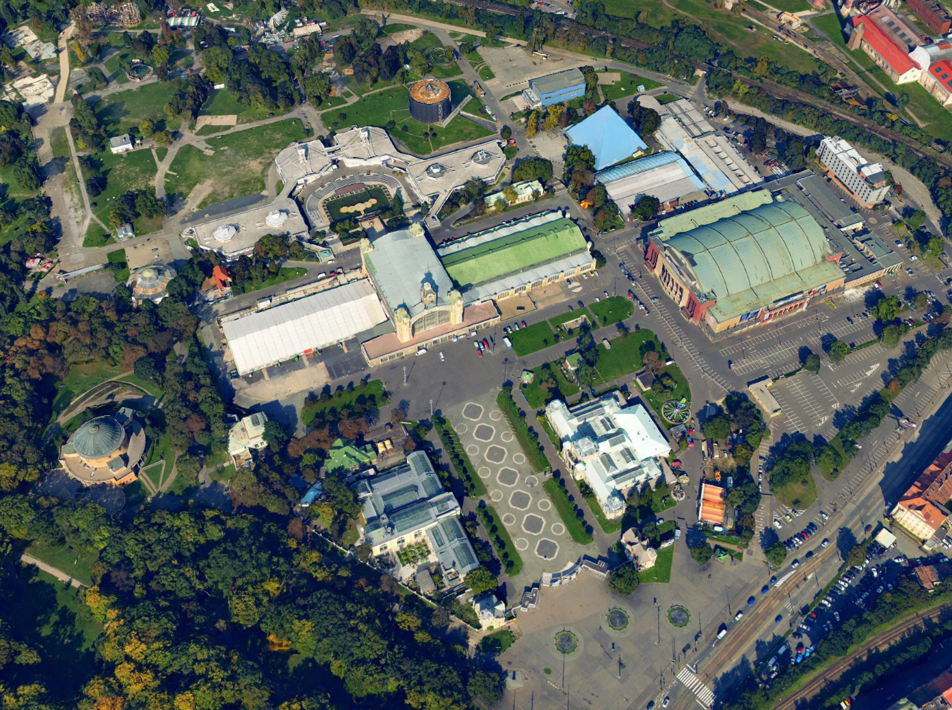
Prague’s Výstaviště (more here) offers several buildings which might be responsible for the Sun glint. To narrow the search, it was needed to compute orientation of the reflecting surface, based on position of Sun and MTG-I1 at time of the glint, 07:18:52 UTC, which is the time of satellite sampling of this area.
First computations (using AI) indicated that azimuth of the normal of the reflecting surface has to be somewhere close to 156 – 158° (which exactly matches orientation of the entire Výstaviště area, 156°, red arrow) and its elevation about 23° – 28°.
After these preliminary AI computations of orientation of the reflecting surface, and detailed search in aerial maps of the larger area, as the most likely candidate turned out to be the Industrial Palace, specifically the glazing of the side clerestory windows of its wings – see the next slides.
Note: the blueish pyramid of GOJA Music Hall was excluded as a possible glint source due to its orientation in azimuth, too high slopes of its walls, as well as the material of these (mate metal).
156°
map source: Mapy.com
Martin Setvák, CHMI

Slide 15
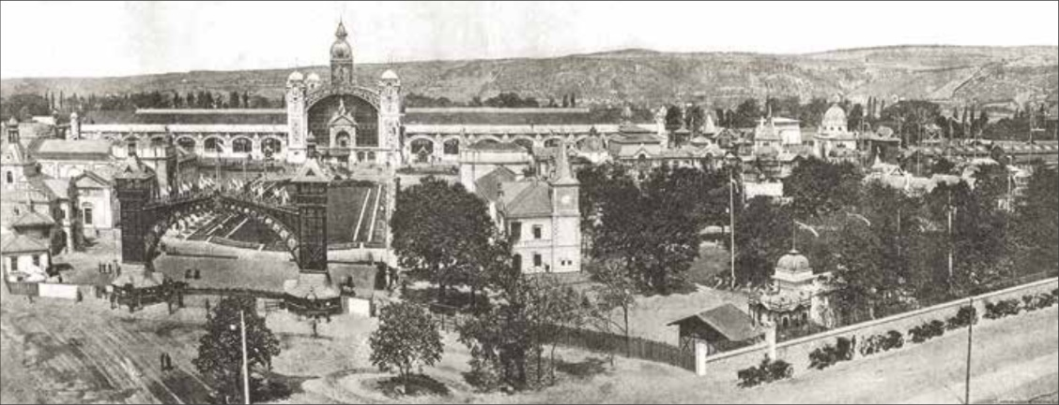
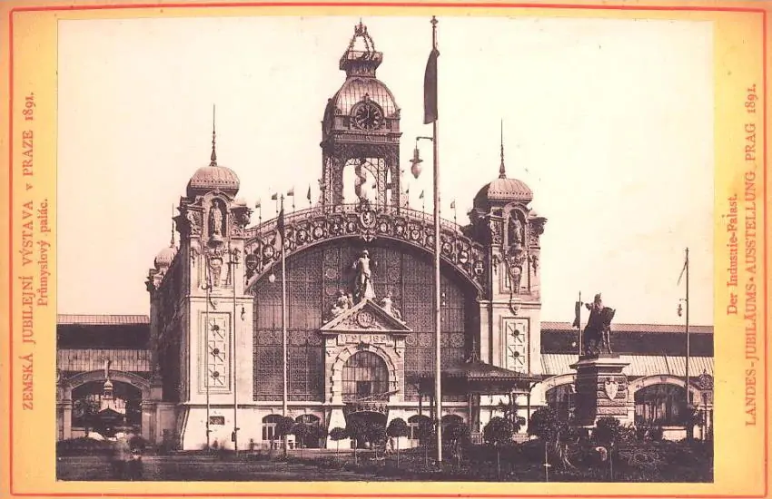
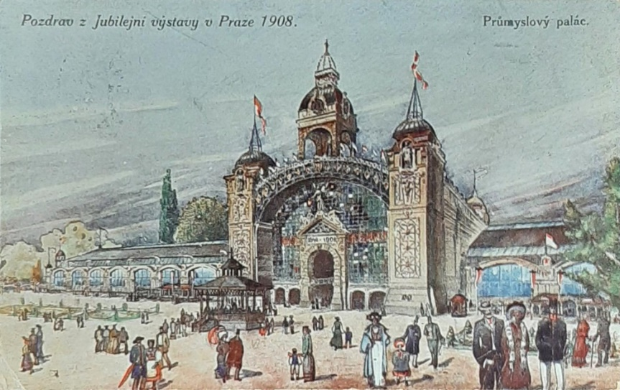
Industrial Palace (Průmyslový palác) at Prague Exhibition Grounds (Výstaviště) was built in 1891, on the occasion of General Land Centennial Exhibition held in Prague that year.
It served not only as an exhibition facility, but it also became a center of entertainment, culture, and the arts. The Prague Industrial Palace was one of the first mounted steel structures in the Czech lands and the glass palace is still one of the most important Art Nouveau buildings in the city.
April 1891
Martin Setvák, CHMI

Slide 16
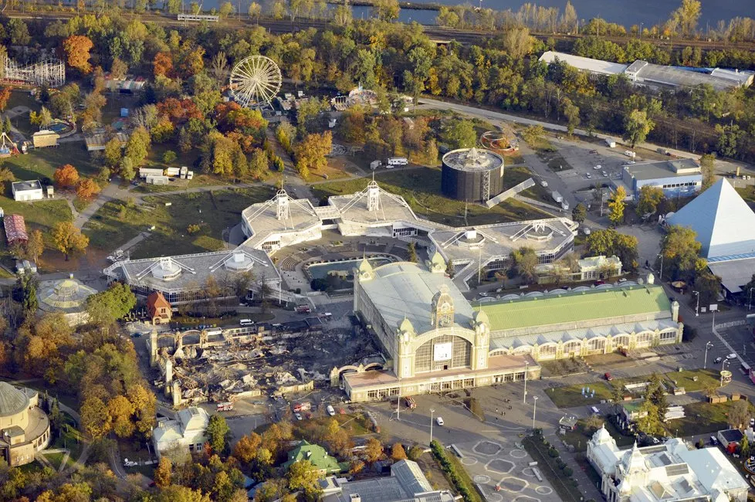

On 16 October 2008, the left (west) wing of the Industrial Palace was destroyed by large fire (caused by an electric cooker). Reconstruction of the Industrial Palace began in 2022, and is to be finished later this year (2026).
Source: e.g. Novinky.cz, Photo: Leoš Kučera, HZS Praha (modified)
Aerial photo of the Industrial Palace, damaged by the fire. The central part and right wing remained intact.
Photo (17 Oct 2028): David Malík, source: Blesk.cz
Martin Setvák, CHMI

Slide 17
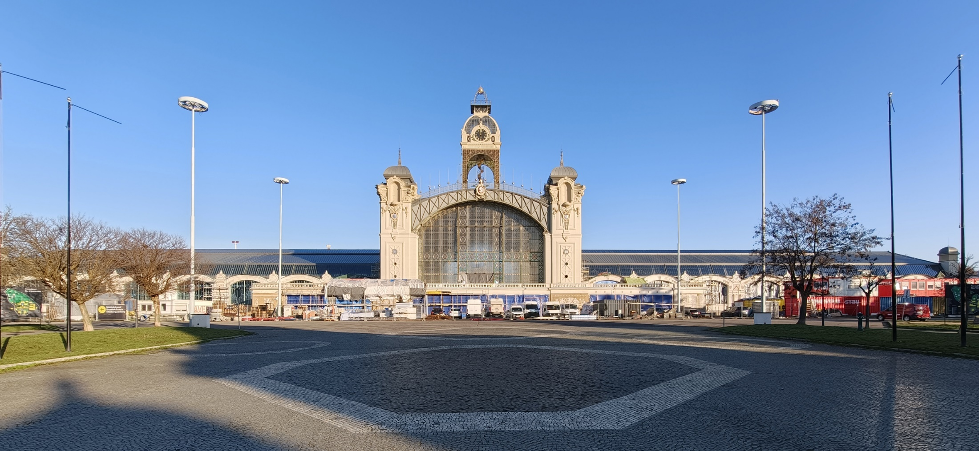
Industrial Palace during the reconstruction, 13 March 2026 (photo MS).
Martin Setvák, CHMI

Slide 18
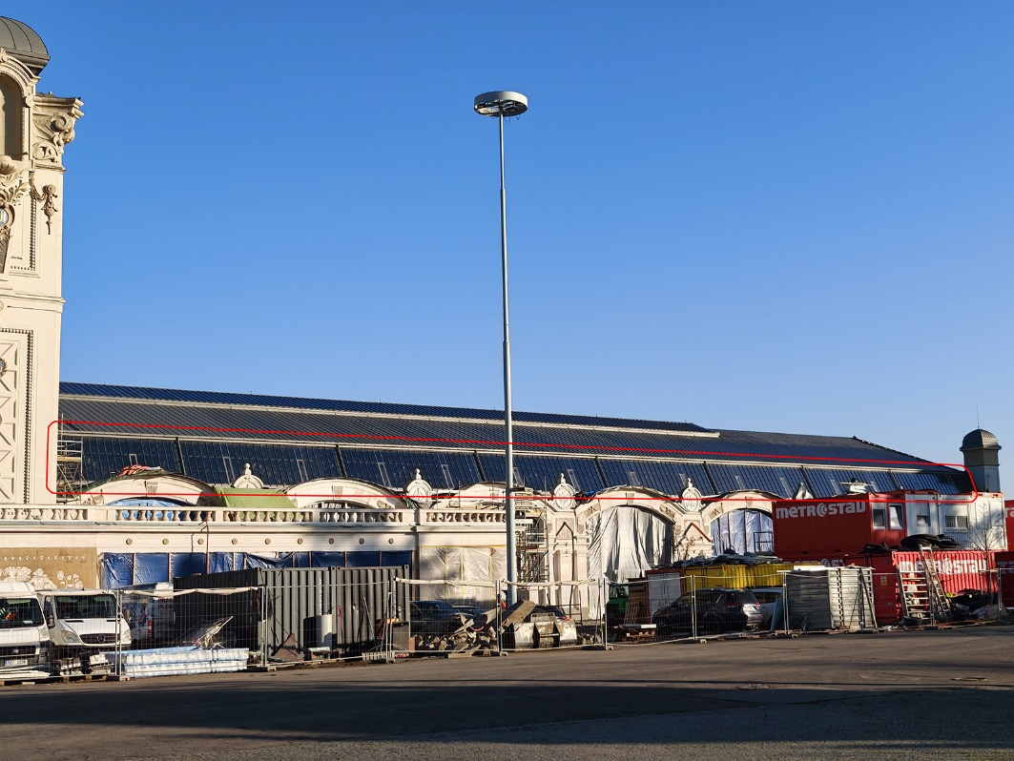
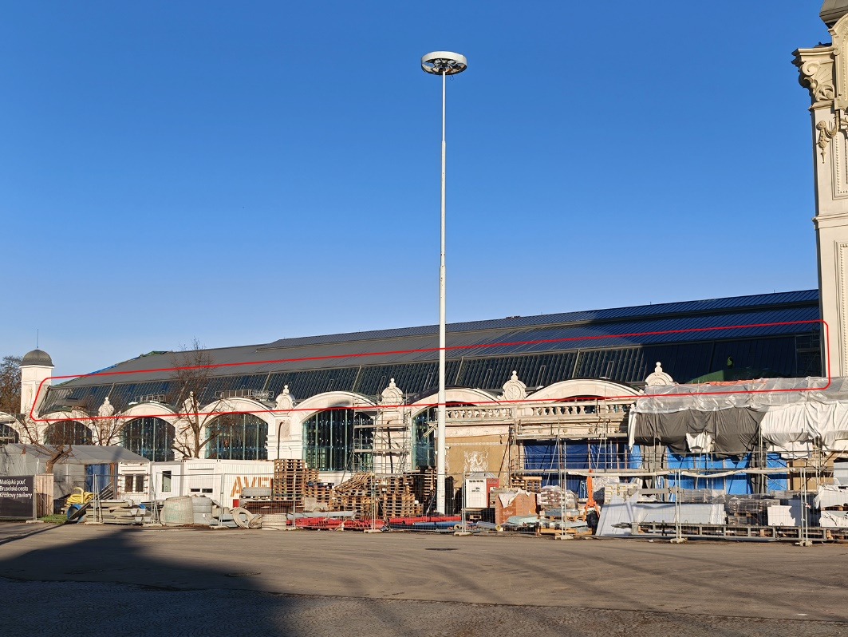
Left (western) wing of the palace, destroyed by fire in October 2008, after its reconstruction.
Highlighted in red is the glazing of the side clerestory windows, which is responsible for the Sun glint, recorded by satellites. Size of the clerestory glazing is about 315 m² (each wing), 630 m² total.
Right (eastern) wing of the palace, restored during the reconstruction of the palace.
Both photos taken by MS, 13 March 2026.
Martin Setvák, CHMI

Slide 19
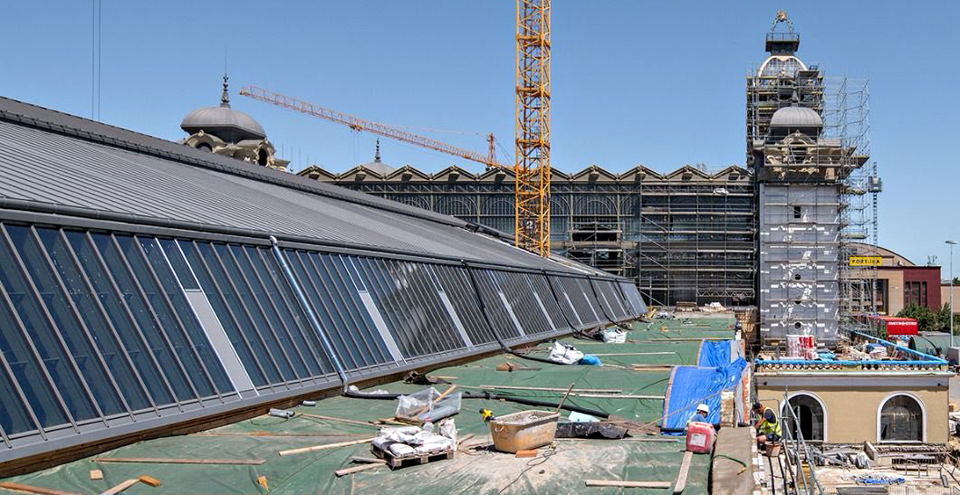
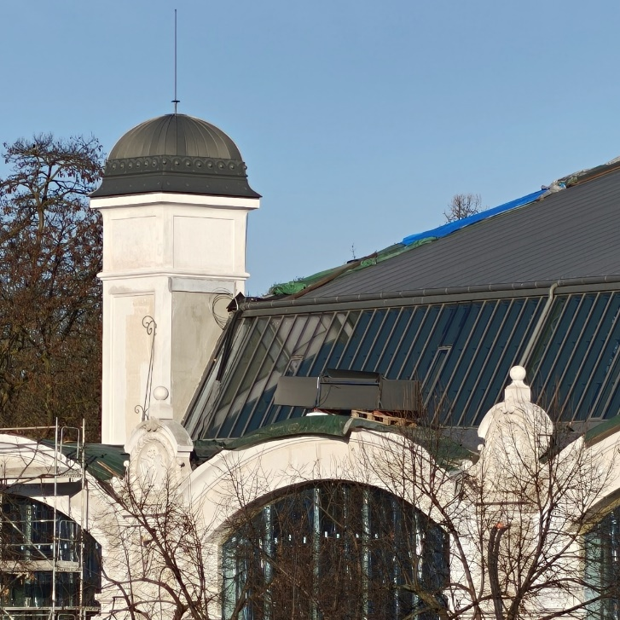
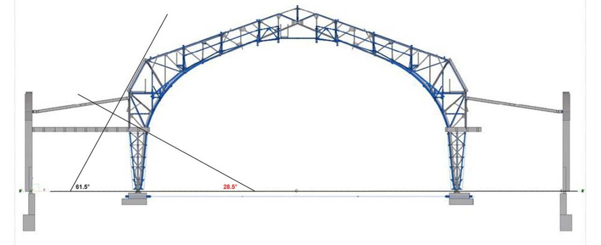
October 2025, source here.
Detail of the clerestory glazing (March 2026, photo MS)
Profile of the roof construction, with details of the clerestory glazing tilt.
Source: Metrostav (modified)
Martin Setvák, CHMI

Slide 20
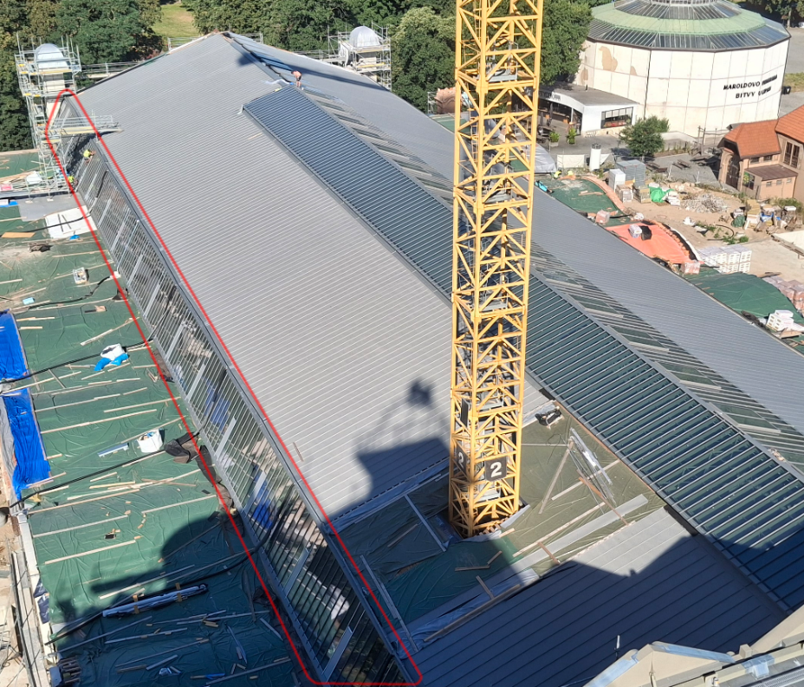
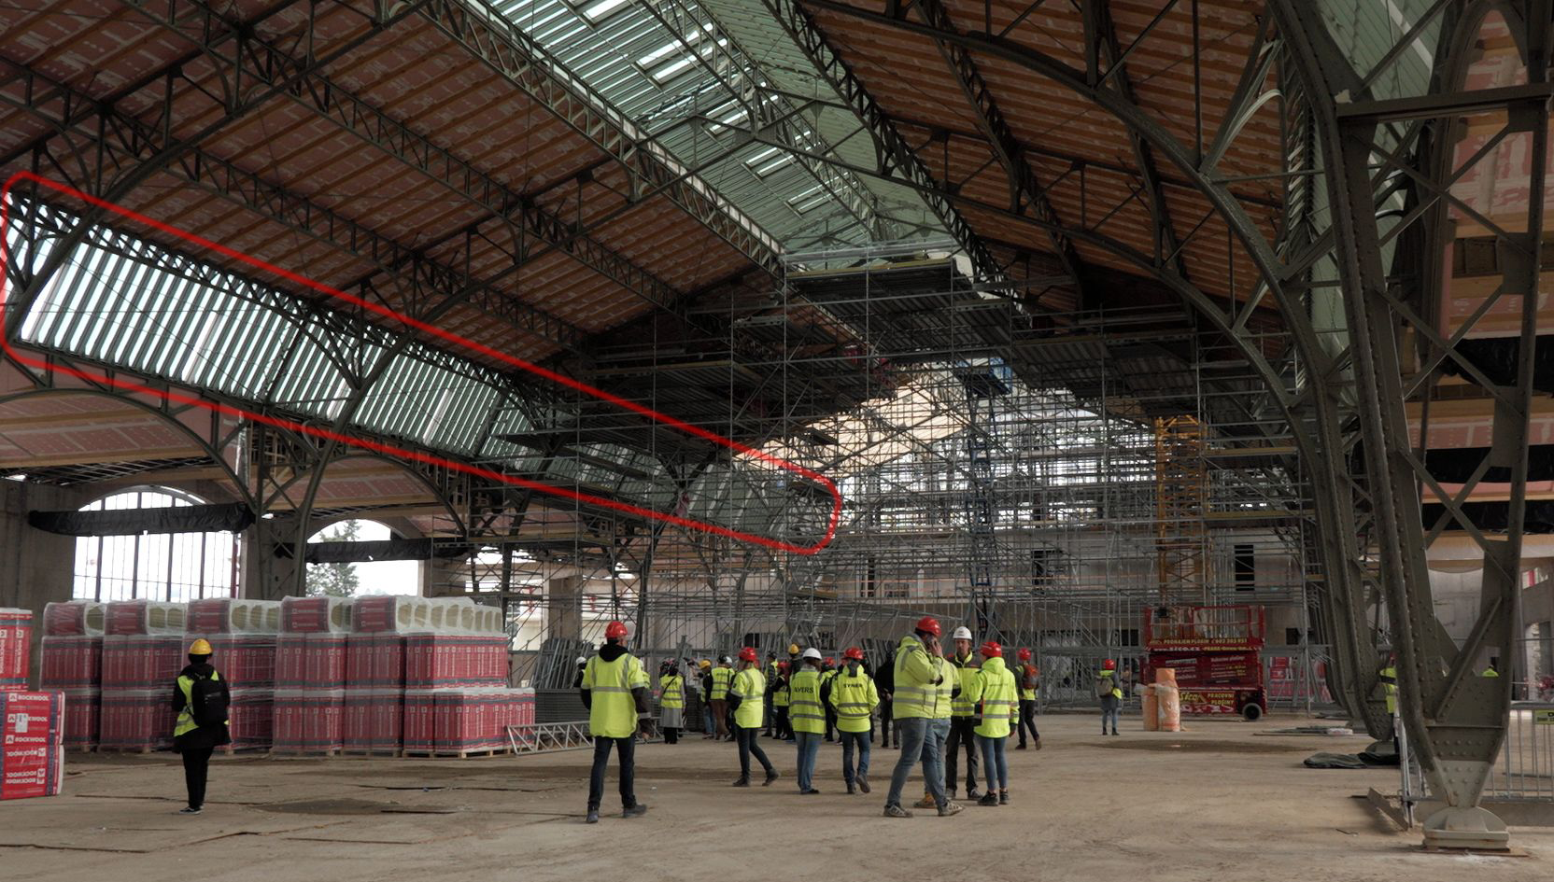
The glint is reflected by the clerestory glazing on the side of the roof, not at its top!
Photo Metrostav, 01 July 2025
Photo Novinky.cz, 26 March 2025 (source photo here)
Martin Setvák, CHMI

Slide 21
More accurate computations of orientation of the reflecting surface
Martin Setvák, CHMI

Slide 22
Further refinement of the reflecting surface parameters was achieved by instructing AI (ChatGPT 5.3, paid version) to use more accurate models for computation of the Sun position, and namely for computation of precise position of both satellites (Meteosat-12 and Meteosat-11) at time of the glint. Detailed orbit ephemerides (obtained here) were used to avoid daily motion of the satellites around their nominal positions. Also, exact location of the reflecting surface (defined as middle part of the Industrial Palace) was used at this step.
  Solar position: NREL SPA / VSOP87-based astronomy
  Satellite position: derived from operational geostationary ephemerides (including station-keeping deviations
  and capturing north–south and east–west librations)
  Geometry: topocentric transformation (geodetic coordinates → ECEF (Earth-centered, Earth-fixed),
  ECEF → topocentric horizontal system (Azimuth / Elevation)), WGS84 ellipsoid
  Reflection: specular reflection (vector bisector)
Exact instrument sampling time of the area (not the image header time) was used as time of the glint.
Verification of accuracy of the computations (interim results) was done by comparing positions of the Sun and the satellites against values obtained for the given time and location from Stellarium software.
Martin Setvák, CHMI

Slide 23
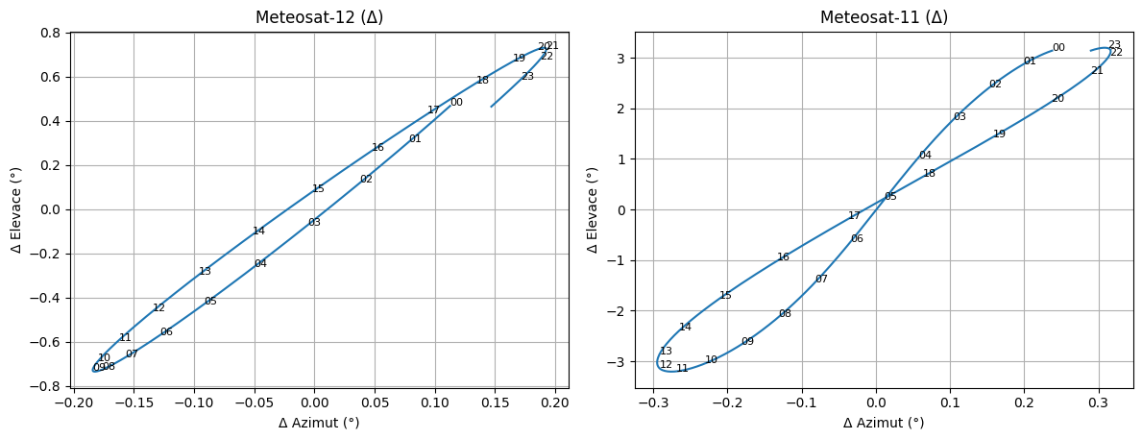
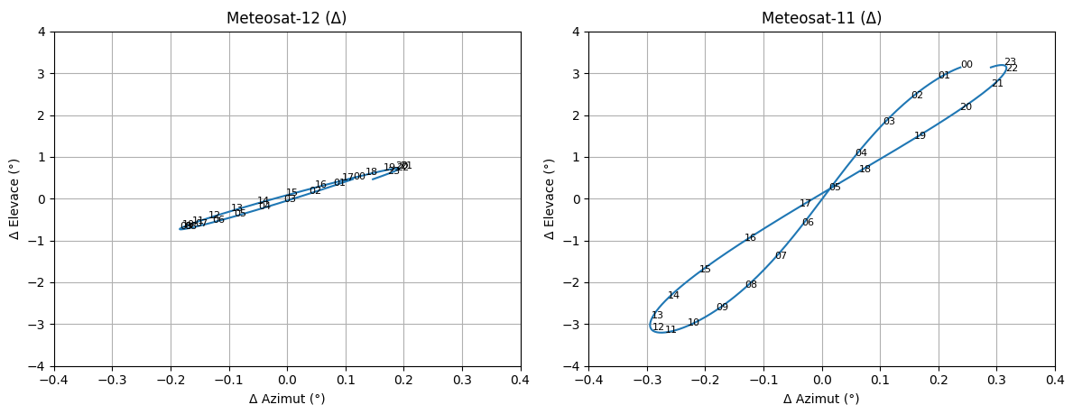
Current orbit details for Meteosat-12 (MTG-I1)
Last update: 9/3/2026, day: 68
Coordinate Frame: Earth-centred, True of date
MTG-I1 Orbit State
Epoch (UTC) = 2026-068T00:00:00.000Z
X-Position: X = -40982.359326 km, X-Velocity: XDOT = -0.724378 km/s
Y-Position: Y = 9939.181522 km, Y-Velocity: YDOT = -2.987495 km/s
Z-Position: Z = 304.296001 km, Z-Velocity: ZDOT = -0.029642 km/s
SRP coefficient: CR = 1.16104325
Semi-Major Axis: A = 42166.263 km
Eccentricity: E = 0.0001722
Inclination: I = 0.6899919 deg
Right Asc. of Asc. Node: RAAN = 23.177747 deg
Argument of Perigee: AOP = 279.09017 deg
True Anomaly: TA = 224.09772 deg
Longitude at epoch: LONG = -0.333505 deg
Mean Longitude: MEAN LONG = -0.319769 deg
Mean Drift Rate: MEAN DRIFT = -0.006748 deg/day
Perigee Height at Epoch: HPERI = 35780.8649695114 km
Apogee Height at Epoch: HAPO = 35795.3870304886 km
Current orbit details for Meteosat-11 (MSG4)
Last update: 9/3/2026, day: 68
Coordinate Frame: Earth-centred, True of date
MSG4 Orbit State
Epoch: 2026/03/09 00:00:00.000 ( 26.068.00.00.00.000 ) UTC
X-Position: X = -42019.0339237 km, X-Velocity: XDOT = -0.2149564 km/s
Y-Position: Y = 2920.5616219 km, Y-Velocity: YDOT = -3.0663691 km/s
Z-Position: Z = 2103.7938648 km, Z-Velocity: ZDOT = -0.0381225 km/s
SRP coefficient: CR = 1.14761
Semi-Major Axis: A = 42167.1399531 km
Eccentricity: E = 0.00013950
Inclination: I = 2.9464698 deg
Right Asc. of Asc. Node: RAAN = 72.0473331 deg
Argument of Perigee: AOP = 272.9385988 deg
True Anomaly: TA = 191.0203258 deg
Longitude at epoch: LONG = 9.32283700 deg
Mean Longitude: MEAN LONG = 9.307403 deg
Mean Drift Rate: MEAN DRIFT = -0.01499 deg/day
Perigee Height at Epoch: HPERI = 35783.12063708 km
Apogee Height at Epoch: HAPO = 35794.88526912 km
Daily motion (analemma) of Meteosat-12 (MTG-I1) and Meteosat-11 (MSG-4) for 06 March 2026
… and the same at corresponding scale
Neglecting the daily motion of satellites would result in inaccurate value of orientation of the reflecting surface, namely in its inclination.
Martin Setvák, CHMI

Slide 24
Final computations
Meteosat-12 (MTG-I1)
2026-03-06 07:18:52 UTC
Location coordinates: 50.1065°N, 14.4300°E
Position of the satellite:
azimuth: 198.69° (198.89°)
elevation: 30.20° (30.24°)
Sun position:
azimuth: 118.51° (118.41°)
elevation: 14.43° (14.93°)
Orientation of normal of the reflecting surface:
azimuth: 155.86°
elevation: 28.18°
Meteosat-11 (MSG-4, RSS)
2026-03-06 08:03 UTC
Location coordinates: 50.1065°N, 14.4300°E
Position of the satellite:
azimuth: 186.41° (186.49°)
elevation: 30.22° (30.29°)
Sun position:
azimuth: 128.20° (128.13°)
elevation: 20.35° (20.84°)
Orientation of normal of the reflecting surface:
azimuth: 156.00°
elevation: 28.40°
Orientation of the normal of the side clerestory windows is: azimuth 156°, elevation 28.5°. This is in excellent agreement with computed values obtained from positions of the Sun and the two satellites at the glint time.
Values in brackets are position data from Stellarium, set at the same time and location. Satellite TLE data used by Stellarium are from 2026-03-20.;
Martin Setvák, CHMI

Slide 25
Spectral properties of the Sun glint
Martin Setvák, CHMI

Slide 26
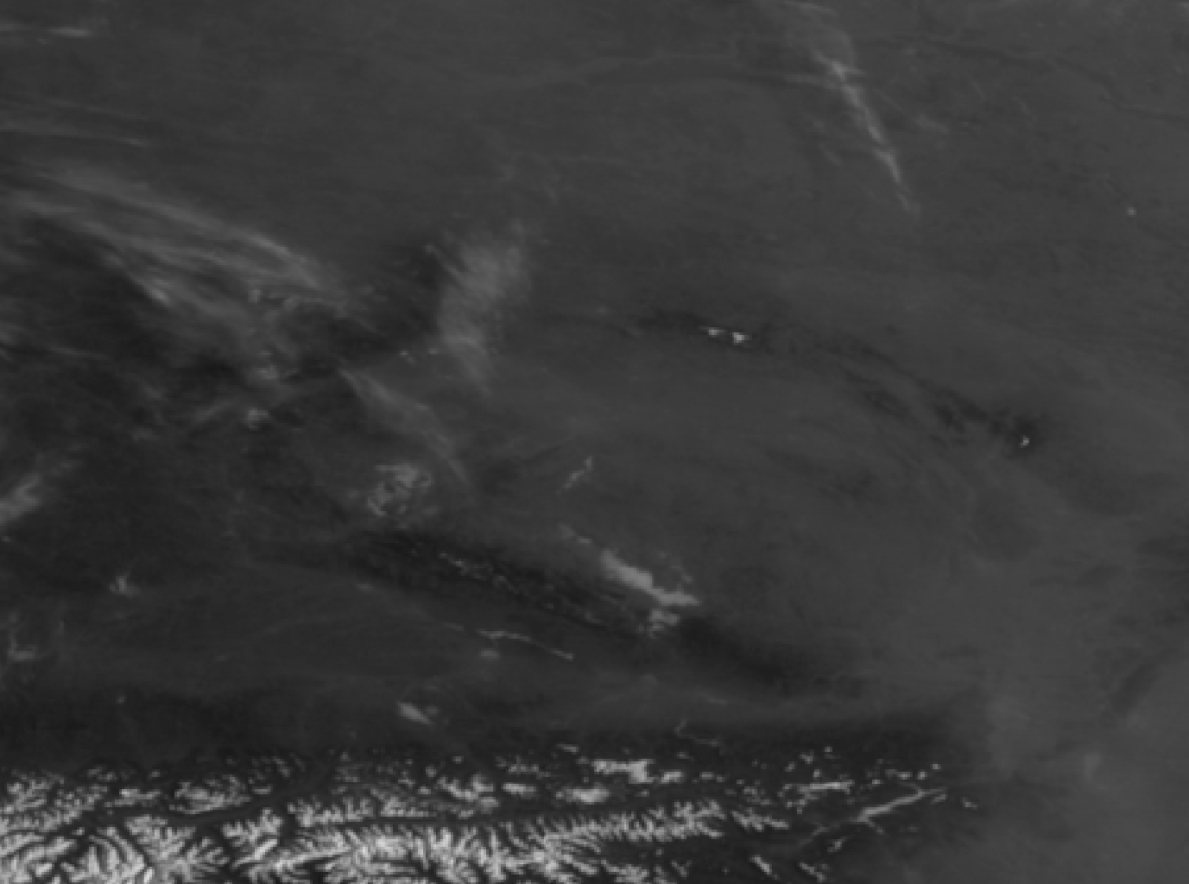
2026-03-07 07:10 UTC
MTG FCI VIS 0.4
The Sun glint is very weak, almost invisible in VIS 0.4 and VIS 0.5, appears first in VIS 0.6 and gets stronger further on, at longer wavelengths.
FOLLOW
THIS
AREA
Martin Setvák, CHMI

Slide 27
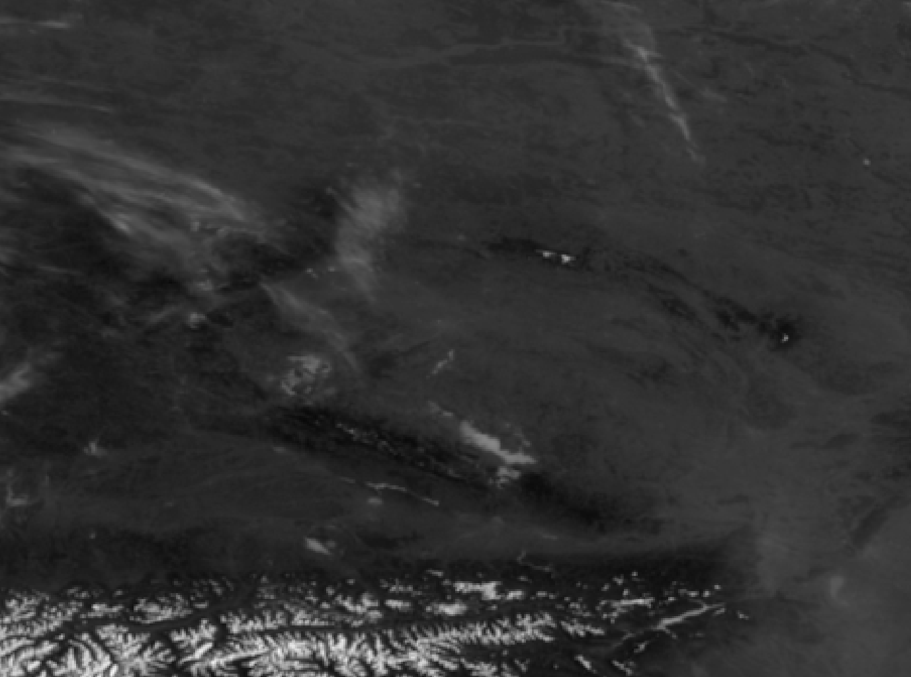
2026-03-07 07:10 UTC
MTG FCI VIS 0.5
Martin Setvák, CHMI

Slide 28
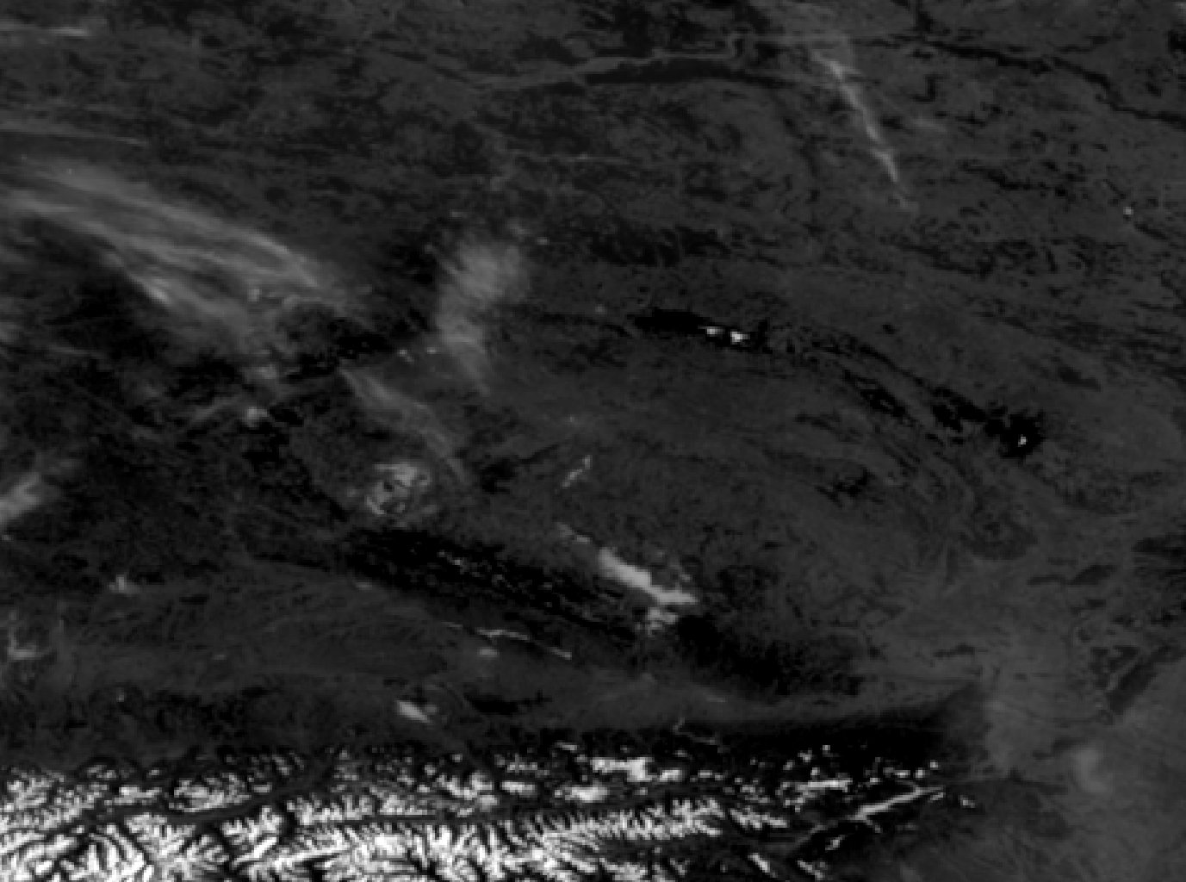
2026-03-07 07:10 UTC
MTG FCI VIS 0.6
Martin Setvák, CHMI

Slide 29
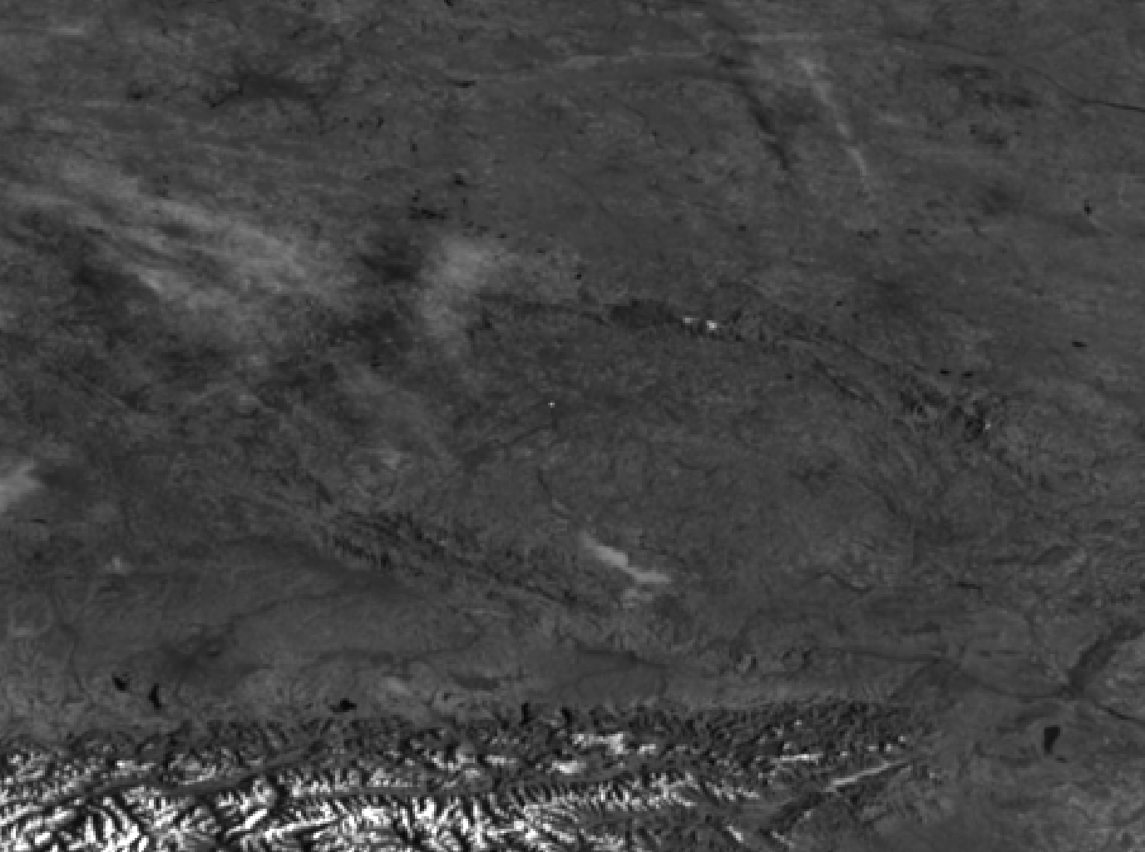
2026-03-07 07:10 UTC
MTG FCI VIS 0.8
Martin Setvák, CHMI

Slide 30
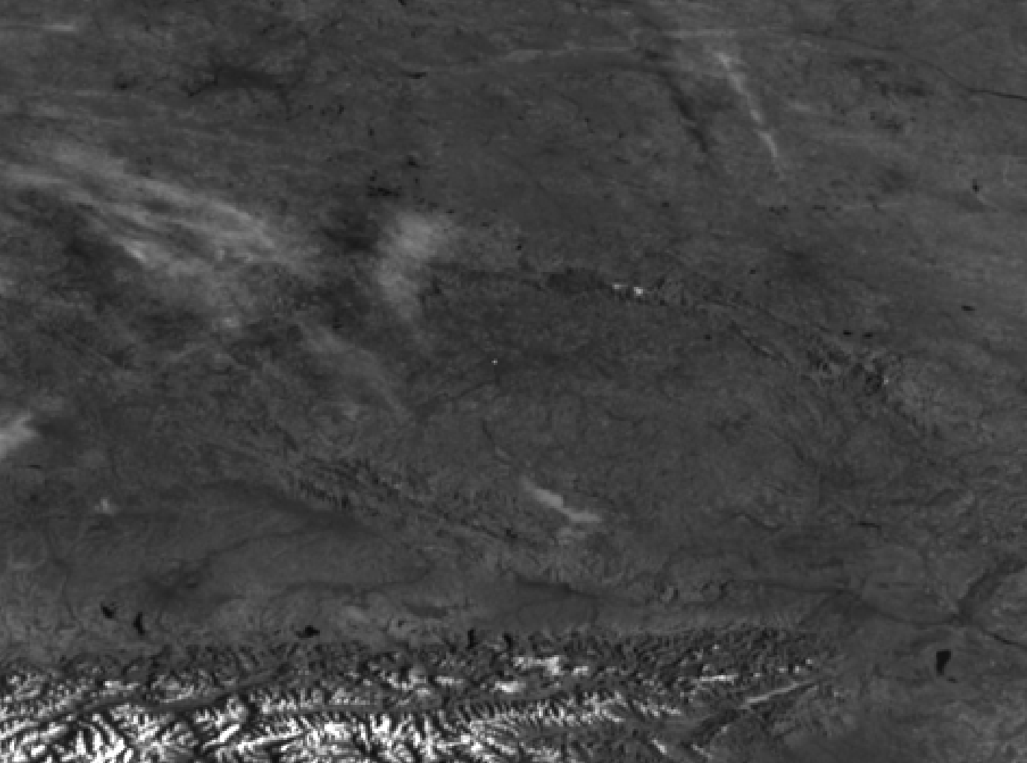
2026-03-07 07:10 UTC
MTG FCI VIS 0.9
Martin Setvák, CHMI

Slide 31
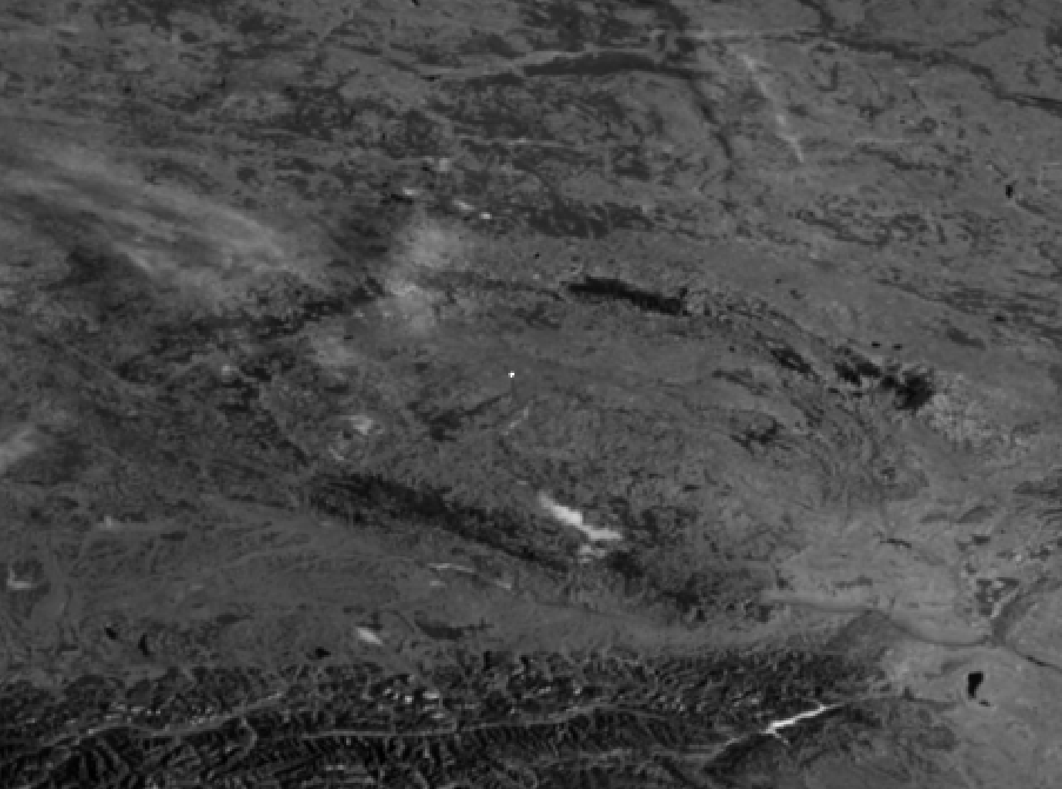
2026-03-07 07:10 UTC
MTG FCI NIR 1.6
Martin Setvák, CHMI

Slide 32
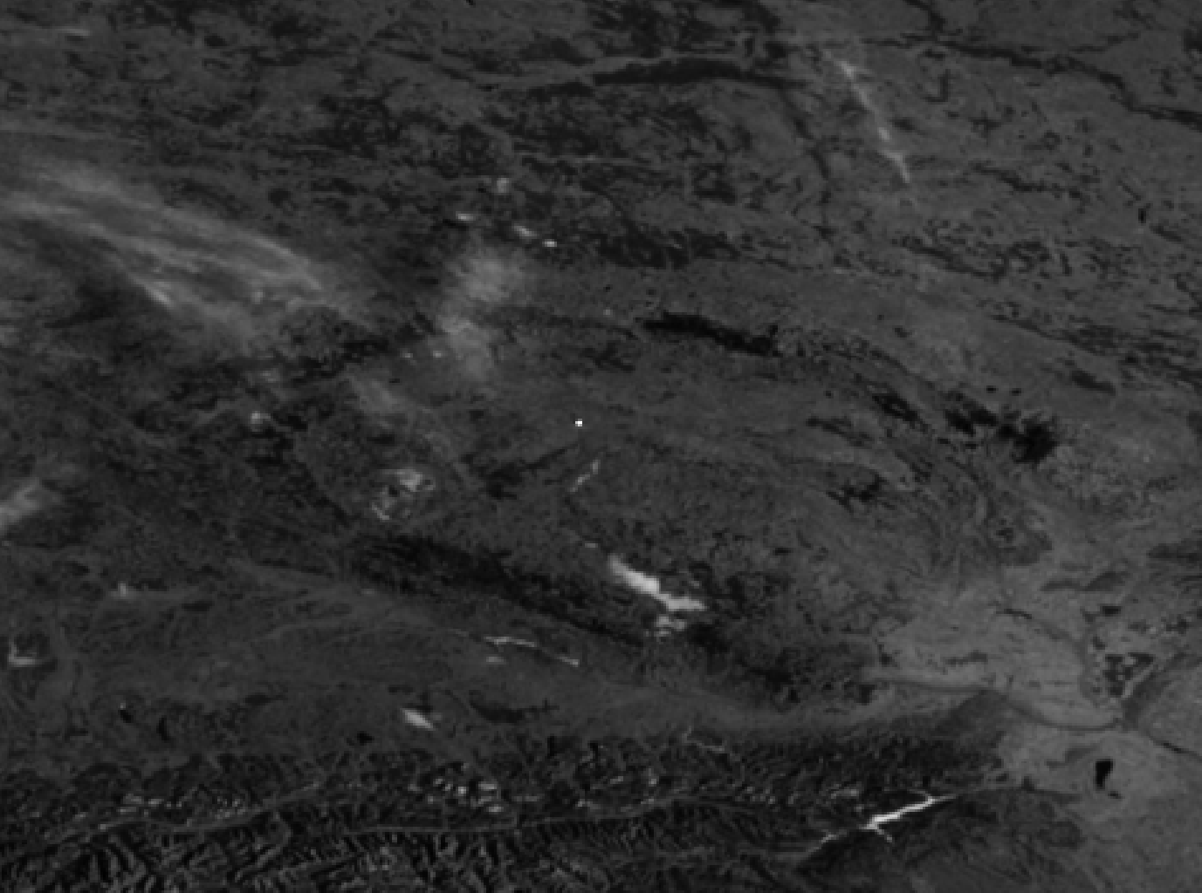
2026-03-07 07:10 UTC
MTG FCI NIR 2.2
Martin Setvák, CHMI

Slide 33
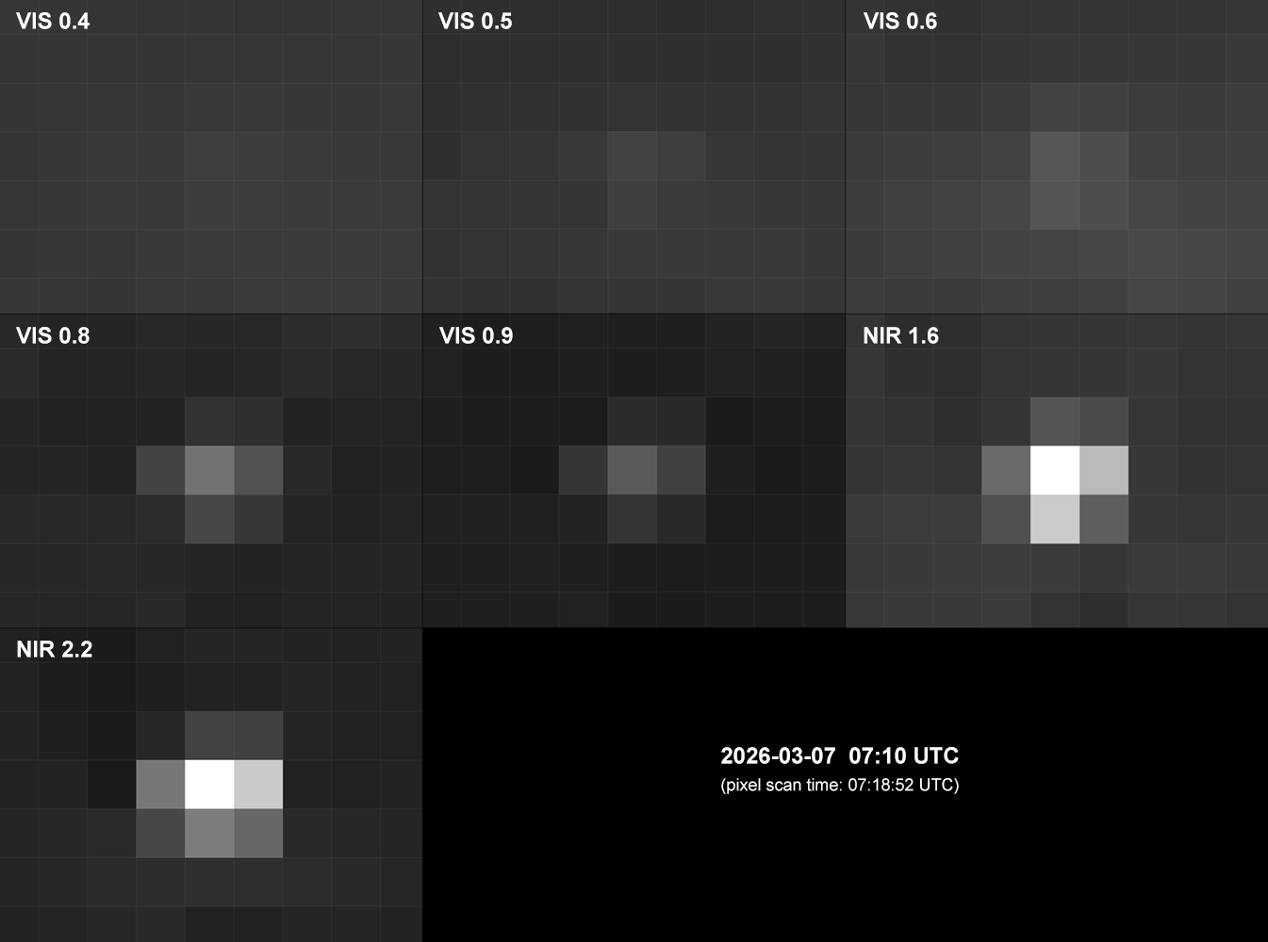
2026-03-07 07:10 UTC
Meteosat-12 (MTG-I1) FCI bands
Strongly zoomed detail of the Sun glint
Original satellite projection (L1c data, all at 1 km resolution), thus no additional re-mapping and no interpolation takes a place here.
Since the entire reflecting surface (both wings) is about 240m long, much smaller than the FCI 1 km pixel size, it can be considered as a point source. Propagation of the signal into the surrounding pixels therefore most likely originates from interpolation and smoothing taking a place during conversion from original raw data to L1c format. Also, propagation of the signal from small point-like sources to neighboring pixels (an optical effect described by the instrument Point Spread Function, PSF) can play a role here as well.
Martin Setvák, CHMI

Slide 34
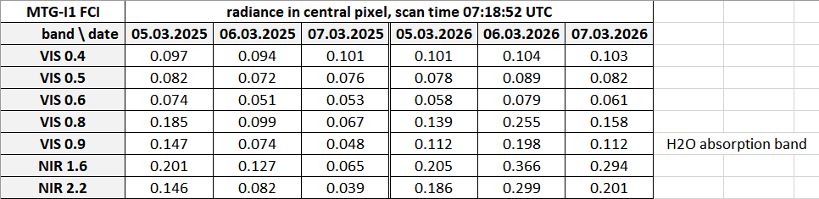
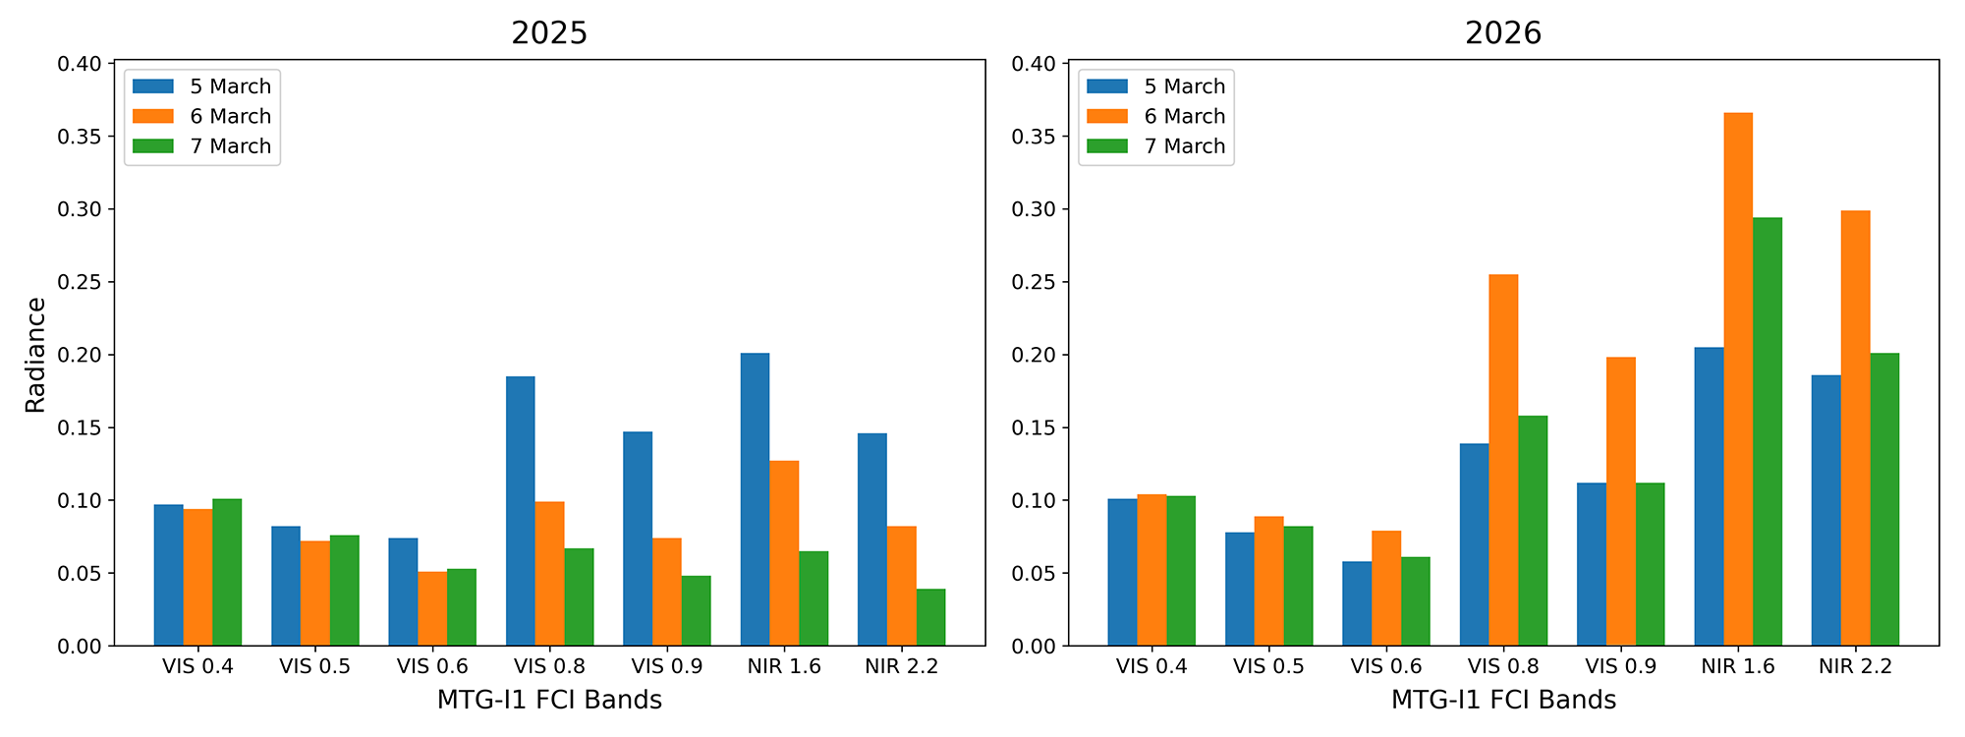
Meteosat-12 (MTG-I1) FCI radiances
[mW·m⁻²·sr⁻¹·(cm⁻¹)⁻¹] in VIS and NIR bands, L1c data
Noticeable increase of radiances (namely in the NIR bands) for 2026 as compared to 2025.
This is closely related to the fact that in 2025 only the left wing of the palace was already covered by the new glass, while the right wing was at this time without the glazing (see next slides). In March 2026, both wings were already covered, thus providing full reflection.
Martin Setvák, CHMI

Slide 35
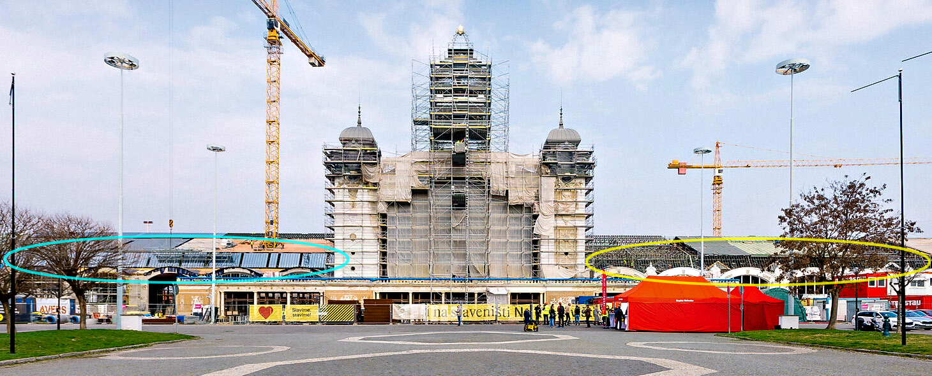
Industrial Palace in April 2025. At this time, the left wing was already covered by the new clerestory glazing (highlighted in blue), while the right wing was without this cover (yellow). Therefore, the reflecting surface was only about half the size of that from 2026. Photo: Metrostav CZ.
Martin Setvák, CHMI

Slide 36
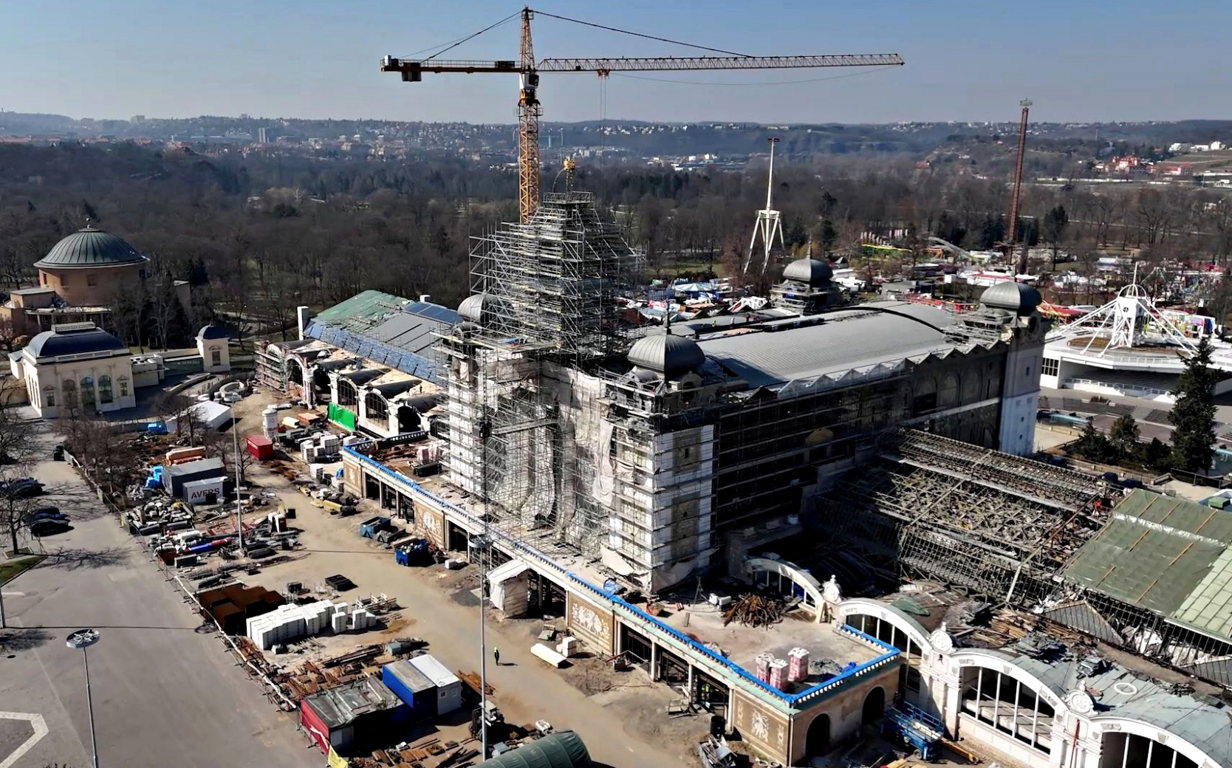
26 March 2025
Another view of the Palace, documenting status of the glazing of the clerestory windows at time shortly after the 2025 Sun glints.
Source: Novinky.cz
Martin Setvák, CHMI

Slide 37
Industrial Palace in March 2026, when it already had both wings covered by the new clerestory glazing. Photo 13 March 2026, MS.
Martin Setvák, CHMI

Slide 38
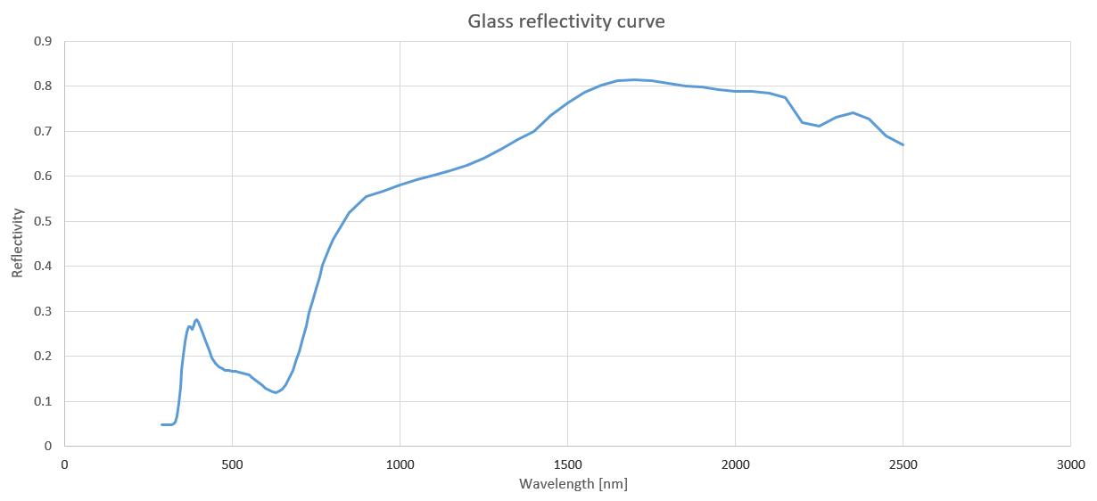
Final step – comparison of spectral properties of the Sun glint as observed by MTG FCI, with spectral properties of the clerestory glazing
Clerestory glazing reflectivity curve, kindly provided by manufacturer of the glass, AGC Processing Teplice, and Metrostav CZ
Martin Setvák, CHMI

Slide 39
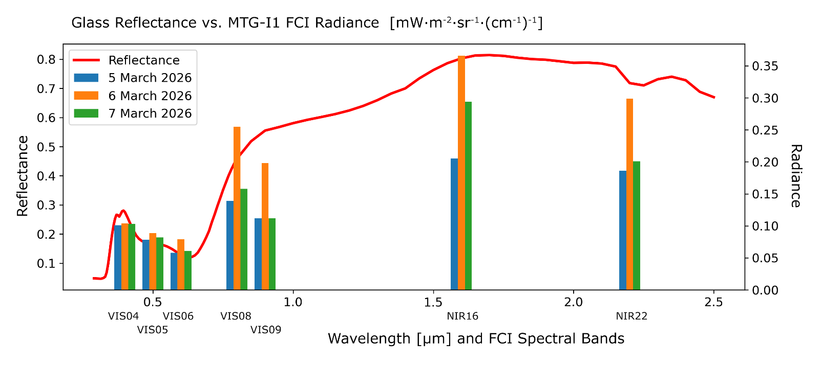
Final step – comparison of spectral properties of the Sun glint as observed by MTG FCI, with spectral properties of the clerestory glazing
Lower radiance in the VIS 0.9 band is most likely related to attenuation of the signal by tropospheric humidity.
Very good correlation of the laboratory glazing reflectivity with radiances measured in the FCI bands can be considered as a final proof that the clerestory glazing is indeed the source of the glint.
Martin Setvák, CHMI

Slide 40
SUMMARY
The link between observed Sun glint in MTG FCI and MSG SEVIRI RSS data with glazing of the side clerestory windows of the Industrial Palace is supported by the following facts:
agreement between the computed normal of the reflecting surface (based on positions of the Sun and the two satellites at the time of the glint) and real orientation of the clerestory glazing;
power of the reflected signal in FCI bands in 2025 and 2026, matching the progress of reconstruction works;
absence of the glint in MSG SEVIRI data before 2025, matching the progress of reconstruction works, and the fact that the original glazing was different from the new one;
agreement between the reflectivity curve of the new glass and spectral characteristics of the Sun glint from FCI data.
Martin Setvák, CHMI

Slide 41
SUMMARY
The link between observed Sun glint in MTG FCI and MSG SEVIRI RSS data with glazing of the side clerestory windows of the Industrial Palace is supported by the following facts:
agreement between the computed normal of the reflecting surface (based on positions of the Sun and the two satellites at the time of the glint) and real orientation of the clerestory glazing;
power of the reflected signal in FCI bands in 2025 and 2026, matching the progress of reconstruction works;
absence of the glint in MSG SEVIRI data before 2025, matching the progress of reconstruction works, and the fact that the original glazing was different from the new one;
agreement between the reflectivity curve of the new glass and spectral characteristics of the Sun glint from FCI data.
Practical applicability of all of this: probably none, the study was motivated just by a plain curiosity.
Indirect applicability: fire detection in satellite data – characteristics and behavior of a strong, point-like signal.
Acknowledgements to Metrostav CZ (Ing. David Čech) and AGC Processing Teplice for provision of the supportive information.
Martin Setvák, CHMI

